Slide 2
Advice

Slide 3
Two Categories
there’s the stuff that I should do
there are the things that I must do

Slide 4
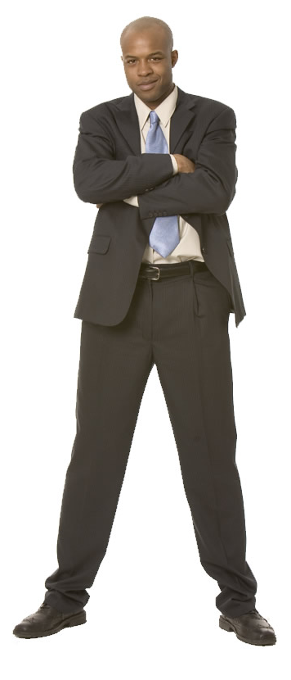
The “Musts of Salvation”

Slide 5
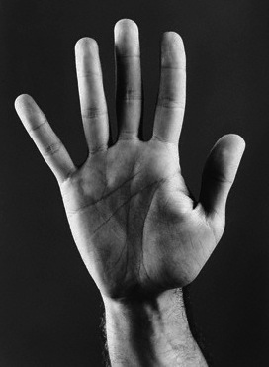

Slide 6
H
E
A
R

Slide 7
B
E
L
I
E
V
E
H
E
A
R

Slide 8
B
E
L
I
E
V
E
R
E
P
E
N
T
H
E
A
R

Slide 9
B
E
L
I
E
V
E
R
E
P
E
N
T
H
E
A
R
C
O
N
F
E
S
S

Slide 10
B
E
L
I
E
V
E
R
E
P
E
N
T
H
E
A
R
C
O
N
F
E
S
S
B
A
P
T
I
Z
E

Slide 11
The “Musts of Salvation”
1. What must I feel to be saved?
Salvation is not an emotion
it’s actually a relationship
to be saved means you have been found

Slide 12
The “Musts of Salvation”
1. What must I feel to be saved?
(1) A person must feel guilt

Slide 13
Psalm 32:1-4 How blessed is he whose transgression is forgiven, Whose sin is covered! How blessed is the man to whom the LORD does not impute iniquity, And in whose spirit there is no deceit! When I kept silent about my sin, my body wasted away Through my groaning all day long. For day and night Your hand was heavy upon me; My vitality was drained away as with the fever heat of summer.

Slide 14
The “Musts of Salvation”
1. What must I feel to be saved?
(1) A person must feel guilt
Guilt is the catalyst for change
Without the feeling that you are lost, you’ll never seek to be saved

Slide 15
Romans 7:19 For the good that I want, I do not do, but I practice the very evil that I do not want.
Matthew 7:7 “Ask, and it will be given to you; seek, and you will find; knock, and it will be opened to you.”

Slide 16
The “Musts of Salvation”
1. What must I feel to be saved?
(1) A person must feel guilt
(2) A person also feels a sense of urgency

Slide 17
Acts 2:37 “Now when they heard this, they were pierced to the heart, and said to Peter and the rest of the apostles, “Brethren, what shall we do?”

Slide 18
Acts 8:35-36 “Then Philip opened his mouth, and beginning from this Scripture he preached Jesus to him. As they went along the road they came to some water; and the eunuch said, “Look! Water! What prevents me from being baptized?”
Acts 16:33 “And he took them that very hour of the night and washed their wounds, and immediately he was baptized, he and all his household.”

Slide 19
The “Musts of Salvation”
1. What must I feel to be saved?
2. What must I know to be saved?

Slide 20
Matthew 28:19-20 “Go therefore and make disciples of all the nations, baptizing them in the name of the Father and the Son and the Holy Spirit, teaching them to observe all that I commanded you; and lo, I am with you always, even to the end of the age.”

Slide 21
The “Musts of Salvation”
1. What must I feel to be saved?
2. What must I know to be saved?
(1) You must know the truth about sin
1 Jn 3:4 “Everyone who practices sin also practices lawlessness; sin is lawlessness

Slide 22
Romans 6:23 “For the wages of sin is death, but the free gift of God is eternal life in Christ Jesus our Lord.”

Slide 23
The “Musts of Salvation”
1. What must I feel to be saved?
2. What must I know to be saved?
(1) You must know the truth about sin
(2) You must know that you are a sinner

Slide 24
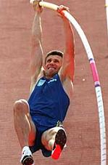
Romans 3:23 “for all have sinned and fall short of the glory of God”

Slide 25
The “Musts of Salvation”
1. What must I feel to be saved?
2. What must I know to be saved?
(1) You must know the truth about sin
(2) You must know that you are a sinner
(3) You must know that the solution to sin is Jesus Christ

Slide 26
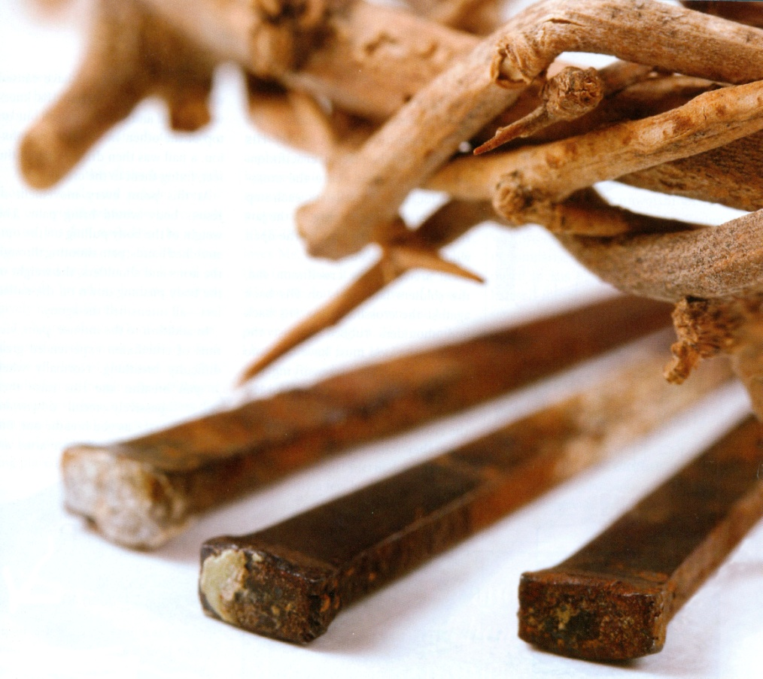
Romans 5:8-9 But God demonstrates His own love toward us, in that while we were yet sinners, Christ died for us. Much more then, having now been justified by His blood, we shall be saved from the wrath of God through Him.

Slide 27
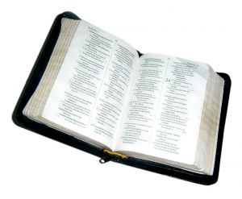
1 Corinthians 15:1-4 Now I make known to you, brethren, the gospel which I preached to you, which also you received, in which also you stand, by which also you are saved, if you hold fast the word which I preached to you, unless you believed in vain. For I delivered to you as of first importance what I also received, that Christ died for our sins according to the Scriptures, and that He was buried, and that He was raised on the third day according to the Scriptures,

Slide 28
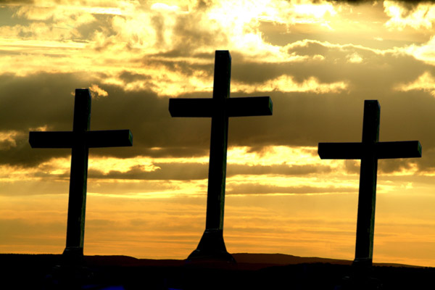
Hebrews 7:26-27 For it was fitting for us to have such a high priest, holy, innocent, undefiled, separated from sinners and exalted above the heavens; who does not need daily, like those high priests, to offer up sacrifices, first for His own sins and then for the sins of the people, because this He did once for all when He offered up Himself.

Slide 29
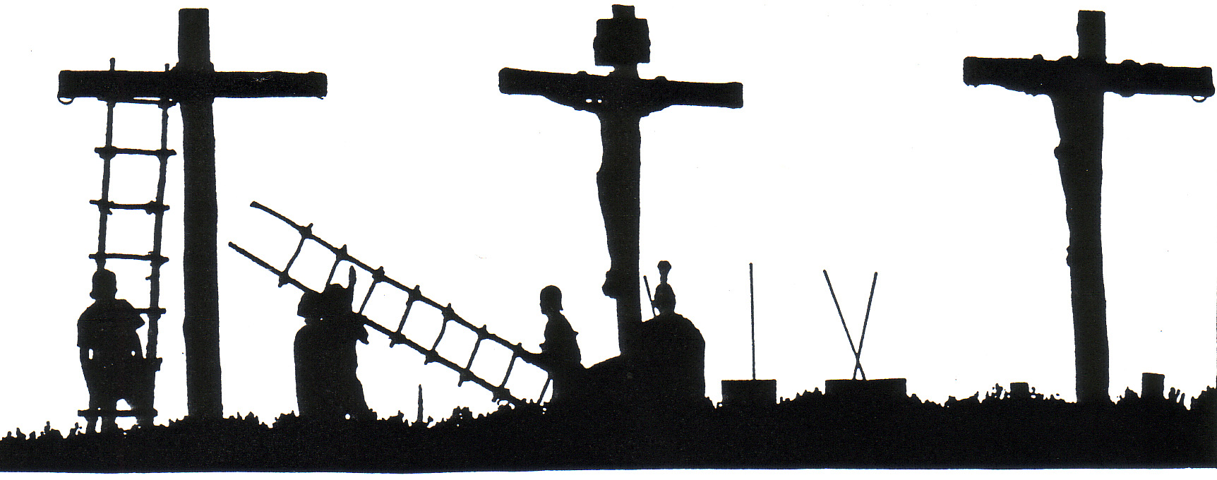
Hebrews 9:28 So Christ also, having been offered once to bear the sins of many, will appear a second time for salvation without reference to sin, to those who eagerly await Him.

Slide 30
The “Musts of Salvation”
1. What must I feel to be saved?
2. What must I know to be saved?
3. What must I believe to be saved?
Hebrews 11:6 “And without faith it is impossible to please Him, for he who comes to God must believe that He is and that He is a rewarder of those who seek Him”

Slide 31
John 8:23-24 “And He was saying to them, “You are from below, I am from above; you are of this world, I am not of this world. Therefore I said to you that you will die in your sins; for unless you believe that I am He, you will die in your sins.”

Slide 32
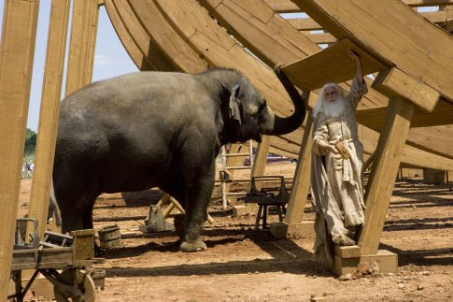
Faith is action

Slide 33
The “Musts of Salvation”
1. What must I feel to be saved?
2. What must I know to be saved?
3. What must I believe to be saved?
(1) You must believe that God wants to save you

Slide 34
The “Musts of Salvation”
1. What must I feel to be saved?
2. What must I know to be saved?
3. What must I believe to be saved?
4. What must I do to be saved?

Slide 35
Acts 2:37-38 Now when they heard this, they were pierced to the heart, and said to Peter and the rest of the apostles, “Brethren, what shall we do?” Peter said to them, “Repent, and each of you be baptized in the name of Jesus Christ for the forgiveness of your sins; and you will receive the gift of the Holy Spirit.”

Slide 36
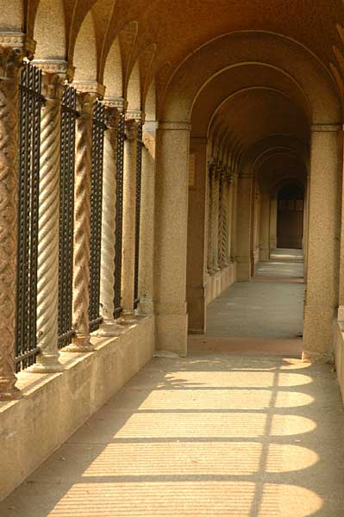
Acts 9:6 “but get up and enter the city, and it will be told you what you must do.”

Slide 37
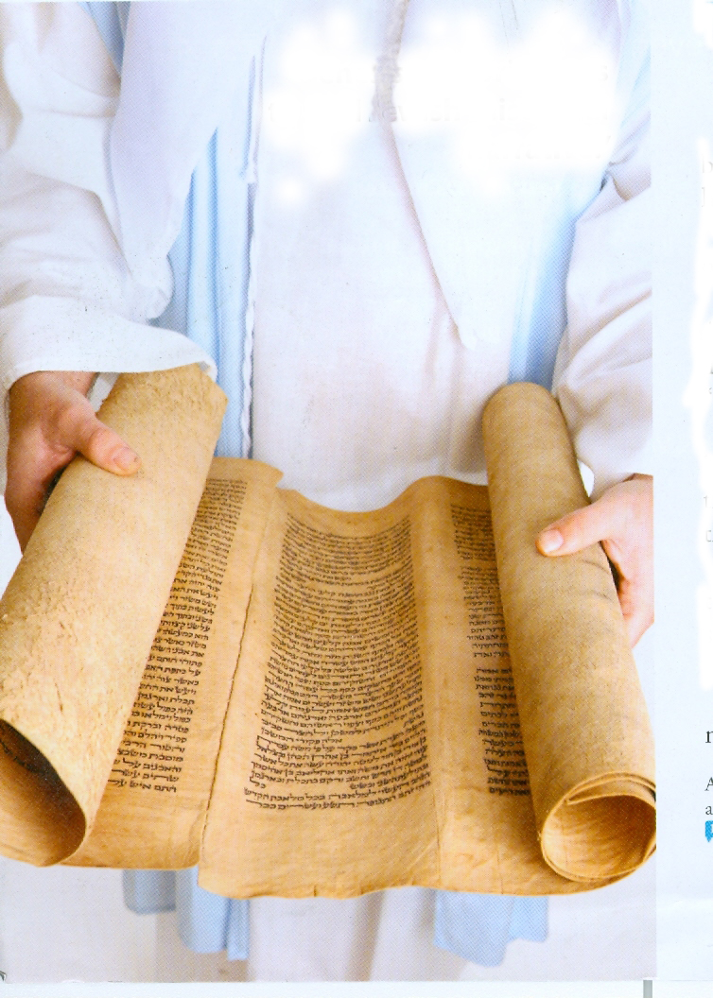
Acts 9:17-18 “So Ananias departed and entered the house, and after laying his hands on him said, “Brother Saul, the Lord Jesus, who appeared to you on the road by which you were coming, has sent me so that you may regain your sight and be filled with the Holy Spirit.” And immediately there fell from his eyes something like scales, and he regained his sight, and he got up and was baptized”

Slide 38
Acts 10:48 “And he ordered them to be baptized in the name of Jesus Christ. Then they asked him to stay on for a few days.”
Acts 10:6 “He lodgeth with one Simon a tanner, whose house is by the sea side: he shall tell thee what thou oughtest to do” (KJV)

Slide 39
I must change the direction of my life
I must acknowledge that Jesus is the Lord of my life
I must be baptized

Slide 40
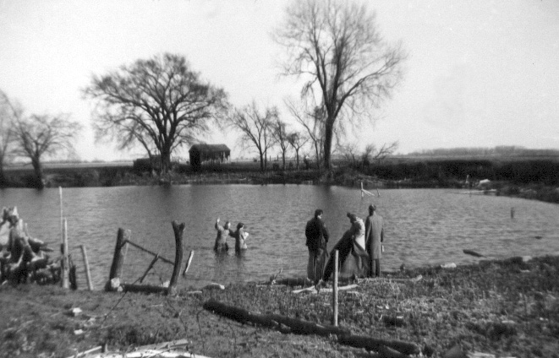
Acts 22:16 ‘Now why do you delay? Get up and be baptized, and wash away your sins, calling on His name.’
1 Peter 3:21 “Corresponding to that, baptism now saves you—not the removal of dirt from the flesh, but an appeal to God for a good conscience—through the resurrection of Jesus Christ”

Slide 41
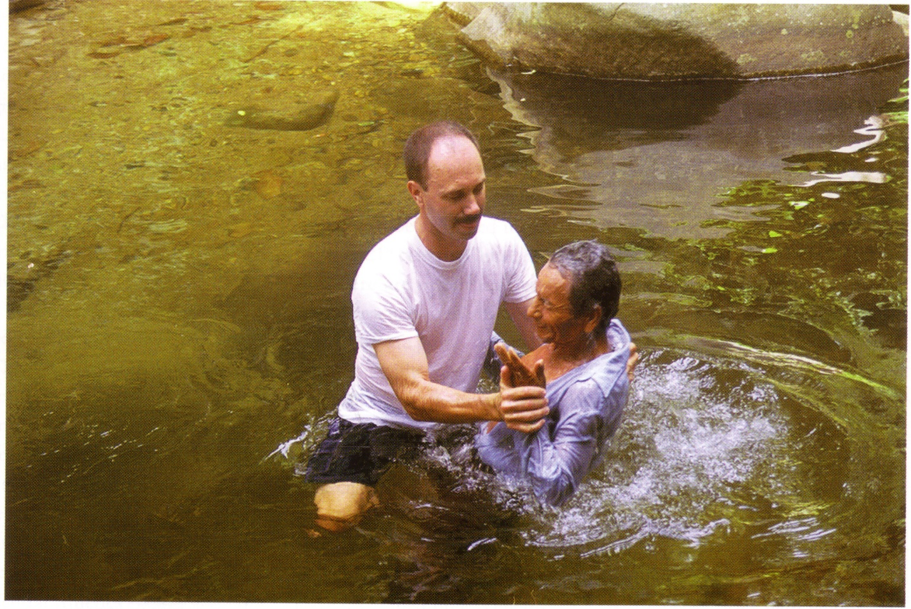
Romans 6:3-4 “Or do you not know that all of us who have been baptized into Christ Jesus have been baptized into His death? Therefore we have been buried with Him through baptism into death, so that as Christ was raised from the dead through the glory of the Father, so we too might walk in newness of life.”

Slide 42
The “Musts of Salvation”
1. What must I feel to be saved?
2. What must I know to be saved?
3. What must I believe to be saved?
4. What must I do to be saved?
5. What must I do to stay saved?

Slide 43
Romans 6:4 Therefore we have been buried with Him through baptism into death, so that as Christ was raised from the dead through the glory of the Father, so we too might walk in newness of life.
Ephesians 4:24-5:1

Slide 44
Colossians 3:15-17 Let the peace of Christ rule in your hearts, to which indeed you were called in one body; and be thankful. Let the word of Christ richly dwell within you, with all wisdom teaching and admonishing one another with psalms and hymns and spiritual songs, singing with thankfulness in your hearts to God. Whatever you do in word or deed, do all in the name of the Lord Jesus, giving thanks through Him to God the Father.

Slide 45
Grow
Become
Shine

Slide 46
The “Musts of Salvation”
1. What must I feel to be saved?
2. What must I know to be saved?
3. What must I believe to be saved?
4. What must I do to be saved?
5. What must I do to stay saved?

