Slide 2
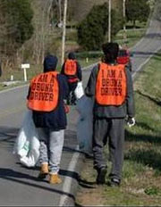

Slide 3
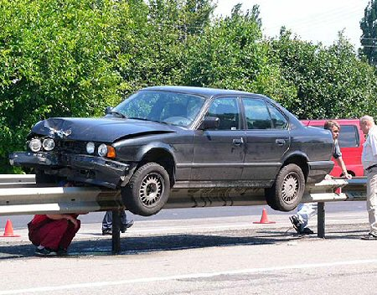
Guardrails
Hitting guardrails will cause some damage, but it keeps you from destroying your life

Slide 4
God’s guardrails
When we hit God’s guardrails, our conscience produces guilt

Slide 5
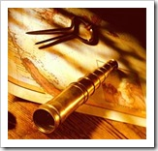
Guilt will cause you to have a course correction

Slide 6
Proverbs 27:12 The prudent see danger and take refuge, but the simple keep going and pay the penalty. (NIV)

Slide 7
Guardrails Around Relationships

Slide 9
For many of us, the trouble we got into came from our friends

Slide 10
God understands the powerful impact that relationships have
1 Cor 15:33 Do not be deceived: "Bad company corrupts good morals."
15:12 Now if Christ is preached, that He has been raised from the dead, how do some among you say that there is no resurrection of the dead?

Slide 11
God understands the powerful impact that relationships have
1 Cor 5:6 “Do you not know that a little leaven leavens the whole lump of dough?”
Mt 16:6 “And Jesus said to the, ‘Watch out and beware of the leaven of the Pharisees and Sadducees.”

Slide 12
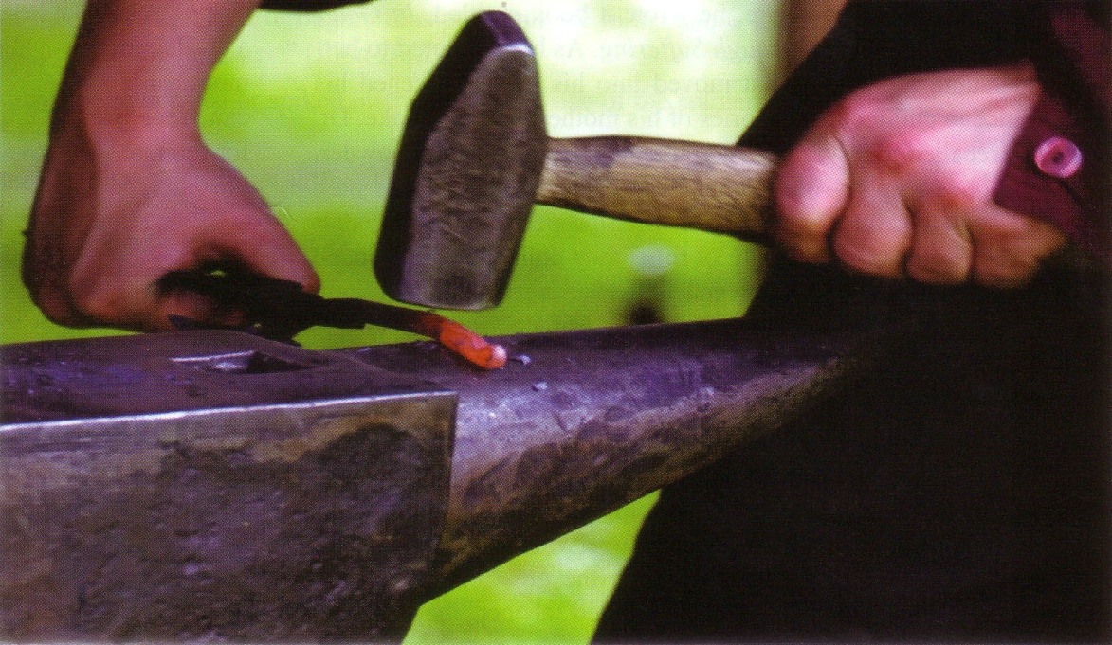
God understands the powerful impact that relationships have
Prov 27:17 “Iron sharpens iron, so one man sharpens another.”
Prov 27:6 “Faithful are the wounds of a friend, but deceitful are the kisses of an enemy

Slide 13
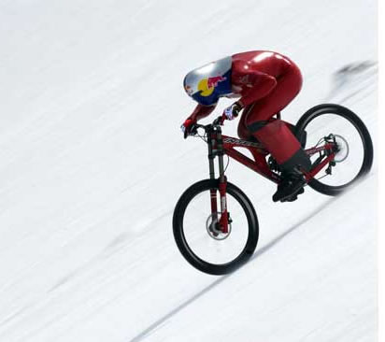
God understands that it is much easier to go downhill that it is to go uphill

Slide 14
Amnon
2 Sam 13:3-5 But Amnon had a friend whose name was Jonadab, the son of Shimeah, David's brother; and Jonadab was a very shrewd man. And he said to him, "O son of the king, why are you so depressed morning after morning? Will you not tell me?" Then Amnon said to him, "I am in love with Tamar, the sister of my brother Absalom.”

Slide 15
Amnon
2 Sam 13:3-5 Jonadab then said to him, "Lie down on your bed and pretend to be ill; when your father comes to see you, say to him, 'Please let my sister Tamar come and give me some food to eat, and let her prepare the food in my sight, that I may see it and eat from her hand.'"

Slide 16
Rehoboam
1 Kg 12:10-11 And the young men who grew up with him spoke to him, saying, "Thus you shall say to this people who spoke to you, saying, 'Your father made our yoke heavy, now you make it lighter for us!' But you shall speak to them, 'My little finger is thicker than my father's loins! 'Whereas my father loaded you with a heavy yoke, I will add to your yoke; my father disciplined you with whips, but I will discipline you with scorpions.'"

Slide 17
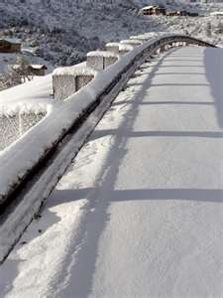
God has guardrails to keep in the good and to keep out the bad
Prov 12:26 “But the righteous is a guide to his neighbor, but the way of the wicked leads them astray.”
Prov 13:20 “He who walks with wise men will be wise, but the companion of fools will suffer harm.”

Slide 18
A person is known by the company that they keep
Right or wrong, people judge you by your company
Mt 11:19 “The Son of Man came eating and drinking and they said, ‘behold a gluttonous man and a drunkard, a friend of tax collectors and sinners!’
Lk 15:2 “Both the Pharisees and the scribes began to grumble, saying, ‘This man receives sinners and eats with them.’”

Slide 19
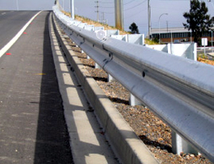
1. You hit God’s Guardrails when you realize that your friends are radically different than you are
Their definitions of success, fun, good and righteous are different than yours
Their attitudes are different
Their language is different
God is trying to keep you from being influenced
God is trying to keep you from going over the edge and ruining your life

Slide 20
2. You hit God’s Guardrails when you find yourself trying to defend the wrong behavior of your friends
God is trying to keep you from being influenced
God is trying to keep you from going over the edge and ruining your life

Slide 21
3. You hit God’s Guardrails when you feel the struggle within to compromise with your friends
God is trying to keep you from being influenced
God is trying to keep you from going over the edge and ruining your life

Slide 22
4. You hit God’s Guardrails when you see yourself becoming more like them than they are becoming like you
In other words, they are influencing you more than you are influencing them
God is trying to keep you from being influenced
God is trying to keep you from going over the edge and ruining your life

Slide 23
Prov 22:24 Do not associate with a man given to anger; or go with a hot-tempered man, lest you learn his ways and find a snare for yourself
Prov 24:1-2 “Do not be envious of evil men, nor desire to be with them; for their mind devise violence, and their lips talk of trouble

Slide 24
This is not a call for isolation
1. God wants you to stand up for yourself and to be defined by you
2. God wants you to see the value of those who walk with Him and include them in your life

Slide 25
Ps 34:3 “O magnify the Lord with me, and let us exalt His name together.”
Ps 119:63 “I am a companion of all those who fear Thee, and of those who keep Thy precepts”
2 Tim 2:22 Now flee from youthful lusts, and pursue righteousness, faith, love and peace with those who call on the Lord from a pure heart”

Slide 26
Gal 6:1 “Brethren even if a man is caught in any trespass, you who are spiritual, restore such a one in a spirit of gentleness…
Ps 122:1 “I was glad when they said to me, let us go to the house of the Lord.”

Slide 27
Guardrails Around Relationships

