Slide 2
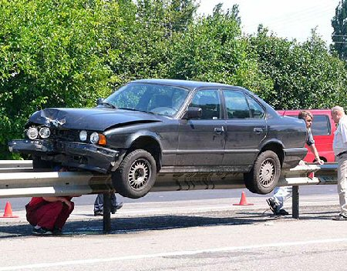
Guardrails
Hitting guardrails will cause some damage, but it keeps you from destroying your life

Slide 3
God’s guardrails
God’s guardrails keep us from ruining our lives

Slide 4
Guardrails Around Relationships

Slide 5
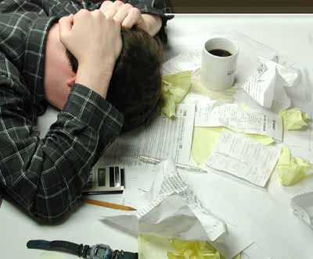
Guardrails Around Finances

Slide 6
Few topics are more Biblical than the subject of Money
There are 500 verses on Prayer
There’s 2,000 on money
Proverbs: riches (26x); wealth (17x)
Ecclesiastes: picture of a man who has everything but in reality has nothing

Slide 7
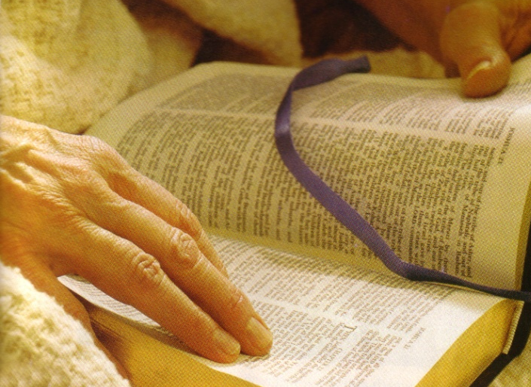
Few Topics are more Biblical than the Subject of Money
Jesus spoke about money & riches more than He did Heaven
16 of the Lord’s parables involve money
The word “riches” is found 15x in Luke

Slide 8
Three phrases define our financial picture:
Big Bills…Big Debt…Big Mistakes

Slide 9
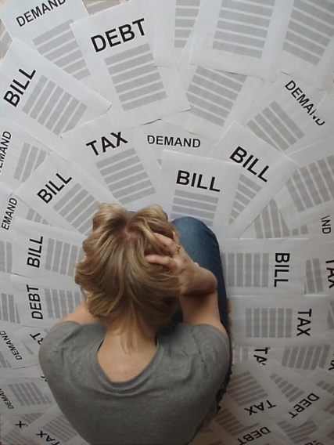
The Current Trend Has Grave Spiritual consequences
1. Financial difficulties is the leading cause of divorce today
2. We are proving that we are not good stewards
Lk 16:10 "He who is faithful in a very little thing is faithful also in much; and he who is unrighteous in a very little thing is unrighteous also in much.

Slide 10
The Current Trend Has Grave Spiritual consequences
1. Financial difficulties is the leading cause of divorce today
2. We are proving that we are not good stewards
3. We haven’t learned contentment

Slide 11
Phil 4:10-13 But I rejoiced in the Lord greatly, that now at last you have revived your concern for me; indeed, you were concerned before, but you lacked opportunity. Not that I speak from want; for I have learned to be content in whatever circumstances I am. I know how to get along with humble means, and I also know how to live in prosperity; in any and every circumstance I have learned the secret of being filled and going hungry, both of having abundance and suffering need.

Slide 12
Phil 4:10-13 But I rejoiced in the Lord greatly, that now at last you have revived your concern for me; indeed, you were concerned before, but you lacked opportunity. Not that I speak from want; for I have learned to be content in whatever circumstances I am. I know how to get along with humble means, and I also know how to live in prosperity; in any and every circumstance I have learned the secret of being filled and going hungry, both of having abundance and suffering need.

Slide 13
1 Tim 6:6 But godliness actually is a means of great gain, when accompanied by contentment.

Slide 14
Heb 13:5 Let your character be free from the love of money, being content with what you have; for He Himself has said, "I WILL NEVER DESERT YOU, NOR WILL I EVER FORSAKE YOU,"

Slide 15
The Current Trend Has Grave Spiritual consequences
1. Financial difficulties is the leading cause of divorce today
2. We are proving that we are not good stewards
3. We haven’t learned contentment
4. Puts us in the position of not being able to help others

Slide 16
Gal 6:10 So then, while we have opportunity, let us do good to all men, and especially to those who are of the household of the faith.

Slide 17
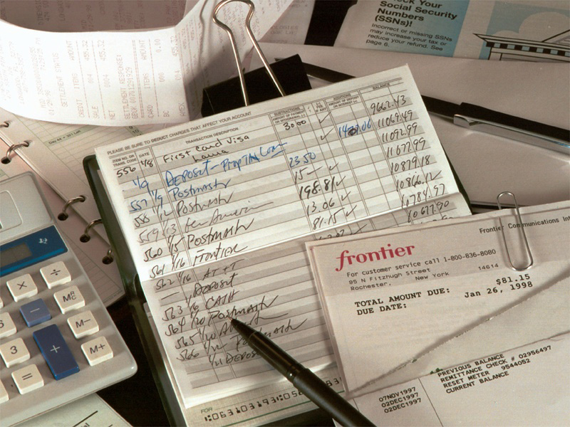
The Current Trend Has Grave Spiritual consequences
1. Financial difficulties is the leading cause of divorce today
2. We are proving that we are not good stewards
3. We haven’t learned contentment
4. Puts us in the position of not being able to help others
5. Unless the trend turns, we become future benevolent cases for the church

Slide 18
How Bad Is It?

Slide 19
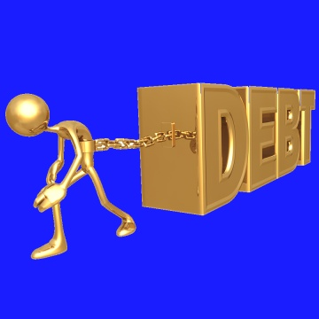
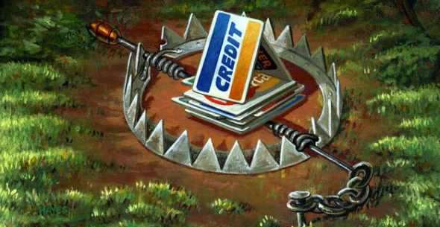
The average household has a balance of $16,000 on credit cards
Enough credit cards in America for every man, woman and child to have 5 each
Average household debt is $118,000 (credit cards, mortgages, student loans)
Average household saving was $397.00

Slide 20
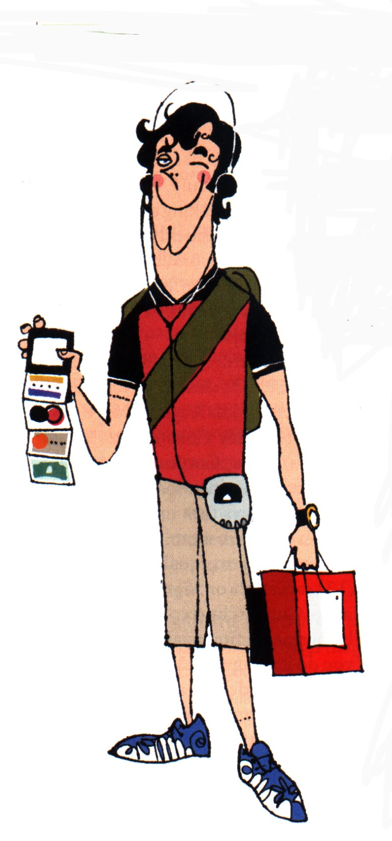
A typical credit card purchase ends up costing 112% more than if cash were used.
A $1,000 charge on an average credit card will take almost 22 years to pay and will cost a total of $3,300 if only 2% minimum payments are made.
23% of Americans admit to maxing out a credit card

Slide 21
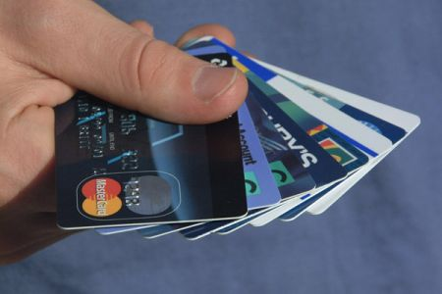
50% of college students have 4 or more credit cards with an average balance of $3,000, 25% of college students carry a balance of $10,000
People using credit cards in fast food restaurants spend up to 50% more than when they pay cash
In 2008 more college kids quit school to get a job to pay debt than for failing grades

Slide 22
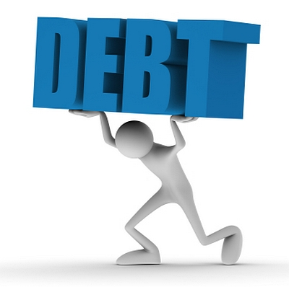
In 2008 more than 50% of income went for debts
43% spend more than they make

Slide 23
“Golden Years are often Not GOLDEN”
93% of retirees carry some debt
62% of people age 65 and older have a retirement income under $30,000
27% haven’t paid off their mortgages
Average credit card debt for 65-69 year olds is $5,800
14% of 64 year olds face retirement with a negative net worth

Slide 24
“Average in America, is overweight and broke”
(Dave Ramsey)
Toys R Us has become “Woe are We.”

Slide 25
The Signs of Coming Disaster
1. We don’t know what’s going on
2. Consider credit cards as money
3. Use credit cards to get the necessities of life
4. Borrowing to pay other debt
5. Look for get rich quick schemes

Slide 26
The Signs of Coming Disaster
6. Collectors call
7. Tempted to be dishonest
8. View bankruptcy as a solution
9. No specific plans
10. Dying spiritual life

Slide 27
If you cross certain lines you increase the potential of immediately hurting yourself right now and making your future not the way you planned
Guardrails

Slide 28
1. Don’t be fooled by the Pied Piper of Money
Ps 39:4-6

Slide 29
1. Don’t be fooled by the Pied Piper of Money
More is not necessarily better
Ecc 5:12 The sleep of the working man is pleasant, whether he eats little or much. But the full stomach of the rich man does not allow him to sleep.
Lk 10:41 "Martha, Martha, you are worried and bothered about so many things;

Slide 30
1. Don’t be fooled by the Pied Piper of Money
More is not necessarily better
Money doesn’t buy happiness
Ecc 5:10 He who loves money will not be satisfied with money, nor he who loves abundance with its income. This too is vanity.

Slide 31
Money may buy a fine dog…but only love will make him wag his tail!

Slide 32
1. Don’t be fooled by the Pied Piper of Money
More is not necessarily better
Money doesn’t buy happiness
What I need and what I want are not the same
Ps 39:4 “"LORD, make me to know my end, And what is the extent of my days, Let me know how transient I am.

Slide 33
2. Determine how you want to live…don’t let someone else determine that
2 Tim 2:15 Be diligent to present yourself approved to God as a workman who does not need to be ashamed, handling accurately the word of truth.

Slide 34
Have a plan
Make sacrifices

Slide 35
Anticipate the famines in life
Lk 15:14 Now when he had spent everything, a severe famine occurred in that country, and be began to be in need.
Gen 41:17-24 (29-30)

Slide 36
Have a plan
Make sacrifices
Live a lifestyle you can afford

Slide 37
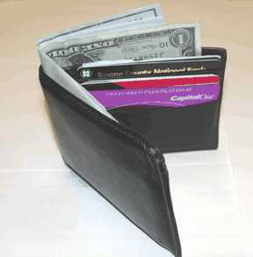
3. Demonstrate with your money that God is the Lord of your life
There are three conversions of a man: the conversion of his mind; the conversion of his heart; and the conversion of his wallet –
Martin Luther

Slide 38
Mt 6:24 "No one can serve two masters; for either he will hate the one and love the other, or he will hold to one and despise the other. You cannot serve God and mammon.
Make money without neglecting your soul
Save money without ignoring others (or the kingdom)
Spend money without it defining your life

Slide 39
Prov 14:20 The poor is hated even by his neighbor, But those who love the rich are many.

Slide 40
Lk 12:15 And He said to them, "Beware, and be on your guard against every form of greed; for not even when one has an abundance does his life consist of his possessions."

Slide 41
Realize that your money won’t buy Heaven but it can keep you from it
Prov 11:28 He who trusts in his riches will fall, But the righteous will flourish like the green leaf.

Slide 42
Realize that your money won’t buy Heaven but it can keep you from it
Prov 11:4 Riches do not profit in the day of wrath, But righteousness delivers from death.

Slide 43
Prov 23:4-5 Do not weary yourself to gain wealth, Cease from your consideration of it. When you set your eyes on it, it is gone. For wealth certainly makes itself wings, Like an eagle that flies toward the heavens.

Slide 44
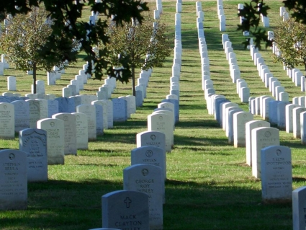
1 Tim 6:7 For we have brought nothing into the world, so we cannot take anything out of it either.

Slide 45
Guardrails Around Finances

