Slide 3
Why should anyone want a relationship with God?
Great scholars reject the idea of God.
Deist accept God but don’t see the need for a relationship with Him.

Slide 4
God Wants You.
Isaiah 41:8–10; 43:3–5
Jeremiah 1:4–8; 17–19; 15:19–21; 42:9–12; 46:27–28
Haggai 1:12–13; 2:2–4

Slide 6
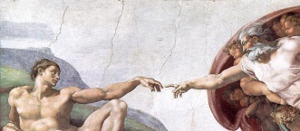

Slide 7
We Must Choose God.
Amos 6:4–8
James 4:7–8
John 14:6–7
Matthew 1:23

