Slide 2
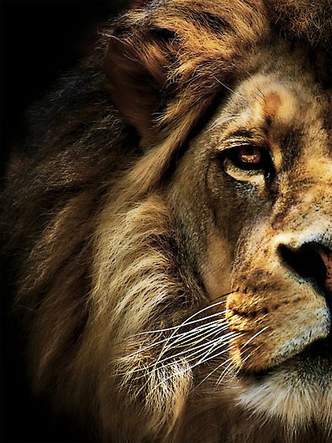
The Book of Daniel

Slide 3
Sun, class Introduction Sun a.m. Chapter 1 Sun p.m. Chapter 2 Monday Chapter 3 Tuesday Chapter 4 Wednesday Chapter 5 Thursday Chapter 6 Friday Evangelism

Slide 4
Daniel
Law
History
Wisdom
Old Testament – 39
New Testament – 27
Total – 66
Major Prophets
Minor Prophets
Gospels
Acts
Letters
Rev

Slide 5
Daniel
Creation & Fall
Exodus & Conquest
Kings & Prophets
Life of Jesus
The Patriarchs
The
Judges
Exile & Return
Early Church
Law
History
Gospels
Acts
Wisdom
Letters
Prophets
Rev

Slide 6
“And your house and your kingdom shall be made sure forever before me. Your throne shall be established forever.” 2 Samuel 7:16
931 BC
722 BC
Northern Kingdom:
ISRAEL
586 BC
597 BC
Saul
David
Solomon
605 BC
Southern Kingdom:
JUDAH

Slide 7
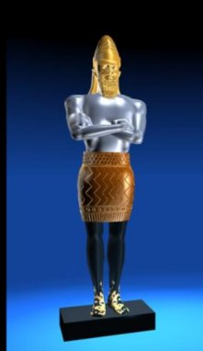
1 2 3 4 5 6 7 8 9 10 11 12
The Book of Daniel
Four empires will rise & fall before the everlasting kingdom.
2
3
4
5
6
7
God rescues & exalts those who are faithful.
Babylonian
Medo-Persian
Grecian
Roman
Aramaic
God humbles the proud.
Fiery Furnace
Lion’s Den
Nebuchad-nezzar
Belshazzar
2
3
4
5
6
7

Slide 8
What did Belshazzar do?
3 Then they brought in the golden vessels that had been taken out of the temple, the house of God in Jerusalem, and the king and his lords, his wives, and his concubines drank from them.

Slide 9
How words lose power
Overuse:
Use as filler:
Dilution:
Alteration:
“Very”
“Like”
“Awesome”
“Wicked”

Slide 10
“God”
Overuse
Dilute
Alteration
Filler

Slide 11
The importance of God’s NAME.
Exo. 5:2 But Pharaoh said, “Who is the LORD, that I should obey his voice and let Israel go? I do not know the LORD…” (compare with Daniel 3:15)
Exo. 12:12 “…on all the gods of Egypt I will execute judgments: I am the LORD.”
Exo. 15:11 “Who is like you, O LORD, among the gods? Who is like you, majestic in holiness, awesome in glorious deeds, doing wonders?”

Slide 12
The importance of God’s NAME.
Exo. 20:3 “I am the LORD your God, who brought you out of the land of Egypt, out of the house of slavery. You shall have no other gods before me.”
Exo. 20:7 “You shall not take the name of the LORD your God in vain, for the LORD will not hold him guiltless who takes his name in vain.”

Slide 13
The importance of God’s NAME.
Exo. 9:16 “But for this purpose I have raised you up, to show you my power, so that my name may be proclaimed in all the earth.”
Isaiah 63:11-13 Where is he who put in the midst of them his Holy Spirit; who caused his glorious arm to go at the right hand of Moses, who divided the waters before them to make for himself an everlasting name, who led them through the depths?

Slide 14
The importance of God’s NAME.
Psalm 106:7-8 Our fathers, when they were in Egypt, did not consider your wondrous works; they did not remember the abundance of your steadfast love, but rebelled by the sea, at the Red Sea. Yet he saved them for his name’s sake, that he might make known his mighty power.

Slide 15
The importance of God’s NAME.
Joshua 7:8-9 “O Lord, what can I say, when Israel has turned their backs before their enemies? For the Canaanites and all the inhabitants of the land will hear of it and will surround us and cut off our name from the earth. And what will you do for your great name?”

Slide 16
The importance of God’s NAME.
1 Samuel 12:22 For the LORD will not forsake his people, for his great name’s sake, because it has pleased the LORD to make you a people for himself.
Jer. 13:11 For as the loincloth clings to the waist of a man, so I made the whole house of Israel and the whole house of Judah cling to me, declares the LORD, that they might be for me a people, a name, a praise, and a glory, but they would not listen.

Slide 17
The importance of God’s NAME.
2 Samuel 7:23 And who is like your people Israel, the one nation on earth whom God went to redeem to be his people, making himself a name and doing for them great and awesome things by driving out before your people, whom you redeemed for yourself from Egypt, a nation and its gods?

Slide 18
“But when they came to the nations, wherever they came, they profaned my holy name, in that the people said of them, ‘These are the people of the LORD, and yet they had to go out of his land.’ But I had concern for my holy name, which the house of Israel had profaned among the nations to which they came…

Slide 19
“Therefore say to the house of Israel, Thus says the Lord GOD: It is not for your sake, O house of Israel, that I am about to act, but for the sake of my holy name, which you have profaned among the nations to which you came. And I will vindicate the holiness of my great name, which has been profaned among the nations, and which you have profaned among them. And the nations will know that I am the LORD, declares the Lord GOD, when through you I vindicate my holiness before their eyes.”
Ezekiel 36:20-23

Slide 20
Exhortation for Exiles
Use God’s name reverently
Speak of his mighty deeds
Defend his reputation
Approach with awe
Live holy lives

