Slide 2
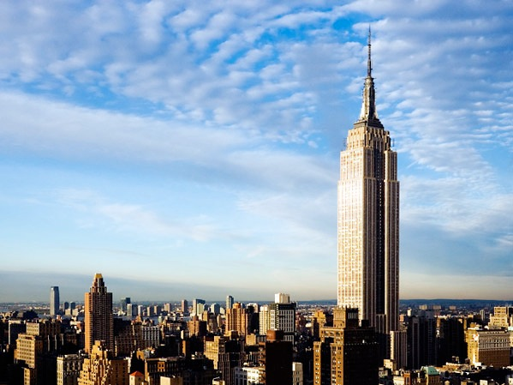

Slide 3
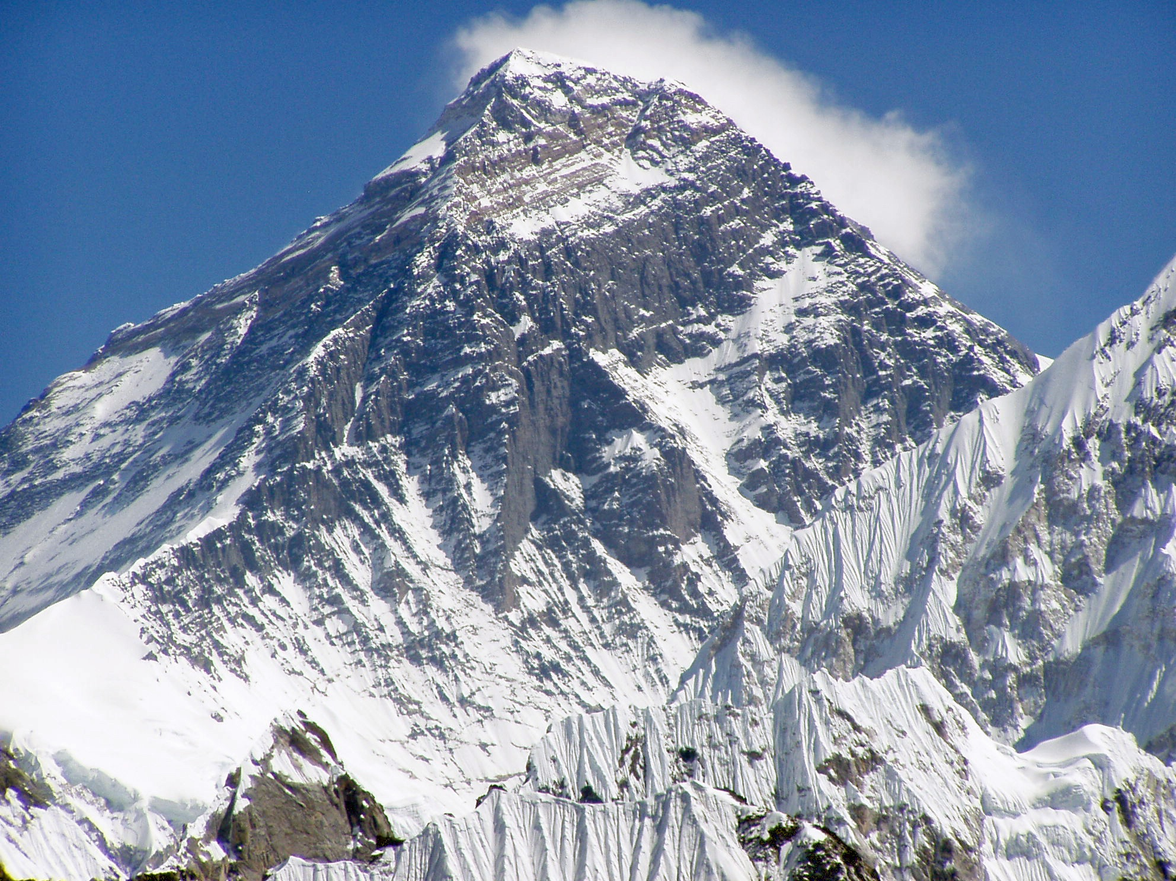

Slide 4
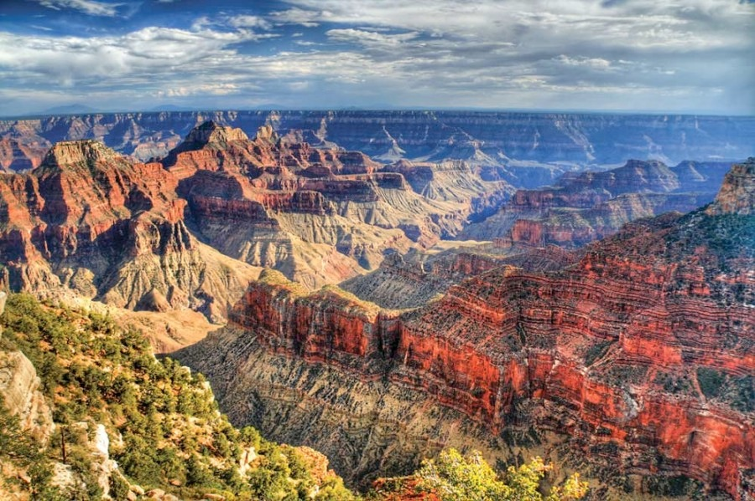

Slide 5
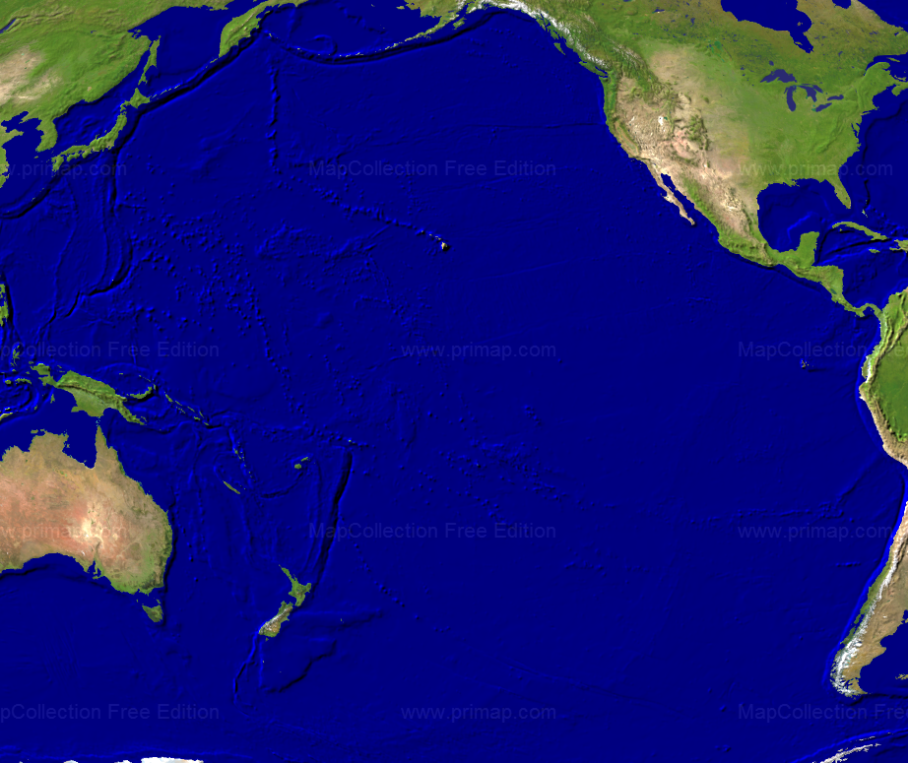

Slide 6
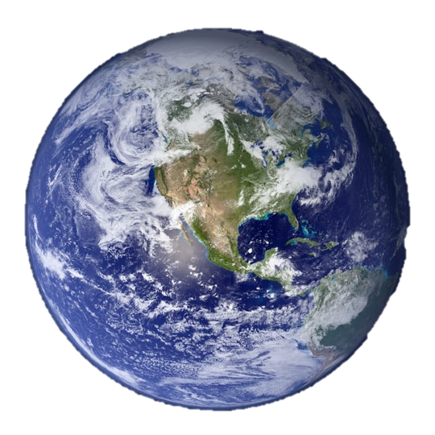

Slide 7
The WORLD AROUND US: God’s Creation

Slide 9
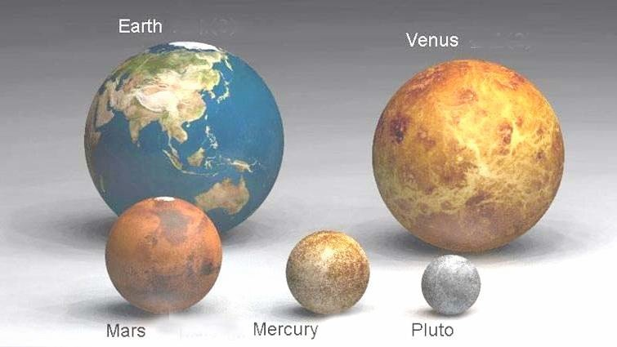

Slide 11
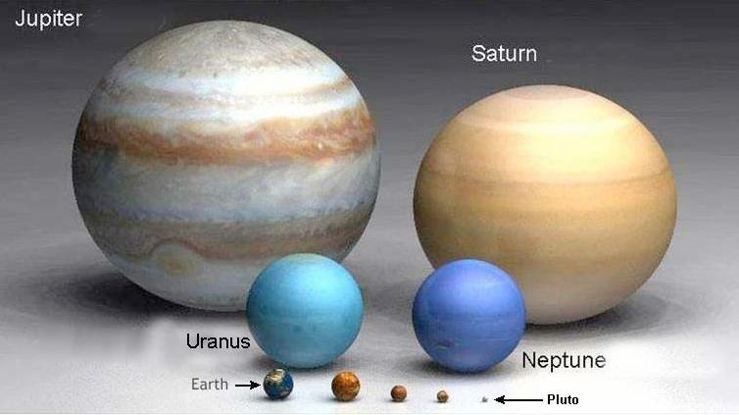

Slide 12
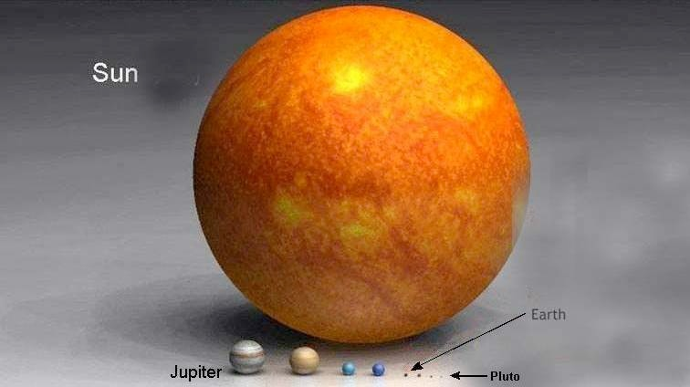

Slide 13
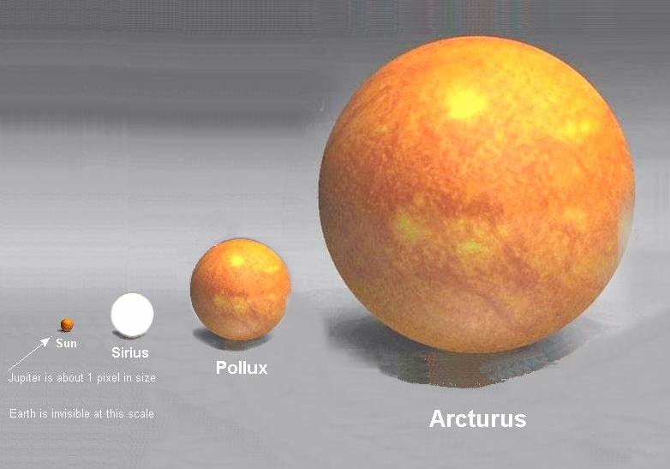

Slide 14
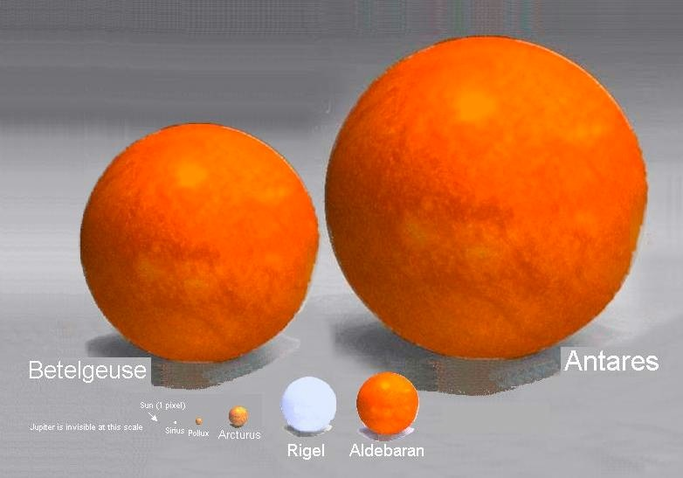

Slide 15
Psalm 8 – in amazement of God’s creation
Psalm 148 – God’s creation praises Him
Isaiah 40:12, 22, 26 – God is familiar with His creation
The WORLD AROUND US: HIS vast Creation

Slide 16
“PRAISE THE LORD” #21 vs. 1, 2
The world around us: HIS vast Creation

Slide 17
“I SING THE MIGHTY POWER…” #12 – Supplement vs. 1, 3
The world around us: HIS vast Creation

Slide 18
The world around us: HIS detailed Creation

Slide 19
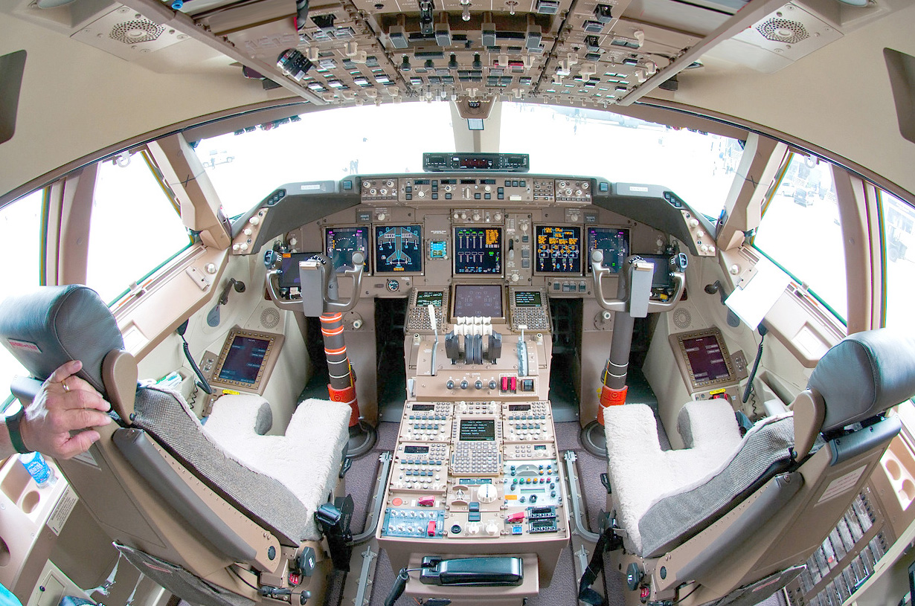

Slide 20
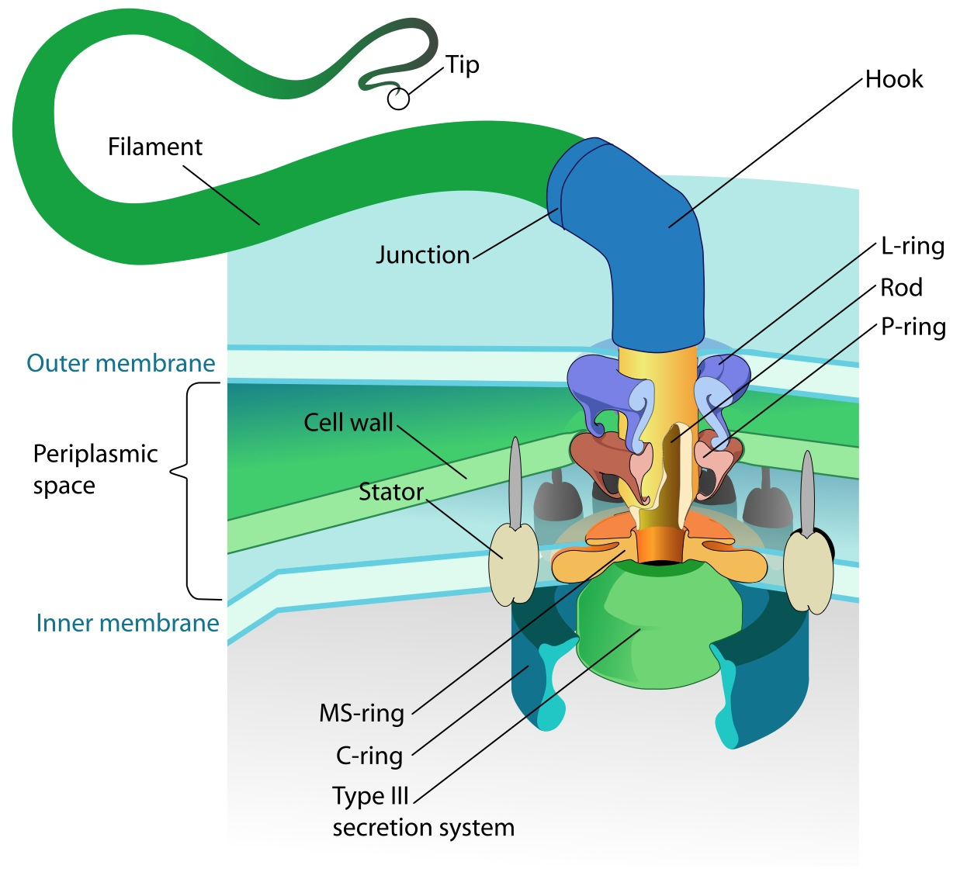
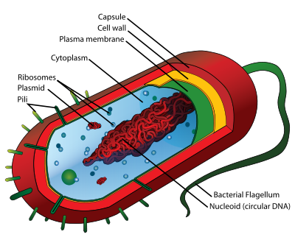

Slide 21
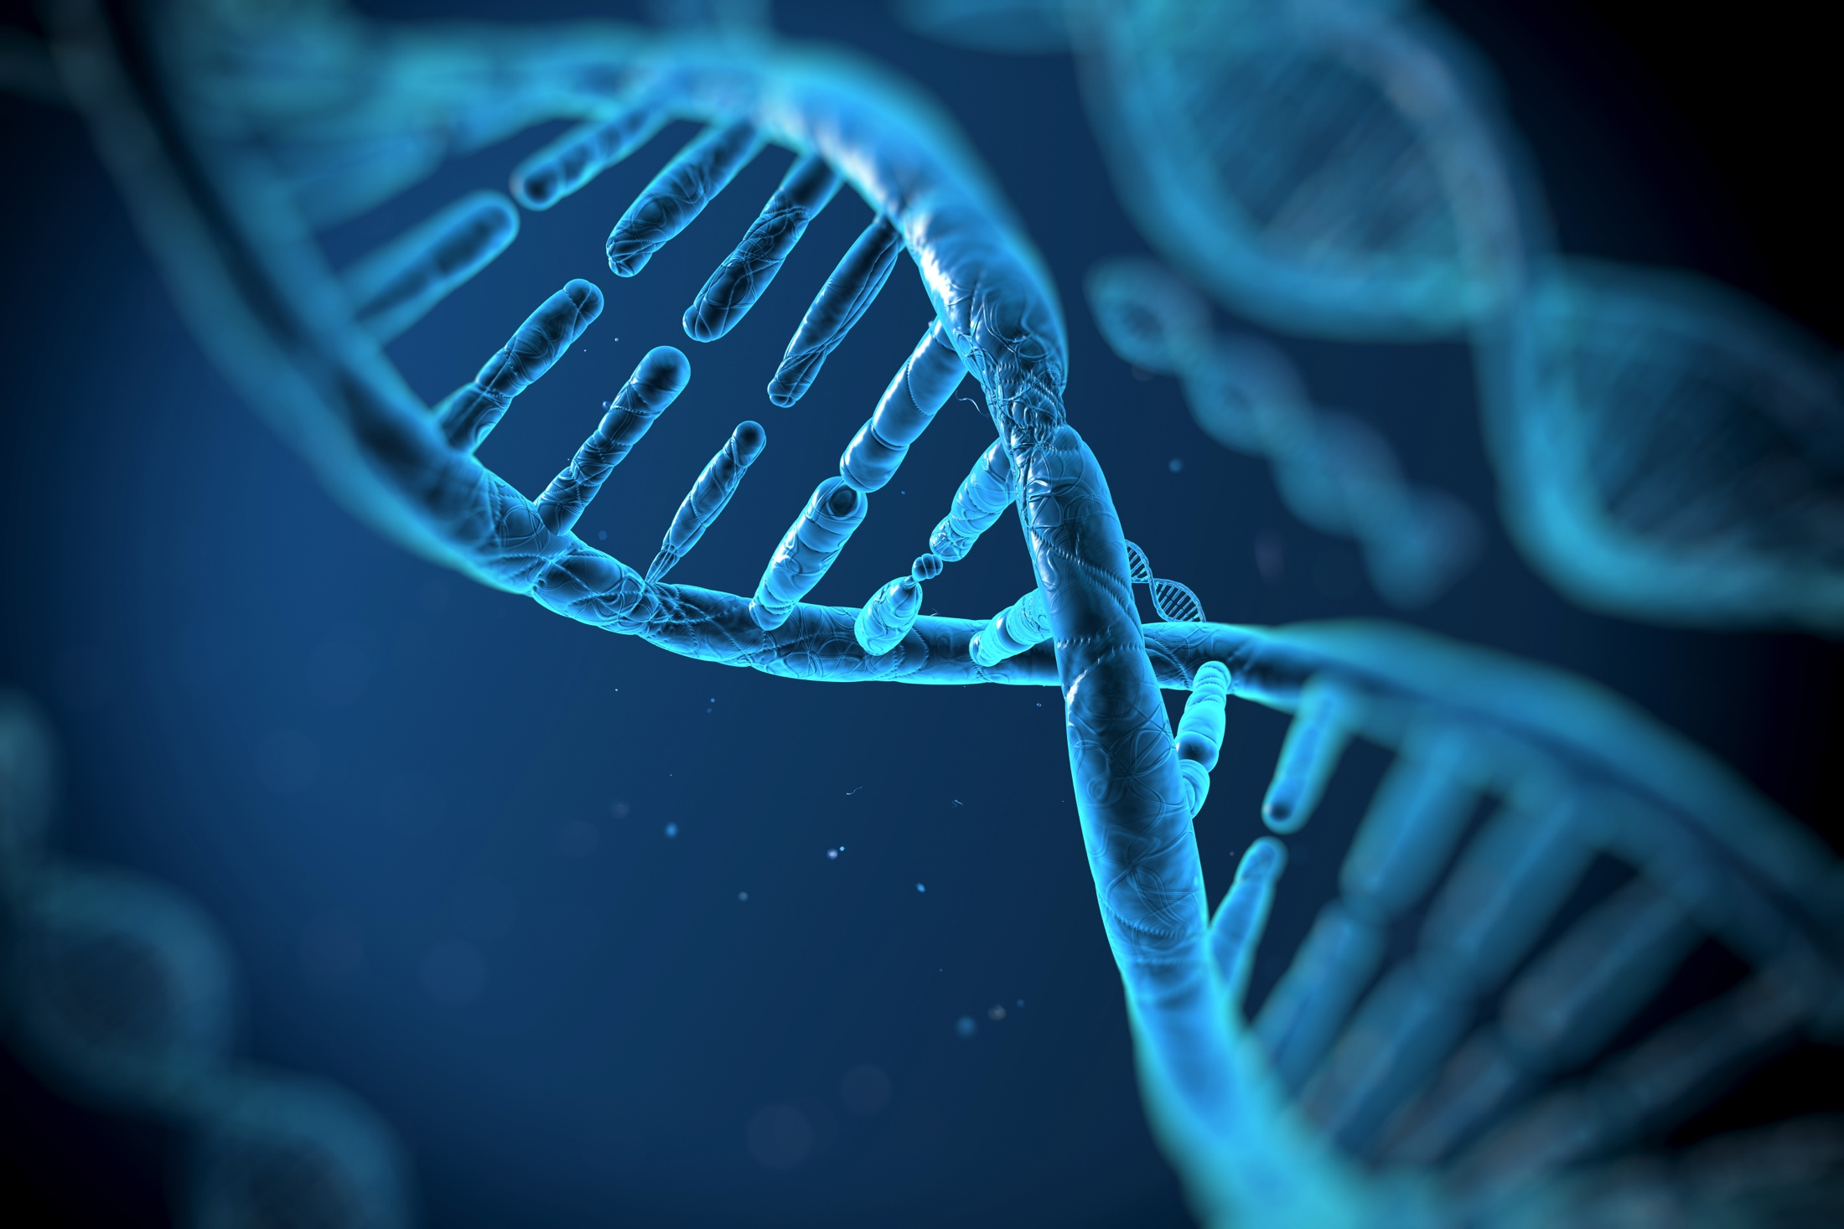

Slide 22
Psalm 139:13-16 – we are wonderfully made
The WORLD AROUND US: HIS detailed Creation

Slide 23
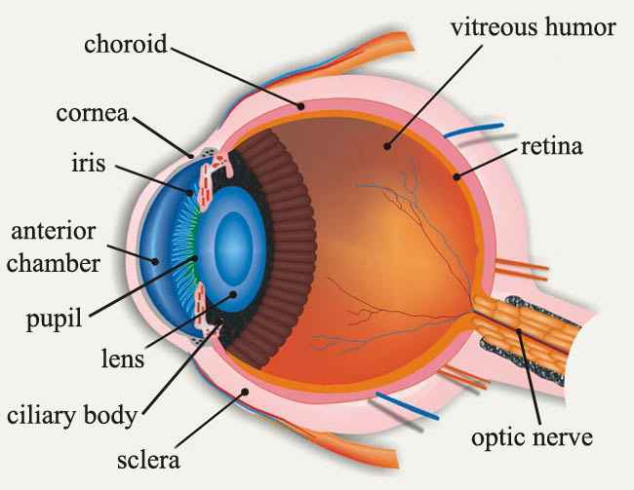

Slide 24
Psalm 139:13-16 – we are wonderfully made
Isaiah 45:5-8, 18 – God created both big and small
Psalm 148:10-12 – small creatures summoned to praise
The WORLD AROUND US: HIS detailed Creation

Slide 25
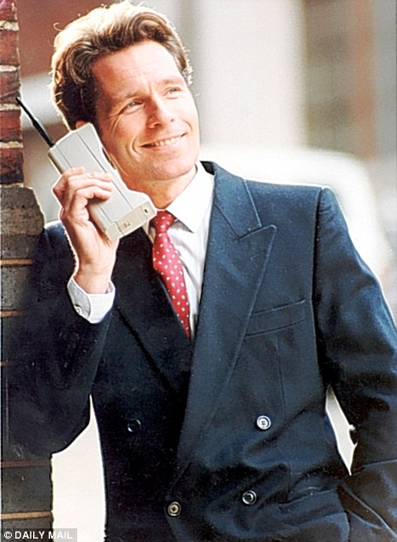

Slide 26
“THIS IS MY FATHER’S WORLD” #127 vs. 1, 2
The world around us: HIS detailed Creation

Slide 27
“ALL THINGS PRAISE THEE” #30 vs. 1, 3
The world around us: HIS detailed Creation

Slide 28
The world around us: HIS human Creation

Slide 30
Gen 1:26 – God made man
1 Peter 5:7 – God cares for man
Matt 6:25f – mankind is above all else
The WORLD AROUND US: HIS human Creation

Slide 31
How Great Thou Art: (1) O Lord my God, when I in awesome wonder Consider all the worlds thy hands have made, I see the stars, I hear the rolling thunder, Thy power throughout the universe displayed: (2) When through the woods and forest glades I wander And hear the birds sing sweetly in the trees, When I look down from lofty mountain grandeur, And hear the brook and feel the gentle breeze: (3) And when I think that God, his Son not sparing, Sent him to die, I scarce can take it in, That on the cross, my burden gladly bearing, He bled and died to take away my sin.
The world around us: HIS human Creation

Slide 32
How Great Thou Art: (1) O Lord my God, when I in awesome wonder Consider all the worlds thy hands have made, I see the stars, I hear the rolling thunder, Thy power throughout the universe displayed: (2) When through the woods and forest glades I wander And hear the birds sing sweetly in the trees, When I look down from lofty mountain grandeur, And hear the brook and feel the gentle breeze: (3) And when I think that God, his Son not sparing, Sent him to die, I scarce can take it in, That on the cross, my burden gladly bearing, He bled and died to take away my sin.
The world around us: HIS human Creation

Slide 33
“CAN YOU COUNT THE STARS” #573 vs. 1, 2
The world around us: HIS human Creation

Slide 34
“GREAT IS THY FAITHFULNESS” #23 vs. 1, 2
The world around us: HIS human Creation

Slide 35
Praise the LORD. How good it is to sing praises to our God, how pleasant and fitting to praise him! He determines the number of the stars and calls them each by name. Great is our Lord and mighty in power; his understanding has no limit. Sing to the LORD with thanksgiving. He covers the sky with clouds; he supplies the earth with rain and makes grass grow on the hills. He provides food for the cattle and for the young ravens when they call. He sends his command to the earth; his word runs swiftly. He spreads the snow like wool and scatters the frost like ashes. He hurls down his hail like pebbles. Who can withstand his icy blast? He sends his word and melts them; he stirs up his breezes, and the waters flow. Praise the LORD. (Psalm 147)
The WORLD AROUND US: GOD’S Vast, Detailed, Human Creation

Slide 36
The WORLD AROUND US: GOD’S Vast, Detailed, Human Creation

