Slide 1
The
Progressive Church
Movement

Slide 2
Progressive Churches
Definition
Characteristics
Comments

Slide 3
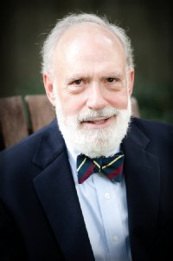
2001
Radical Restoration
A Call for Pure and Simple Christianity
F. LaGard Smith

Slide 4
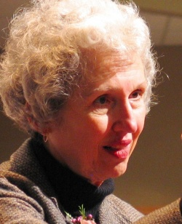
2008
The Great Emergence
How Christianity Is Changing and Why
Phyllis Tickle

Slide 5
New Ways of “Doing Church”
Emerging church
House church
Simple church
Organic church
Missional church
New paradigm church
Progressive
Church Movement

Slide 6
Progressive Churches
Definition
Characteristics

Slide 7
Outward Features
Meetings held somewhere other than a traditional church building
Younger demographic
Informality, casualness
Interactive, participatory worship
No gender limitations on worship roles

Slide 8
Outward Features
Only one assembly per week of the entire congregation
De-emphasis on sermons and preaching
Contemporary worship music
Lord’s Supper as interactive meal
Renaming of congregation

Slide 9
Inward Characteristics
Desire to not be “bound by tradition”
Rejection of “fundamentalism”
Celebration of change
Rejection of “institutional” religion
Post-denominational perspective

Slide 10
Inward Characteristics
De-emphasis on authority, hierarchy
De-emphasis on doctrine
De-emphasis on church meetings
Different concept of congregational fellowship
Broadly ecumenical answer to “Who is my brother?”

Slide 11
Inward Characteristics
Rejection of “pattern/restoration”
Postmodern view of language and truth
Embracing of mainstream culture in matters of “worldliness”
Desire for cultural “relevance”
Valuing of “inclusiveness/diversity”

Slide 12
Inward Characteristics
Valuing of “social justice”
Greater emphasis on subjective feelings and personal experience
Subjective interpretation of the activity of the Holy Spirit
“Missional/incarnational” approach to evangelism
Greater emphasis on the here-and-now

Slide 13
Progressive Churches
Definition
Characteristics
Comments

Slide 14
Positive Factors
Evangelism
Radical discipleship
Compassion and social justice
Heartfelt worship
Connection between worship and daily life

Slide 15
Serious Problems
Progressive view of . . .
Scripture
God and grace
Kingdom of God and mission of church
Salvation
Local church

Slide 16
We Need to Be Careful
Avoid knee-jerk reactions
Flexible in matters of personal preference
Listen and learn

Slide 17
Conclusion
Must be careful . . . but also courageous
“Test everything; hold fast what is good” 1 Thessalonians 5:21

