Slide 2
Should Christians Drink Alcohol?

Slide 3
Ten Reasons Christians Should Not Drink Alcohol
I. Drunkards Will Go to Hell (1 Cor. 6:9-11).

Slide 4
Ten Reasons Christians Should Not Drink Alcohol
II. Drunkenness is Not the Only Thing Condemned about Drinking (1 Pet. 4:1-5).
“Revelries” from Gr. kōmos meaning - “a revel, carousel, i.e. in the Greek writers properly a nocturnal and riotous procession of half-drunken and frolicsome fellows who after supper parade through the streets with torches and music in honor of Bacchus [i.e. the god of wine] or some other deity” (Thayer, 367).

Slide 5
Ten Reasons Christians Should Not Drink Alcohol
II. Drunkenness is Not the Only Thing Condemned about Drinking (1 Pet. 4:1-5).
“Drinking parties” from Gr. potos “a drinking or a carousing” (Thayer, 533).

Slide 6
Ten Reasons Christians Should Not Drink Alcohol
III. Christians are Priests (1 Peter 2:1-5).
Mosaic law concerning priests (Lev. 10:8-11).
IV. Christians are Saints (1 Cor. 1:2; Eph. 2:17-19).
Mosaic law for those “set apart” (Num. 6:1-6).

Slide 7
Ten Reasons Christians Should Not Drink Alcohol
V. Christians are to be Temperate (1 Tim. 3:2, 11; Titus 2:2; 1 Pet. 5:3).
Gr. nēphaleos meaning “sober, temperate, abstaining from wine...” (Thayer, 425).

Slide 8
Ten Reasons Christians Should Not Drink Alcohol
VI. Even One Drink Impairs Judgment (1 Pet. 5:8; Matt. 24:42-44).

Slide 9
Impairment in performance begins at below 0.02% BAC (1 to 1-1/2 drinks can result in this level).
Effects of Alcohol Consumption
(NIAAA - Alcohol Problems and Aging: 1998 U.S. Dept. of Health and Human Services).

Slide 10
At low doses the effects of alcohol may include alterations in mood, cognition, anxiety level, and motor performance. It may also impair performance several hours after the blood alcohol level has gone down. Even slightly elevated levels result in more fatal accidents, and the majority of individuals who experience a problem related to alcohol use are light and moderate drinkers.
Effects of Alcohol Consumption
(Department of Health and Human Services in their reports to Congress 1990 and 1993).

Slide 11
One to two drinks of alcohol impair mental and physical abilities; mental processes such as restraint, awareness, concentration and judgment are affected, reaction time slowed, and an inability to perform complicated tasks.
Effects of Alcohol Consumption
(“The Effects of Alcohol and Other Drugs,” Motorcycle Safety Foundation, Irvine, CA, 1991).

Slide 12
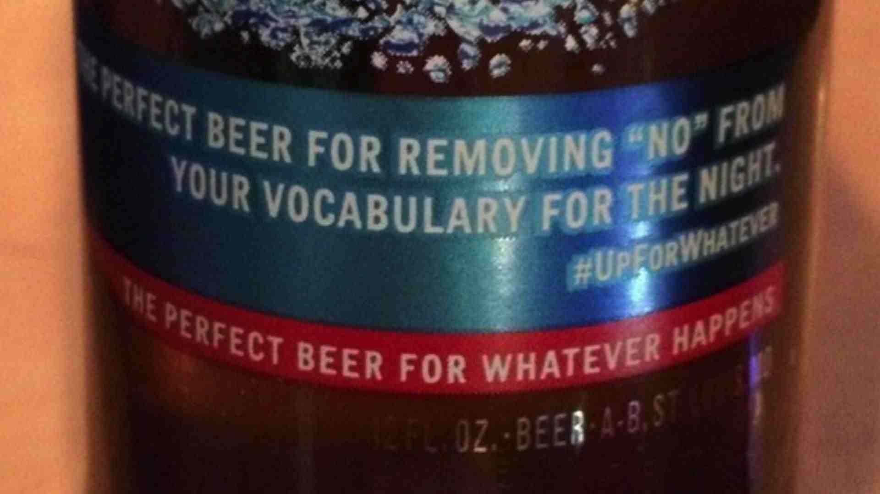
“THE PERFECT BEER FOR REMOVING ‘NO’ FROM YOUR VOCABULARY FOR THE NIGHT”
Effects of Alcohol Consumption
Controversial Budweiser Light Label

Slide 13
Any blood alcohol level, even a BAC of 0.02%, the result of just one drink, increases the risk of a crash. Alcohol impairs nearly every aspect of the brain’s ability to process information, as well as the eye’s ability to focus and react to light.
Effects of Alcohol Consumption
(University of California, Berkeley, Wellness Letter, Jan. 1998).

Slide 14
Ten Reasons Christians Should Not Drink Alcohol
VII. It Could Cause Others to Stumble (Rom. 14:20-21; Phil. 2:3-4).
VIII. It Could Damage Our Influence (Matt. 5:13-16).

Slide 15
Ten Reasons Christians Should Not Drink Alcohol
IX. Ancient Drinks and Modern Drinks are not the Same (John 2:1-10; 1 Tim. 5:23).
X. We Have So Many Other Choices (1 Cor. 10:25-31).

Slide 16
Resources on What the Bible Teaches about Drinking:
ECI Conference – 2015 Studies on Social Drinking: http://www.eciconference.com/page6/page5.html
Pressing On Magazine – April Special Issue: http://www.pressingonmagazine.com/

