Slide 2
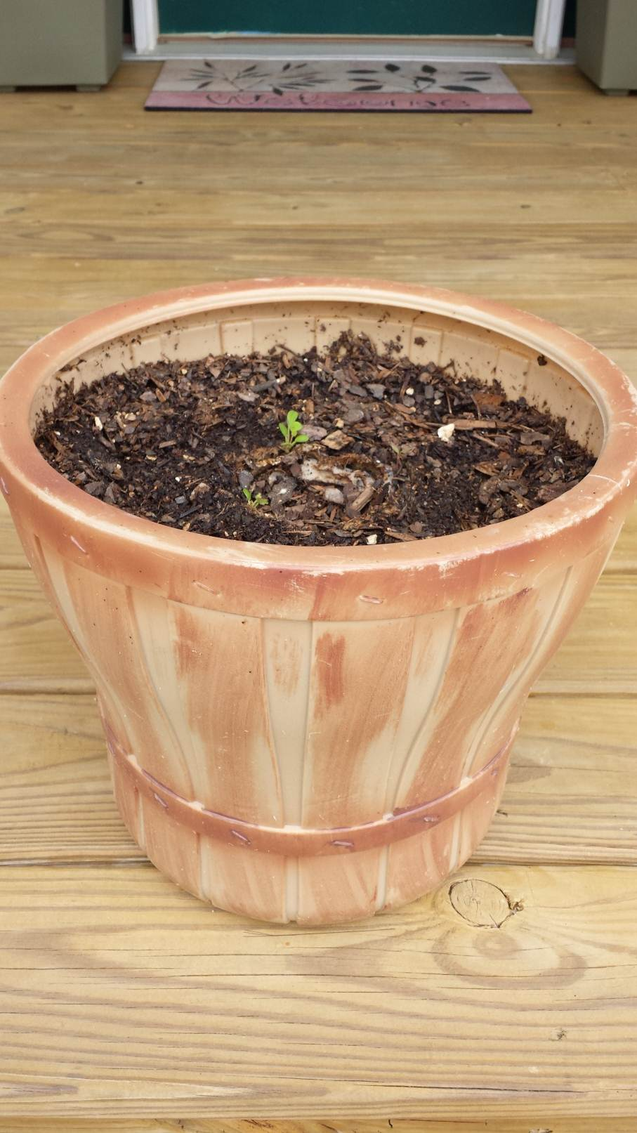
How To Grow Spiritually
Hebrews 5:11 – 6:1

Slide 3
Reminders about Spiritual Growth
God expects spiritual growth
Spiritual growth is a deliberate choice
Need to know the goal of spiritual growth

Slide 4
The Goal of Spiritual Growth: BE LIKE CHRIST!
Eph. 4:13-15
Eph. 5:1-2
I Cor. 11:1
Rom. 8:29
I Jn. 2:5-6
I Jn. 3:16
Gal. 2:20
Gal. 4:19
Jn. 13:13-17
Jn. 15:12
Phil. 2:5-8
I Pet. 2:21-23

Slide 5
Some Indicators of Spiritual Growth
Do you crave the meat of the word?
Are you anxious to spend time with God?
Are you able to overlook personal offenses?
Do you respond positively to suffering?
Are you happy to serve others? To sacrifice?
Are you quick to show compassion
and slow to cast judgment?
Are you eager to share the gospel?
Do you give God the credit?

Slide 6
Final Observations about Spiritual Growth
Spiritual growth won’t happen instantly
Be patient with each other
Make use of the “trellises” God has provided
The Lord sees our growth even when we can’t

