Slide 2
What the Heart is…

Slide 3
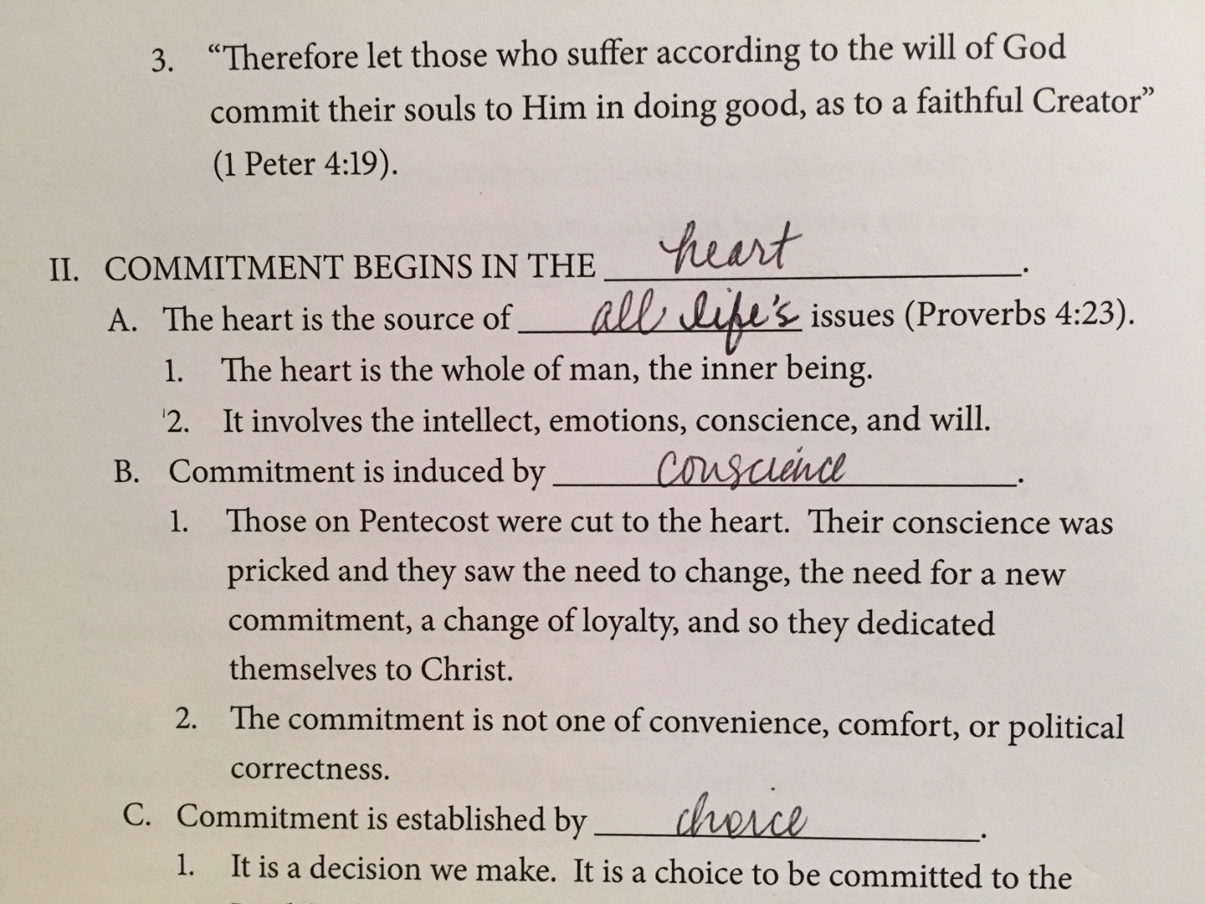

Slide 4
What the Heart is…
What does the Bible mean when it says heart?
Used more than 800 times in OT/NT always figuratively
Thayer’s definition: “the center and seat of spiritual life, “the soul or mind, as it is the fountain and seat of the thoughts, passions, desires, appetites, affections, purposes, endeavors” (so in English heart, inner man, etc.)”

Slide 5
What the Heart is…
9 that if you confess with your mouth Jesus as Lord, and believe in your heart that God raised Him from the dead, you will be saved; 10 for with the heart a person believes, resulting in righteousness, and with the mouth he confesses, resulting in salvation.
5 Then the LORD saw that the wickedness of man was great on the earth, and that every intent of the thoughts of his heart was only evil continually.
Intellect
Thinks – Gen. 6:5
“as a man thinks in his heart, so is he…” Prov. 23:7
Reasons – Lk. 5:22
Understands – Matt. 13:13-15
Believes – Rom. 10:9,10
22 But Jesus, aware of their reasonings, answered and said to them, “Why are you reasoning in your hearts?”

Slide 6
What the Heart is…
16 Then it happened as the ark of the LORD came into the city of David that Michal the daughter of Saul looked out of the window and saw King David leaping and dancing before the LORD; and she despised him in her heart.
Emotions
Loves – Matt. 22:37
Despises – 2nd Sam. 6:16
Desires – Rom. 10:1
Trusts – Prov. 3:5
1 Brethren, my heart’s desire and my prayer to God for them is for their salvation.

Slide 7
What the Heart is…
12 For the word of God is living and active and sharper than any two-edged sword, and piercing as far as the division of soul and spirit, of both joints and marrow, and able to judge the thoughts and intentions of the heart.
Will
Intentions – Heb. 4:12
Purposes – 2 Cor. 9:7
Stands Firm – 1 Cor. 7:37
Obeys – Rom. 6:17
7 Each one must do just as he has purposed in his heart…
17 But thanks be to God that though you were slaves of sin, you became obedient from the heart to that form of teaching to which you were committed,

Slide 8
What the Heart is…
2 You are our letter, written in our hearts, known and read by all men; 3 being manifested that you are a letter of Christ, cared for by us, written not with ink but with the Spirit of the living God, not on tablets of stone but on tablets of human hearts.
We began in Jer. 31
“I will put My law within them, and on their heart I will write it…”
We are to be the fulfillment
2 Cor. 3:2-3

Slide 9
What the Heart is…
“but sanctify the Lord as Christ in your heart…” -1 Pet. 3:15
Let Him reign and rule over all we:
Think
Feel
Do

