Slide 2
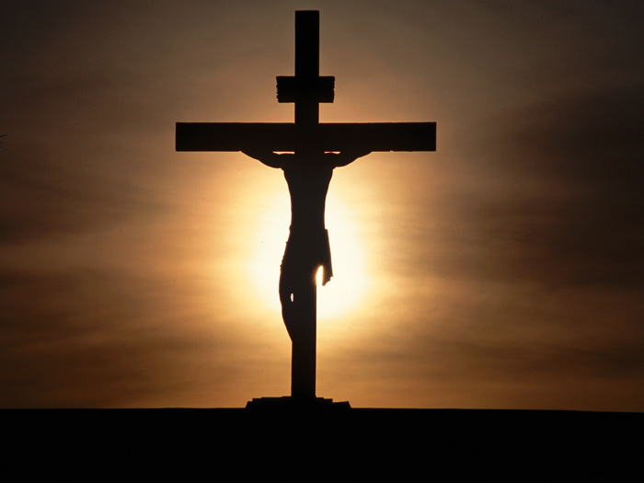
The Message of the Cross
-1 Cor. 1:18

Slide 3
Fulfillment of Prophecy
Prophecy
Silent when accused – Isa. 53:7
Innocent to die for guilty – Dan. 9:26
Crucified – Ps. 22:16
Given vinegar to drink – Ps. 69:21
Numbered with transgressors-Isa. 53:12
Mocked – Ps. 22:7
Interceded for enemies – Is. 53:12
Darkness – Amos 8:9
Cast lots for His garments – Ps. 22:18
Bones would not be broken – Ps. 34:20
Fulfillment
Matt. 27:12-14
Rom. 4:25
Lk. 23:33
Matt. 27:34
Matt. 27:38
Matt. 27:39-43
Lk. 23:34
Matt. 27:45
Mk. 15:24
Jn. 19:33, 36

Slide 4
Culmination of the Law
Col. 2:14-17; Eph. 2:13-16
Misunderstanding of this leads to religious error
Burning incense, Sabbath-keeping, tithing, instrumental music
We cannot be justified by the Law – Gal. 5:4
The Law was limited:
Between God and Israel only – Ex. 20:2
In duration – Gal. 3:19
Could not give life – Gal. 3:21
Could not take away sin – Heb. 10:1-4

Slide 5
Culmination of the Law
Purpose of the Law:
Preserve Abraham’s lineage – Eph. 2:14
Define and condemn sin – Rom. 7:7
Provide a shadow of what would come – Heb. 10:1
Bring us to Christ – Rom. 10:1-4

Slide 6
Terrible Nature of Sin
Old Testament punishments for sin give us a clue:
Flood
Sodom and Gomorrah destroyed
Animal sacrifices
Nadab and Abihu
Uzzah
The cross makes it clear

Slide 7
Terrible Nature of Sin
Consider the sacrifice:
God’s only son
Only did good to fellow man
Sinless
Came from heaven to do the will of the Father
Consider the suffering - Matt. 27:27-50
Consider the reason:
Sin
Yours and mine - Rom. 3:23

Slide 8
God’s Love for the Sinner
What else could inspire such a sacrifice – Jn. 3:16
Demonstrated by Jesus in Gethsemane
Matt. 26:36-39, 42, 44
There was no other way
Rom. 3:25-26
Rom. 5:6-8
There is no other explanation
1 Jn. 4:9-10

Slide 9
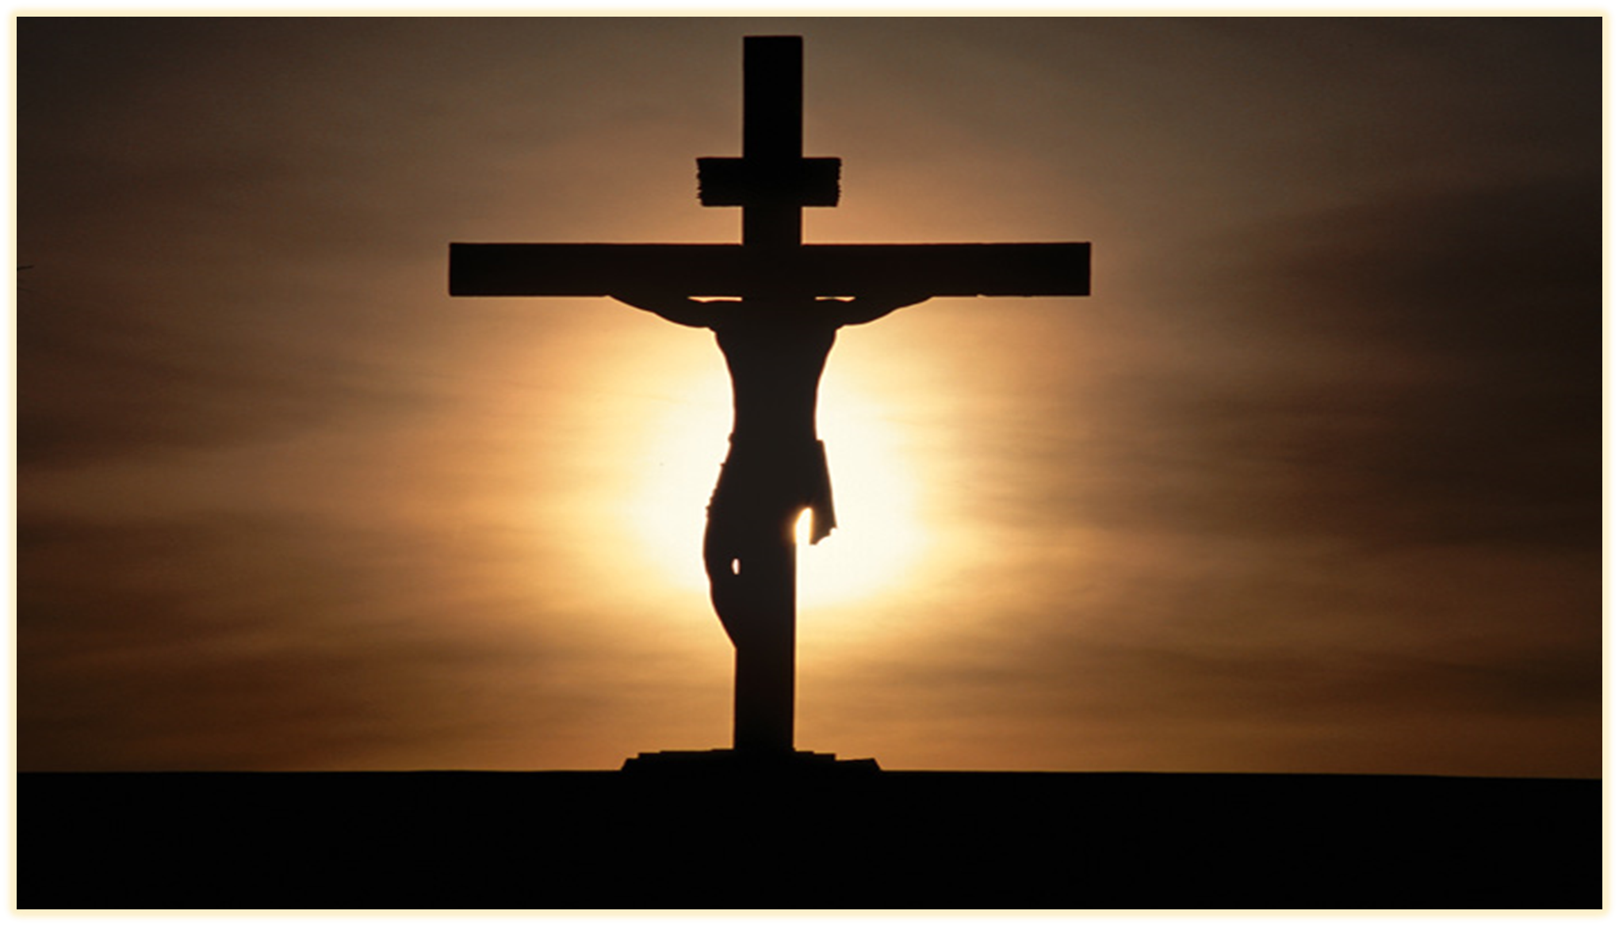
Fulfillment of Prophecy
Terrible Nature of Sin
Culmination of the Law
God’s Love for the Sinner

