Slide 2
Falling Asleep at the Wheel

Slide 3
Resolutions for Men
(Malachi 4:6) “He will turn the hearts of the fathers to their children, and the hearts of the children to their fathers; or else I will come and strike the land with a curse."

Slide 4
Never Too Late to Start

Slide 5
Not All Men Are Fathers
(1 Cor. 7:7,26,27, 32)
(Barnabas, Paul, Timothy, Titus, Acts 20:4)
Whether you are married or not, or have children or not, we invite you to take on this challenge.

Slide 6
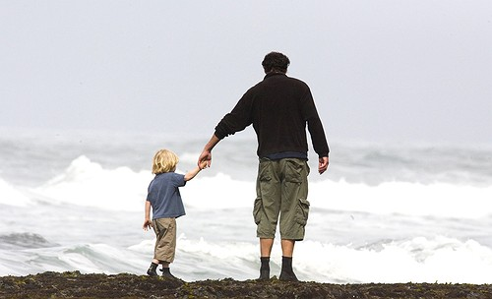
The Power of a Father
“Tell me about your dad.”
What does my dad really think about me?
Intentional fathering (1 Timothy 5:4, 8)

Slide 7
The Missing Piece
God cares for orphans (James 1:27)
Debilitating Dads:
Divorce
Work
Entertainment
Media - anti – fatherhood bias.
Devil seeks to immobilize

Slide 8
Purpose of Fatherhood
God designed fathers to reveal and represent:
a loving Provider
a strong Protector
a truthful Leader
a respectable Authority
an intimate Friend
Rules without Relationship breed Rebellion

Slide 9
Purpose of Fatherhood
Teach your children to serve the family, parents, siblings, elderly.
Teach your children how to work and provide for themselves.
Don’t enable them as lazy and slothful.
If they won’t work – they don’t eat (2 Th. 3:10)

Slide 10
Purpose of Fatherhood
Your children want to know:
Who is God?
Who am I?
Am I loved?
Do I have what it takes?
What is my purpose in life?

Slide 11
The Resolutions for Men
I DO solemnly resolve before God to take full responsibility for myself, my wife, and my children.

Slide 12
The Resolutions for Men
I WILL love them, protect them, serve them, and teach them the Word of God as the spiritual leader of my home.

Slide 13
The Resolutions for Men
I WILL be faithful to my wife, to love and honor her, and be willing to lay down my life for her as Jesus Christ did for me.

Slide 14
The Resolutions for Men
I WILL bless my children and teach them to love God with all of their hearts, all of their minds and all of their strength.
I WIL train them to honor authority and live responsibly.

Slide 15
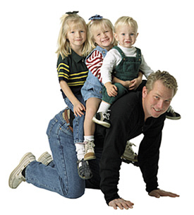
The Resolutions for Men

Slide 16
The Resolutions for Men
I WILL confront evil, pursue justice and love mercy.

Slide 17
The Resolutions for Men
I WILL pray for others and treat them with kindness, respect, and compassion.

Slide 18
The Resolutions for Men
I WILL work diligently to provide for the needs of my family.

Slide 19
The Resolutions for Men
I WILL forgive those who have wronged me and reconcile with those I have wronged.
I WILL learn from my mistakes, repent of my sins, and walk with integrity as a man answerable to God.

Slide 20
The Resolutions for Men
I WILL seek to honor God, be faithful to His family the church, obey His Word and do His will.
I WILL courageously work with the strength God provides to fulfill this resolution for the rest of my life and for His glory.

Slide 21
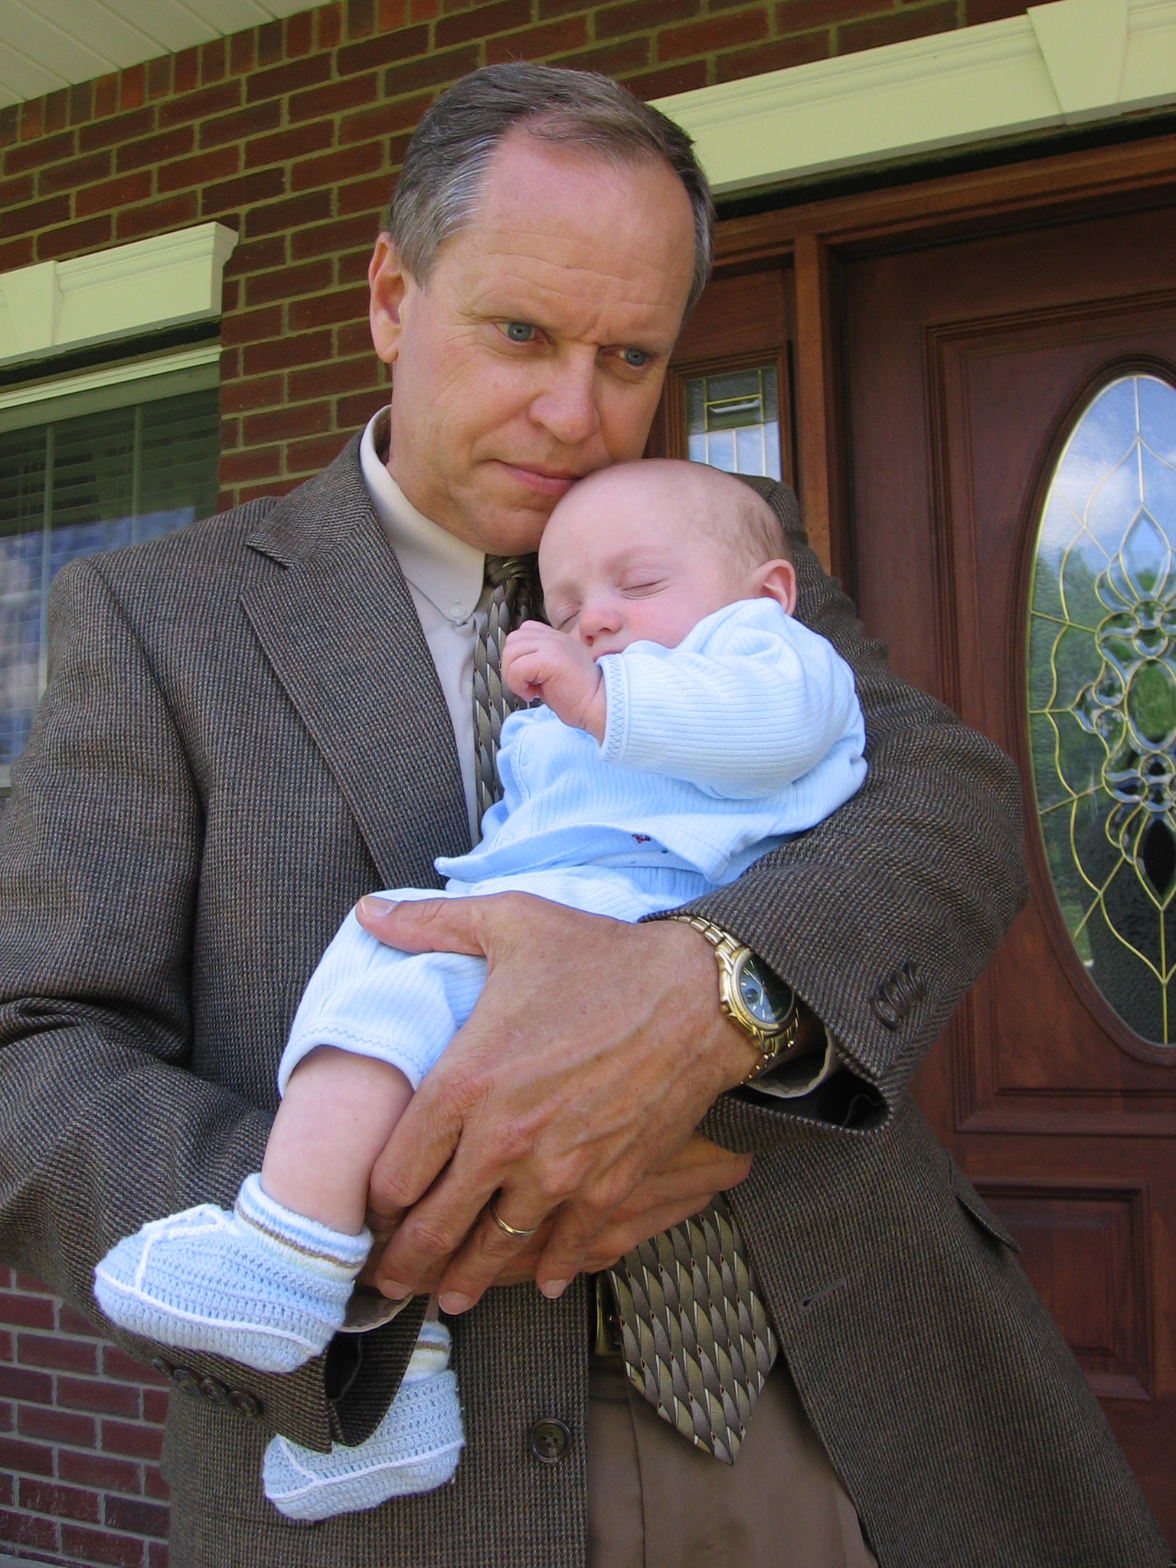
The Resolutions for Men

Slide 22
Falling Asleep at the Wheel

Slide 24
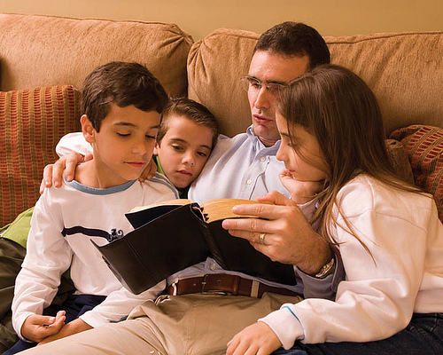
Will You Resolve?
(Malachi 4:6) “He will turn the hearts of the fathers to their children, and the hearts of the children to their fathers; or else I will come and strike the land with a curse."

Slide 25
Will You Resolve?
Who will teach my son and daughter to follow Christ?
Who will provide for and protect my family?
Who will break the destructive patterns in my family’s history?
Who will pray for and bless my children?
Will your respond? “I will. I am their father.”

