Slide 2
Jesus of Nazareth

Slide 3
Who is Jesus of Nazareth?
John 7:40 ”Some of the people therefore, when they heard these words, were saying, "This certainly is the Prophet.“ 41 Others were saying, "This is the Christ." Still others were saying, "Surely the Christ is not going to come from Galilee, is He? 42 "Has not the Scripture said that the Christ comes from the descendants of David, and from Bethlehem, the village where David was?“ 43 So a division occurred in the crowd because of Him…45 The officers then came to the chief priests and Pharisees, and they said to them, "Why did you not bring Him?“ 46 The officers answered, "Never has a man spoken the way this man speaks."

Slide 4
1 Corinthians 15:3 - 4
1Corinthians 15:3 ” For I delivered to you as of first importance what I also received, that Christ died for our sins according to the Scriptures, 4 and that He was buried, and that He was raised on the third day according to the Scriptures, 5 and that He appeared to Cephas, then to the twelve. 6 After that He appeared to more than five hundred brethren at one time, most of whom remain until now…”

Slide 5
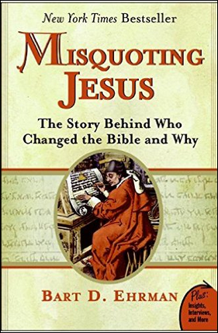
In review of the book, Daniel B. Wallace wrote How Badly Did the Early Scribes Corrupt the New Testament?
“One reason this book has done so well is that it appeals to the skeptic who wants reasons not to believe, who considers the Bible a book of myths.”
“’There are more variations among our manuscripts than there are words in the New Testament,’ argues Ehrman. Elsewhere he states that the number of variants is as high as 400,000. That is true enough but by itself is misleading. Anyone who teaches NT textual criticism knows this fact is only part of the picture and that, if left dangling in front of the reader without explanation, is a distorted view… Indeed, less than 1 percent of the textual variants are both meaningful and viable.”

Slide 6
Daniel B. Wallace, How Badly Did the Early Scribes Corrupt the New Testament?
Speaking of remarks in this book concerning certain texts –
Mark 16:9-20 John 7:53-8:11 1 John 5:7-8
“…these passages have been considered inauthentic by most NT scholars…for well over a century…Yet Ehrman writes as though the excision of such texts could shake up our theological convictions. Such is hardly the case. “
“In sum, Misquoting Jesus does not disappoint on the provocative scale. But it comes up short on genuine substance about Ehrman’s primary contention. Scholars bear a sacred duty not to alarm layreaders on issues where they have little understanding…Unfortunately the average layperson will leave Misquoting Jesus with far greater doubts about the wording and teachings of the NT than any textual critic would ever entertain. A good teacher doesn’t hold back on telling his students what’s what, but he also knows how to package the material so they don’t let emotion get in the way of reason.”

Slide 7
Resources
Lee Strobel, The Case for Christ
Lee Strobel, The Case for the Real Jesus
Paul Copan and William Lane Craig, Contending With Christianity’s Critics
Kenneth Chumbley, The Gospel Argument for God

Slide 8
External Citations of an Historical Jesus
Josephus A.D. 37-97 - the Jewish historian, who was no friend to Christianity, wrote of Jesus in his History of the Jews, 20:9c.
Testimonium Flavium “About this time there lived Jesus, a wise man, if indeed one ought to call him a man. For he was one who performed surprising deeds and was a teacher of such people as accept the truth gladly. He won over many Jews and many of the Greeks. He was the Christ. And when, upon the accusation of the principal men among us, Pilate had condemned him to a cross, those who had first come to love him did not cease. He appeared to them spending a third day restored to life, for the prophets of God had foretold these things and a thousand other marvels about him. And the tribe of the Christians, so called after him, has still to this day not disappeared.
Flavius Josephus: Antiquities of the Jews, Book 18, Chapter 3, 3^{[51]}
*Italicized portions may be interpolations

Slide 9
External Citations of an Historical Jesus
Pliny the Younger, 112 AD
In the year 112, Pliny the Younger was faced with a dilemma. He was the governor in the Roman province of Bithynia (modern day Turkey) when a number of Christians were brought into his court. It is unclear what the initial charges are, but he ultimately decided, despite the fact that the Christians seemed generally harmless to him, that he should execute them if they refused to recant their faith. Because he is unsure as to whether he can kill them legally for no other crime than their faith, he writes to his friend the Emperor (Trajan) for advice. The Emperor replies that he did the right thing in executing them, but advises him not to seek out Christians for prosecution.
http://www.pbs.org/wgbh/pages/frontline/shows/religion/maps/primary/pliny.html

Slide 10
External Citations of an Historical Jesus
"But not all the relief that could come from man, not all the bounties that the prince could bestow, nor all the atonements which could be presented to the gods, availed to relieve Nero from the infamy of being believed to have ordered the conflagration, the fire of Rome. Hence to suppress the rumor, he falsely charged with the guilt and punished with the most exquisite tortures, the persons commonly called Christians, who were hated for their enormities. Christus, (Latin for Christ) the founder of the name, was put to death by Pontius Pilate, procurator of Judea in the reign of Tiberius: but the pernicious superstition, repressed for a time broke out again, not only through Judea, where the mischief originated, but through the city of Rome also."
Tacitus, Annals XV.44.

Slide 11
Luke’s Careful History
Luke 1:1 - 4 “Inasmuch as many have undertaken to compile an account of the things accomplished among us,
just as they were handed down to us by those who from the beginning were eyewitnesses and servants of the word,
it seemed fitting for me as well, having investigated everything carefully from the beginning, to write it out for you in consecutive order, most excellent Theophilus;
so that you may know the exact truth about the things you have been taught.”

Slide 12
Luke’s Careful History
Luke 3:1 – 2 “Now in the fifteenth year of the reign of Tiberius Caesar, when Pontius Pilate was governor of Judea, and Herod was tetrarch of Galilee, and his brother Philip was tetrarch of the region of Ituraea and Trachonitis, and Lysanias was tetrarch of Abilene,
Luke 3:2 in the high priesthood of Annas and Caiaphas, the word of God came to John, the son of Zacharias, in the wilderness.”

Slide 13
Sir William Mitchell Ramsay
(1851 - 1939)
“… a Scottish writer, New Testament scholar and archaelologist. He was the first Professor of Classical Archaeology at Oxford University and pioneered the study of antiquity in what is today western Turkey…
Greece and Turkey remained the focus of Ramsay's research for the remainder of his academic career. He was known for his expertise in the historic geography and topography of Asia Minor and of its political, social, cultural and religious history. ” wikipedia.com

Slide 14
Sir William M. Ramsay
“I may fairly claim to have entered on this investigation without any prejudice in favour of the conclusion which I shall now attempt to justify to the reader. On the contrary, I began with a mind unfavourable to it, for the ingenuity and apparent completeness of the Tubingen theory had at one time convinced me. . .

Slide 15
Sir William M. Ramsay
“...but more recently I found myself often brought in contact with the Book of Acts as an authority for the topography, antiquities, and society of Asia Minor. It was gradually borne in upon me that in various details the narrative showed marvelous truth”
St. Paul the Traveller & the Roman Citizen, pg.8

Slide 16
Sir William M. Ramsay
“Works that profess to be historical are of various kinds and trustworthy in varying degrees…
There is, finally, the historical work of the highest order… Great historians are the rarest of writers…
…stating in the following chapters reasons for placing the author of Acts among the writers of first rank.”
Saint Paul the Traveler & the Roman Citizen, p.2-4

Slide 17
Classical Greek and Roman Authors
Author Date of Writing First Copy Time Gap Number of Copies
Thucydides 460-400 B.C. 900 A.D. 1300 years 8
Plato 427-347 B.C. 1100 A.D. 1400 years 20
Aristotle 345-322 B.C. 1100 A.D. 1400 years 49
Caesar 100-44 B.C. 900 A.D. 1000 years 10
Tacitus 100 A.D. 1100 A.D. 1000 years 20
Suetonius 75-160 A.D. 950 A.D. 800 years 8
New Test. 50 – 100 A.D. 250 A.D. 150 years 5,800

Slide 18
Bible and Archaelogy
“The interval then between the dates of original composition and the earliest extant evidence becomes so small as to be a fact negligible, and the last foundation for any doubt that the Scriptures have come down to us substantially as they were written has now been removed. Both the authenticity and the general integrity of the books of the New Testament may be regarded as finally established.” Sir Frederick Kenyon

Slide 19
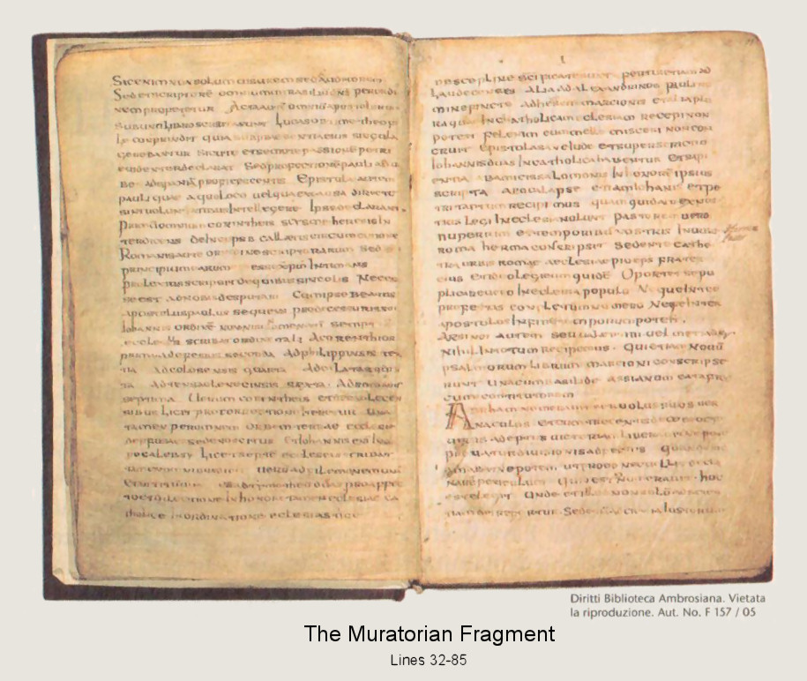
Muratorian fragment
discovered in Milan in the 1700’s: 7th or 8th cent. copy of a text from ca. 170 A.D.
Henry M. Gwatkin, ed., Selections from Early Writers Illustrative of Church History to the Time of Constantine (London: MacMillan and co., 1937), pp. 82-88.
1. ...quibus tamen interfuit et ita posuit 2. tertio evangelii librum secundo lucan 3. lucas iste medicus post ascensum XPi 4. cum eo paulus quasi ut juris studiosum 5. secundum adsumsisset numeni suo 6. ex opinione conscripset dnm tamen nec ipse 7. vidit in carne et ide prout asequi potuit 8. ita et ad nativitate iohannis incipet dicere. 9. quarti evangeliorum iohannis ex decipolis.
From: Bruce Metzger's The Canon of the New Testament (Oxford: Clarendon Press, 1987), pp. 191-201.
Below is Metzger's English translation of a critically amended text of the Fragment, from Appendix IV of the same book (pp. 305-7).
. . at which nevertheless he was present, and so he placed [them in his narrative]. ^{[1]}
(2) The third book of the Gospel is that according to Luke.
(3) Luke, the well-known physician, after the ascension of Christ,
(34) Moreover, the acts of all the apostles
(35) were written in one book. For 'most excellent Theophilus' ^{[5]} Luke compiled
citations & photo from: http://www.bible-researcher.com/muratorian.jpg

Slide 20
"What is the Muratorian Canon?"
The Muratorian Canon (also called the Muratorian Fragment) is an ancient list of New Testament books—the oldest such list we have found. The original document, which was probably written in Greek, is dated to about AD 170 and lists 22 of the 27 books that were later included in the New Testament of the Christian Bible. The Muratorian Canon was discovered by Italian historian Ludovico Muratori in the Ambrosian Library in northern Italy and was published by him in 1740. The manuscript copy that Muratori discovered was written in Latin and has been dated to the 7th or 8th century AD. Several internal indicators have convinced most experts that the original Muratorian Canon should be dated near the end of the 2nd century (c. AD 170).
http://www.bible-researcher.com/muratorian.html

Slide 21
"What is the Muratorian Canon?"
It is noteworthy that the Muratorian Canon omits several epistles that later did win acceptance in the Christian New Testament such as the books of James and 2 Peter.
This may go to demonstrate that the early church practiced discernment in recognizing which books carried with them apostolic authority.
They did not immediately accept any book or letter that claimed to be associated with an apostle.
This fact makes it all the more remarkable that the Muratorian Canon includes all four biblical gospels as well as the Acts of the Apostles, the Pauline Epistles, and most of John’s writings.
This means that, within 150 years of Jesus’ death and resurrection, the core writings that were later included in the New Testament were already deemed authoritative by early Christians.

Slide 22
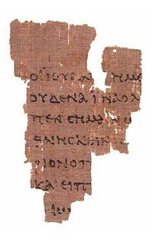
"What is the John Rylands Fragment?"
Gospel of John 18:31-33 (recto)
ΟΙ ΙΟΥΔΑΙΟΙ ΗΜΙΝ ΟΥΚ ΕΞΕΣΤΙΝ ΑΠΟΚΤΕΙΝΑΙ OYΔΕΝΑ ΙΝΑ Ο ΛΟΓΟΣ ΤΟΥ ΙΗΣΟΥ ΠΛΗΡΩΘΗ ΟΝ ΕΙ- ΠΕΝ ΣΕΜΑΙΝΩΝ ΠΟΙΩ ΘΑΝΑΤΩ ΗΜΕΛΛΕΝ ΑΠΟ ΘΝΕΣΚΕΙΝ ΕΙΣΗΛΘΕΝ ΟΥΝ ΠΑΛΙΝ ΕΙΣ ΤΟ ΠΡΑΙΤΩ- ΡΙΟΝ Ο ΠΙΛΑΤΟΣ ΚΑΙ ΕΦΩΝΗΣΕΝ ΤΟΝ ΙΗΣΟΥΝ ΚΑΙ ΕΙΠΕΝ ΑΥΤΩ ΣΥ ΕΙ ΒΑΣΙΛΕΥΣ ΤΩΝ ΙΟΥ- ΔΑΙΩN ...
said to him the Jews, "To us it is lawful to kill no one," so that the word of Jesus might be fulfilled, which he said signifying by what sort of death he was about to die. Entered again into the Praetorium Pilate and called Jesus and said to Him. Are you the king of the Jews?

Slide 23
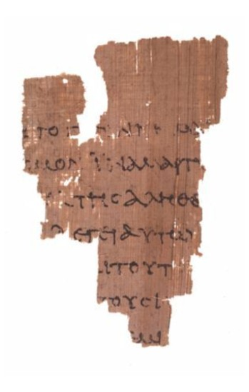
"What is the John Rylands Fragment?"
Gospel of John 18:37-38 (verso)
ΒΑΣΙΛΕΥΣ ΕΙΜΙ ΕΓΩ ΕΙΣ ΤΟΥΤΟ ΓΕΓΕΝΝΗΜΑΙ ΚΑΙ (ΕΙΣ ΤΟΥΤΟ) ΕΛΗΛΥΘΑ ΕΙΣ ΤΟΝ ΚΟΣΜΟΝ ΙΝΑ ΜΑΡΤΥ- ΡΗΣΩ ΤΗ ΑΛΗΘΕΙΑ ΠΑΣ Ο ΩΝ ΕΚ ΤΗΣ ΑΛΗΘΕI- ΑΣ ΑΚΟΥΕΙ ΜΟΥ ΤΗΣ ΦΩΝΗΣ ΛΕΓΕΙ ΑΥΤΩ Ο ΠΙΛΑΤΟΣ ΤΙ ΕΣΤΙΝ ΑΛΗΘΕΙΑ ΚΑΙ ΤΟΥΤΟ ΕΙΠΩΝ ΠΑΛΙΝ ΕΞΗΛΘΕΝ ΠΡΟΣ ΤΟΥΣ ΙΟΥ- ΔΑΙΟΥΣ ΚΑΙ ΛΕΓΕΙ ΑΥΤΟΙΣ ΕΓΩ ΟΥΔΕΜΙΑΝ ΕΥΡΙΣΚΩ ΕΝ ΑΥΤΩ ΑΙΤΙΑΝ
a King I am. I for this have been born and (for this) I have come into the world so that I should testify to the truth. Everyone being of the truth hears my voice. Says to him Pilate, "What is truth?" and this saying, again he went out to the Jews and says to them, "I nothing find in him a case."

Slide 24
Who Do You Say that I am?
Matthew 16:13 – 17 “My Father has revealed it”
Who revealed to Peter that Jesus was the Christ?
By what means? (Cf. Matthew 11:2 – 5)
"Are you the one who is to come, or shall we look for another?"
Mat 11:4 And Jesus answered them, "Go and tell John what you hear and see:
Mat 11:5 the blind receive their sight and the lame walk, lepers are cleansed and the deaf hear, and the dead are raised up, and the poor have good news preached to them.” (cf. Isa. 35;61)

Slide 25
Was Jesus God in a physical body?
John 1:14; 1 John 1:1; 4:2; 2 John vs. 7 (God in flesh) [Docetism]
Hebrews 1:1 – 3 “these last days has spoken to us in His Son, whom He appointed heir of all things, through whom also He made the world. 3 And He is the radiance of His glory and the exact representation of His nature, and upholds all things by the word of His power.”
Colossians 2:9 “For in Him all the fullness of Deity dwells in bodily form,”

Slide 26
Prophecies concerning Jesus
Seed of Abraham
(Gen.12:3; 21:12; 22:18; Matt. 1:1; Gal.3:16)
Birthplace - two Bethlehem's in Palestine
(Joshua 19:15; Micah 5:2; Mt.2:5-6)
Rejection, crucifixion and resurrection
(Isa. 53; Ps.22; 16:8-11; Cf. Acts 2)

Slide 27
Power of Prophecy
Isaiah 46:9 - 10
9 "Remember the former things long past, For I am God, and there is no other; I am God, and there is no one like Me,
10 Declaring the end from the beginning, And from ancient times things which have not been done, Saying, 'My purpose will be established, And I will accomplish all My good pleasure';

Slide 28
Probability of Fulfillment [8 miracles]
"Now suppose that we take 10 -17th power silver dollars and lay them on the face of Texas. They will cover all of the state 2 feet deep.
Now mark one of the silver dollars and stir the whole mass thoroughly, all over the state.
Blindfold a man and tell him that he can travel as far as he wishes, but he must pick up one silver dollar and say that this is the right one.
What chance would he have of getting the right one?
Just the same chance that the prophets would have had of writing these eight prophecies and having them all come true in any one man, from their day to the present time, providing they wrote them in their own wisdom.”
Science Speaks, Peter Stoner, p. 106 - 107

Slide 29
Fake Fulfillment?
How do you pre-plan whom your parents will be?
What ethnic nationality (Jewish) you will be?
That you will be of the tribe of Judah (Gen.49:10)
That your mother will be a virgin when you are conceived and born (Matthew 1:22 – 25)
How do you fake being born in Bethlehem of Judea? (Micah 5:2)
How do you fake what the Romans will do to you? (Mt.16:21)

Slide 30
Miracles Confirmed The Message
Jesus birth
Isaiah 7:14;
Matthew 1:22 – 23 “She will bear a son, and you shall call his name Jesus, for he will save his people from their sins.“ 22 All this took place to fulfill what the Lord had spoken by the prophet: 23 "Behold, the virgin shall conceive and bear a son, and they shall call his name Immanuel" (which means, God with us).”
Who knew for sure?

Slide 31
Miracles not Denied by Enemies
John 11:47 – 48 ”So the chief priests and the Pharisees gathered the council and said, "What are we to do? For this man performs many signs.
48 If we let him go on like this, everyone will believe in him, and the Romans will come and take away both our place and our nation."

Slide 32
Resurrection
"more than 500 brethren at once” (1 Cor.15:4-8).
These witnesses could touch and handle him (1 Jn.1:1-2)
Witnesses were hesitant to believe at first (Mk.16:11,14)
Dramatic change in the eye – witnesses.
Thomas (Jn.20:19-20, 24-29)
Luke 24:13 – 32 He has really risen.

Slide 33
Liar, Lunatic or Lord?
“I am trying here to prevent anyone saying the really foolish thing that people often say about Him: ‘I’m ready to accept Jesus as a great moral teacher, but I don’t accept His claim to be God.’ That is the one thing you must not say. A man who was merely a man and said the things Jesus said would not be a great moral teacher. He would either be a lunatic… or else he would be the Devil of Hell. You must make your choice. Either this man was, and is the Son of God: or else a madman or something worse. You can shut Him up for a fool, you can spit at Him and kill Him as a demon; or you can fall at His feet and call Him Lord and God. But let us not come with any patronizing nonsense about His being a great human teacher. He has not left that open to us. He did not intend to.”
(C.S. Lewis: Mere Christianity, as quoted in Case for Christ, p. 271)

