Slide 2
Follow Me
In Countering the Culture of Prejudice

Slide 3
Declaration of Independence
“We hold these truths to be self-evident, that all Men are created equal, that they are endowed by their Creator with certain unalienable Rights, that among these are Life, Liberty, and the Pursuit of Happiness.”

Slide 4
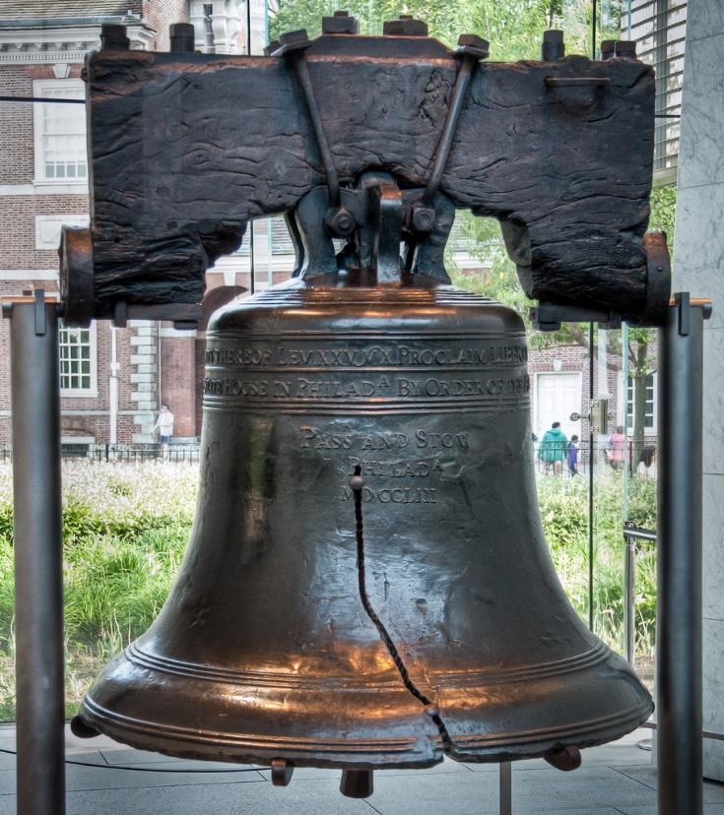
Proclaiming Liberty
“proclaim liberty throughout all the land unto all the inhabitants thereof:”
(Leviticus 25:10)
This Photo by Unknown Author is licensed under CC BY-NC
This Photo by Unknown Author is licensed under CC BY-NC

Slide 5
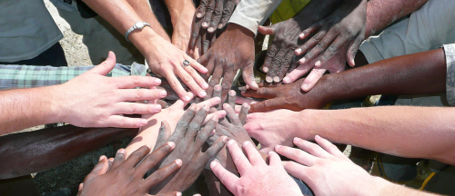
God’s Declaration
Acts 17: 26 “From one man (blood, KJV) he made every nation (ethnos) of men, that they should inhabit the whole earth; and he determined the times set for them and the exact places where they should live. 27 God did this so that men would seek him and perhaps reach out for him and find him, though he is not far from each one of us.” (NIV)

Slide 6
Jesus (John) and the Jews
Matthew 3:8 – 9 "Therefore bring forth fruit in keeping with repentance; 9 and do not suppose that you can say to yourselves, 'We have Abraham for our father'; for I say to you, that God is able from these stones to raise up children to Abraham.”

Slide 7
Jesus and the Jews
Luke 4:25 – 27
“25 I assure you that there were many widows in Israel in Elijah's time, when the sky was shut for three and a half years and there was a severe famine throughout the land. 26 Yet Elijah was not sent to any of them, but to a widow in Zarephath in the region of Sidon. 27 And there were many in Israel with leprosy in the time of Elisha the prophet, yet not one of them was cleansed--only Naaman the Syrian."

Slide 8
Jesus Experienced Prejudice
Questions regarding His birth
John 8:41
Place of residence
John 1:46
Lack of Education
John 7:15, 41 – 52
Low view of occupation
Mark 6:2 - 3

Slide 9
Treated People with Respect
(Luke 2:46) “After three days they found him in the temple courts, sitting among the teachers, listening to them and asking them questions. 47 Everyone who heard him was amazed at his understanding and his answers.”

Slide 10
Treated People with Respect
(1 Timothy 4:12) “Don't let anyone look down on you because you are young, but set an example for the believers in speech, in life, in love, in faith and in purity.”

Slide 11
Treated People with Respect
(Matt. 23:2 – 3) “Then Jesus said to the crowds and to his disciples:
2 "The teachers of the law and the Pharisees sit in Moses' seat.
3 So you must obey them and do everything they tell you. But do not do what they do, for they do not practice what they preach.” (NIV)

Slide 12
Jesus Countered the Culture
Matthew 5:43 "You have heard that it was said, 'Love your neighbor and hate your enemy.' 44 But I tell you: Love your enemies and pray for those who persecute you, 45 that you may be sons of your Father in heaven. He causes his sun to rise on the evil and the good, and sends rain on the righteous and the unrighteous.”

Slide 13
Jesus and Gentiles
Luke 7:9 “Now when Jesus heard this, He marveled at him, and turned and said to the multitude that was following Him, "I say to you, not even in Israel have I found such great faith."

Slide 14
Jesus and Gentiles
Mark 7: 26 “Now the woman was a Gentile (Greek – Hellenist), of the Syrophoenician race.(Gk. Genos – born, country, kindred) And she kept asking Him to cast the demon out of her daughter.
27 And He was saying to her, “Let the children be satisfied first, for it is not good to take the children's bread and throw it to the dogs.”
28 But she answered and said to Him, "Yes, Lord, but even the dogs under the table feed on the children's crumbs."

Slide 15
Jesus and Gentiles
John 12:20 “Now there were some Greeks among those who went up to worship at the Feast. 21 They came to Philip, who was from Bethsaida in Galilee, with a request. "Sir," they said, "we would like to see Jesus.“
Acts 13:47 “For this is what the Lord has commanded us: "'I have made you a light for the Gentiles, that you may bring salvation to the ends of the earth.'"

Slide 16
Jesus and Samaritans
Luke 9:54 “And when His disciples James and John saw this, they said, "Lord, do You want us to command fire to come down from heaven and consume them?"
55 But He turned and rebuked them, and said, "You do not know what kind of spirit you are of;
56 for the Son of Man did not come to destroy men's lives, but to save them." And they went on to another village.

Slide 17
Jesus and Samaritans
Luke 17:15 “Now one of them, when he saw that he had been healed, turned back, glorifying God with a loud voice, 16 and he fell on his face at His feet, giving thanks to Him. And he was a Samaritan. 17 And Jesus answered and said, "Were there not ten cleansed? But the nine-- where are they? 18 "Was no one found who turned back to give glory to God, except this foreigner?"

Slide 18
Jesus Taught People
John 4:3 - 4
Followers of Jesus taught everywhere - Samaritans
Acts 8:4 - 24
Followers of Jesus taught Ethiopians
Acts 8:25 - 40

Slide 19
Look up and Look out
John 4:35 “Do you not say, 'Four months more and then the harvest'? I tell you, open your eyes and look at the fields! They are ripe for harvest.”

Slide 20
Gospel is for All
Galatians 3:26 – 28 “You are all sons of God through faith in Christ Jesus, 27 for all of you who were baptized into Christ have clothed yourselves with Christ. 28 There is neither Jew nor Greek, slave nor free, male nor female, for you are all one in Christ Jesus.”
All lives matter to Jesus.

