Slide 1
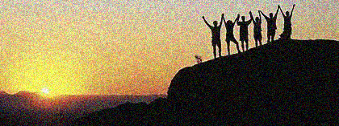
MORE THAN CONQUERORS
A Study of the Book of Romans
Fall 2018

Slide 2
“Yet in all these things we are more than conquerors through Him who loved us.”
-Romans 8:37 (NKJV)

Slide 3
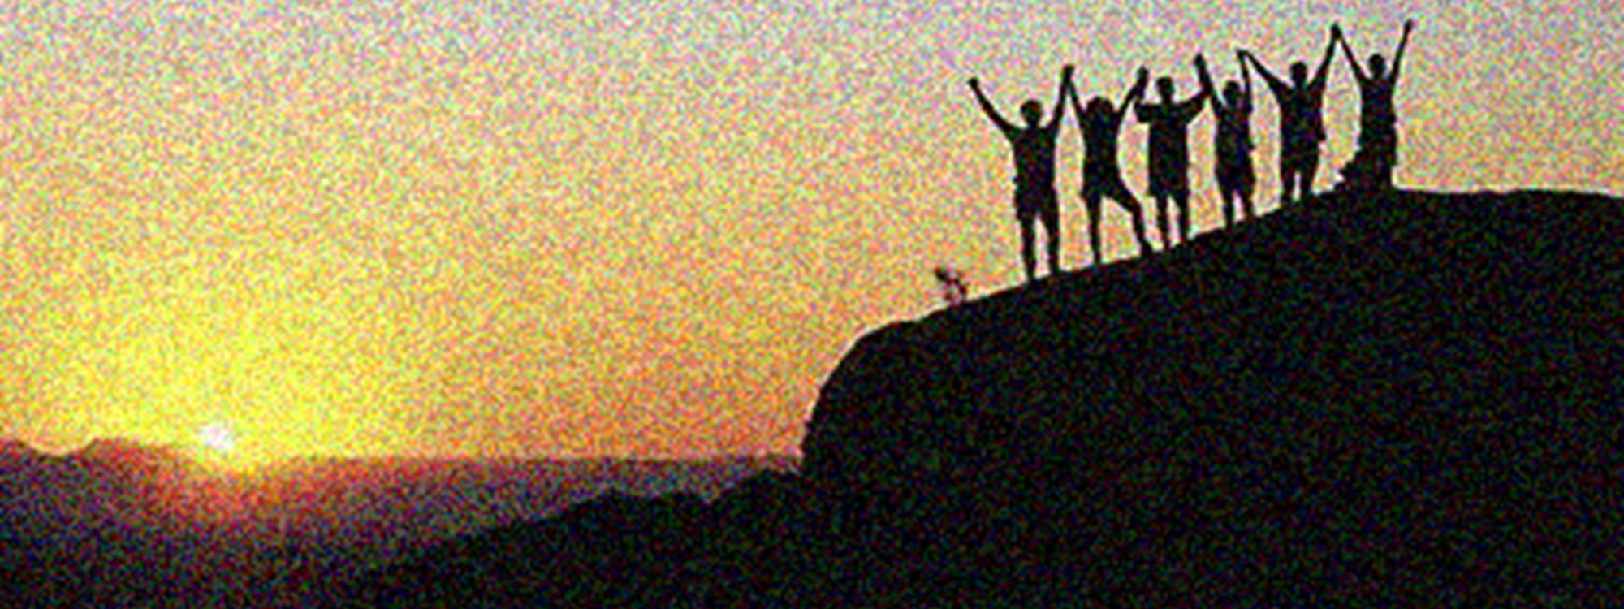
OUTLINE
MORE THAN CONQUERORS
The Gospel
We All Need The Gospel
We Can Be Righteous
We Are Dead to Sin
We Are Free
We Have All We Need
We Are The Children of Promise
We Must Be Changed
Paul's Plans
Greetings and Closing

Slide 4
OVERVIEW
MORE THAN CONQUERORS
We Must Be Changed (12:1-15:7)
God’s mercy requires something of us
Sacrificial service
True brotherly love
Submission
Government and each other
“And do not be conformed to this world, but be transformed by the renewing of your mind, that you may prove what is that good and acceptable and perfect will of God.” (12:2)

Slide 5
Wednesday:
We Must Be Changed
Why Do You Judge Your Brother (14:1-13)
“And do not be conformed to this world, but be transformed by the renewing of your mind, that you may prove what is that good and acceptable and perfect will of God.” (12:2)

Slide 6
Romans 14:1-13
MORE THAN CONQUERORS
Issues likely due to Jew/Gentile context (15:8-9)
Some Jews cling to dietary restrictions of Law of Moses
Jew/Gentiles concern of meat offered to idols (1 Cor. 8)
Some Jews cling to “Days” in the Law of Moses (Gal. 4)
Like today, Christians come from different backgrounds
All things under consideration are approved of God
The discussion is on differing personal action in areas of liberty
Romans 14 is not a catch-all for “doctrinal disputes”
“faith” – subjective personal belief, conscience, scruples, etc.
“let each be fully convinced in his own mind” Rom. 14:5

Slide 7
Romans 14:1-13
MORE THAN CONQUERORS
Foundational Teaching
Don’t be arrogant about your own opinions
12:3, 16
Genuinely love your brethren
12:9, 10, 16
Love does no harm to a neighbor (13:8-10)
We should not fulfill our own desires (13:11-14)
To have my way
To have my opinion accepted and validated

Slide 8
Questions or comments?

Slide 9
Romans 14:1-13
MORE THAN CONQUERORS
Receive one who is weak in faith (1)
But not:
to disputes over doubtful things -NKJV
for the purpose of passing judgment on his opinions -NASB
to quarrel over opinions -ESV
for decision of scruples -ASV
quarreling over disputable matters -NIV
to determinations of reasonings -YLT
to work on them until they agree with you -BMV*

Slide 10
Romans 14:1-13
MORE THAN CONQUERORS
God has received him (2-4)
The one who believes he may eat (strong in conscience)
Includes Paul (14:14, 15:1), calls for love not arrogance
Don’t treat with contempt the one who does not eat
The one who does not eat (weak in conscience)
Eats only herbs (to avoid “unclean” meat)
Don’t condemn him who eats
Who are either one of you to judge another’s servant?
Each will be judged by their own Master

Slide 11
Romans 14:1-13
MORE THAN CONQUERORS
Another illustration of the principle (5-6)
One treats one day as special, one treats every day same
Each must fully convinced in his own mind (strong)
Both act out of regard for the Lord
In the previous example, one ate and one did not eat, but both are acting out of regard for the Lord
Each does what he does and “gives God thanks”
Leave the judging to the Master who can make each stand
God knows His servants personal beliefs (2), mind (5), and attitude (6)

Slide 12
Romans 14:1-13
MORE THAN CONQUERORS
We don’t live or die for ourselves (7-9)
Our primary focus should be our responsibility to God
Focus on pleasing our Master not judging His other servants
We don’t live to satisfy ourselves
Or dispute with our brethren over opinions
When we die our relationship to the Lord will matter
Not our ability to get brethren to “line up” with our views
That’s why Christ died and rose, to be our Lord
In life and in death

Slide 13
Romans 14:1-13a
MORE THAN CONQUERORS
Now, why do you judge your brother?? (10-13)
Why do you show contempt for your brother?
Whom Christ died and rose for too
Ultimately, we all will face the same Judge
“every knee shall bow… every tongue shall confess” (Isa. 45:23)
Each of us will be giving our account of ourselves to God
You and your brother whom you love
Let’s stop judging one another’s opinions
Instead, let’s help each other be ready for judgment

Slide 14
We Must Be Changed
Receive One Another (14:13b-15:7)
“And do not be conformed to this world, but be transformed by the renewing of your mind, that you may prove what is that good and acceptable and perfect will of God.” (12:2)

Slide 15
Romans 14:14-15:7
MORE THAN CONQUERORS
Let’s focus on not causing our brother to sin (13b-18)
Nothing is unclean in and of itself
But, if one is not “fully convinced” it is unclean to that individual
Still, if the exercise of my “right” causes by brother to sin
I am not walking in love
I turn something “good” into something that destroys my brother
Choosing my rights over my brother is not kingdom living
Choose to serve Christ instead of self
That is acceptable to God
That attitude will bring unity

Slide 16
Romans 14:14-15:7
MORE THAN CONQUERORS
Pursue peace and things that build up (19-23)
Don’t destroy your brother…
“the work of God”/“for whom Christ died”(15)/God’s “servant” (4)
… for the sake of a liberty
Give up any liberty that might cause your brother to sin
Even if your “faith” approves a personal practice
Happily keep that to yourself, rather than hurt your brother
And, in harming your brother, condemn yourself
Remember, if one can’t “eat from faith”, he sins

Slide 17
Romans 14:14-15:7
MORE THAN CONQUERORS
Strength is measured by what it does not do (15:1-3)
The duty of the “strong brother”
Demonstrate your strength with patience toward others
Not in exercise or defense of strong personal convictions
Put our neighbors needs above our own
Value building others up above pleasing self
Putting others before self is what Christ did
And was prophesied to do (Ps. 69:9)

Slide 18
Romans 14:14-15:7
MORE THAN CONQUERORS
Our hope is bound up in His example (15:4-7)
Learn from what has been revealed about the Christ
About God’s patience, love and forbearance
About the character God desires in His people
About God’s faithfulness to deliver His people
Let these things comfort us with hope
And teach us to live with patience
Be like-minded toward one another, in accord with Christ
Receive one another, “as Christ has also received us”

Slide 19
OVERVIEW
MORE THAN CONQUERORS
Paul's Plans (15:8-33)
His “aim” to preach the gospel
His plans to come to Rome
Greetings and Closing (16:1-27)
Personal salutations
Final exhortations
16:25-27

Slide 20
Thank you for your attention and participation

