Slide 1

Singles & Their Churches:
Helping Each Other Grow in Love

Slide 2
Percentage of Americans ages 18 years old or older who were married:
Chart: The Pew Research Center using US Census Data, September 2017
Notes:
AT FIRST GLANCE, THIS CHART MIGHT BE A GOOD THING. PEOPLE ARE WAITING UNTIL THEY ARE OLDER THAN 18 TO GET MARRIED! I THINK MOST 18 YEAR OLDS WOULD AGREE THAT THEY AREN’T QUITE READY FOR THE RESPONSIBILITIES OF MARRIAGE AT THAT AGE.

Slide 3
Percent of men and women ages 25 and older who have never been married.
Chart: The Pew Research Center using US Census Data, September 2014
Notes:
THE LAST CHART AGREES WITH THIS ONE, THAT BOTH MEN AND WOMEN ARE WAITING LATER THAN 18 TO GET MARRIED.

Slide 4
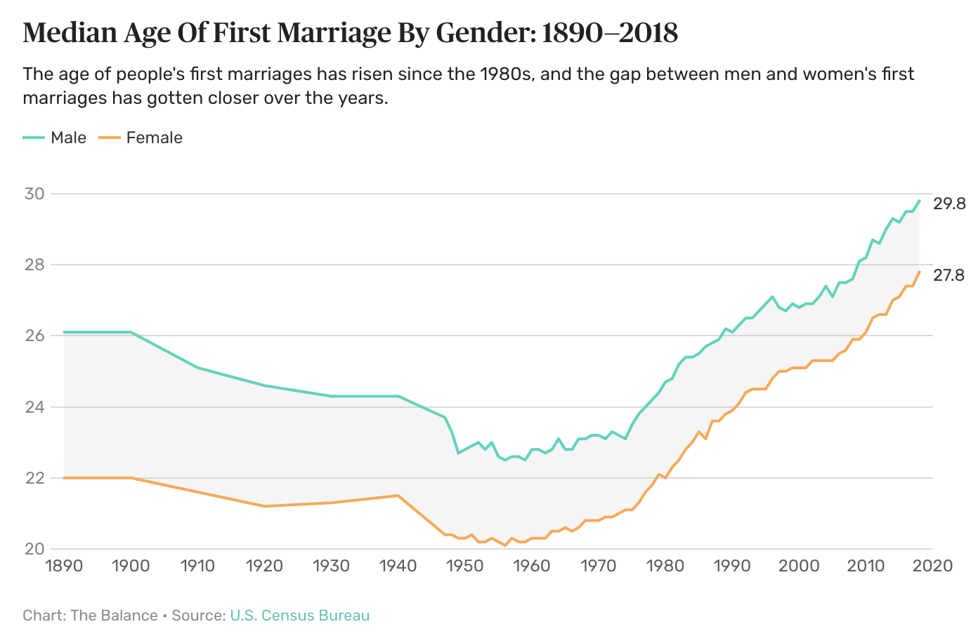
Notes:
EVEN THOSE WHO DO GET MARRIED ARE WAITING LATER AND LATER. IN THE MID-1900’S BOTH MEN AND WOMEN WERE GETTING MARRIED AT RELATIVELY YOUNG AGES. THAT IS NO LONGER THE CASE! SOME DON’T GET MARRIED AT ALL.

Slide 5
“Of all the many cultural shifts the church did not see coming down the pike – and possibly at the top of the list – may be the growth of singleness.”
- Owen Strachan
Notes:
Owen Strachan
Remember, these charts do not explore why there has been a societal shift to singleness. All these charts do is track what HAS happened. It is not our goal this weekend to dissect the causes, but to explore the facts: people are getting married later and later, or not at all.
LONG PAUSE…HOLD MY HAND UP TO MY EAR TO HEAR BETTER.
And I think I just heard a well-intentioned match-maker in the back say something like, “Challenge accepted!” =)
The fact that we just laughed reveals there is a kernel of truth in the joke. Actually, we are here this weekend to reevaluate what the Bible says about singleness and maybe learn that this season of life has more value and purpose; it isn’t a circumstance to be rescued from.

Slide 6
Let’s review some foundational, Bible truths:
REGARDING MARRIAGE:
1
Gen. 2:28
It is not good for man to be alone.
God created marriage, and it is good!
2
Marriage reflects a greater relationship, that of Christ with the church.
Eph. 5:22-33
Marriage reveals a greater mystery
3
Marriage should be a blessing to you and others.
Gen. 1:28, 2:24
There are blessings of marriage
4
Marriage can help guard against immorality, but requires self-control.
Heb. 13:4; 1 Cor. 7:1-5
Physical intimacy is a blessing
5
Not everyone chooses or is free to marry!
Matt. 19:10-12
Some chose singleness!
Notes:
Regarding Marriage:
Gen. 2:28 – It is not good for man to be alone
Eph. 5:22-33 – Marriage is to reflect X and the church. Marriage reveals a greater mystery.
Marriage is temporary! Specific marriages will only last as long as spouses live, but marriage itself as an institution is limited to the created world (Matt. 22:30, For in the resurrection they neither marry nor are given in marriage, but are like angels in heaven)! However, the church’s marriage to Christ will last into eternity!
Gen. 1:8 – There are blessings to being married. One of them is being able to have children. Song of Solomon. Rom. 7:1-5, stability and permanence. Gen. 2.24 & 1 Cor,. 6 – The blessing of the one-flesh dynamic.
Heb. 13:4; 1 Cor. 7:1-5 – Physical intimacy in marriage can guard against immorality, but marriage still requires self-control!
1Matt. 19:10-12 – Despite all of these things being true, some still choose singleness!

Slide 7
Let’s review some foundational, Bible truths:
REGARDING SINGLENESS:
1
1 Cor. 7:6-7
Singleness is good & glorifies God.
Being single is good!
2
Every Christian is a part of the ultimate marriage as a member of the bride of Christ!
Eph. 5:22-33
Belong to the greater relationship
3
Being single should be a blessing to you and others.
See the chart:
God uses singles in the kingdom!
4
1 Cor. 7:36-38
This is expected of every disciple
Being single requires self-control.
5
Those who choose singleness need to make sure it’s for the right reasons.
Matt. 19:10-12
Own the decision to God’s glory!
Notes:
Regarding singleness:
1 Cor. 7:6-7, 25-28 – Being single is a perfectly acceptable thing to be.
1 Eph. 5:22-33 – Every Christian is already a part of what earthly marriage points toward!
Chart – Being single is a blessing to you and to others
1 Cor. 7:36-38 – Self-control is required of every believer regardless of their marital status
Matt. 19:10-12 – Make sure your decision to be single is for the right reasons. Glorify God! You are saying that there is something more important to you than being a marriage with someone. And this is right!

Slide 8

Matt. 19:10-12 - NLT
“For there are eunuchs who have been so from birth, and there are eunuchs who have been made eunuchs by men, and there are eunuchs who have made themselves eunuchs for the sake of the kingdom of heaven. Let the one who is able to receive this receive it.”
Notes:
Jesus is saying three things here,
1) some people, outside of their control, were born without the ability to engage in physical intimacy,
2) some people, against their will, were made incapable of engaging in physical intimacy and
3) that some people chose to refrain from marital intimacy for the sake of the kingdom! I am about to say something that I expect to hear about later…Every unmarried adult in this room is currently single by choice.
Let me repeat myself…every unmarried adult in this room is currently single by choice.
S0, before anyone starts throwing tomatoes and calling me an insensitive jerk, let’s think through the statement as it relates to Matt. 19:12.
If you wanted to be married badly enough, you could be. You could fly to Las Vegas, find a willing stranger, pop into a wedding chapel and have an Elvis impersonator officiate your wedding. If you wanted, you could jump online and find someone willing to be a modern day mail-order spouse. The point is, if being MARRIED was your ultimate goal in life, you could be married in a relatively short period of time.
But why aren’t you married?
For some of our spiritual siblings, they are the surviving spouse. Their beloved husband or wife has died, and gone on to be with the Lord first. What every married couple In the room needs to realize, is that unless the Lord comes first, at some point in our futures many of us will be single again.
Others have gone through a divorce. People in that situation are either Biblically free to remarry but have chosen not to, or they believe the scripture does not give them the freedom to remarry.
And then there are those who have never been married. As we mentioned at the beginning of the sermon, in our country and our congregations, this group is growing.
Look at our verse again. According to Jesus, why are the people in the third category choosing not to get married? FOR THE SAKE OF THE KINGDOM.

Slide 9
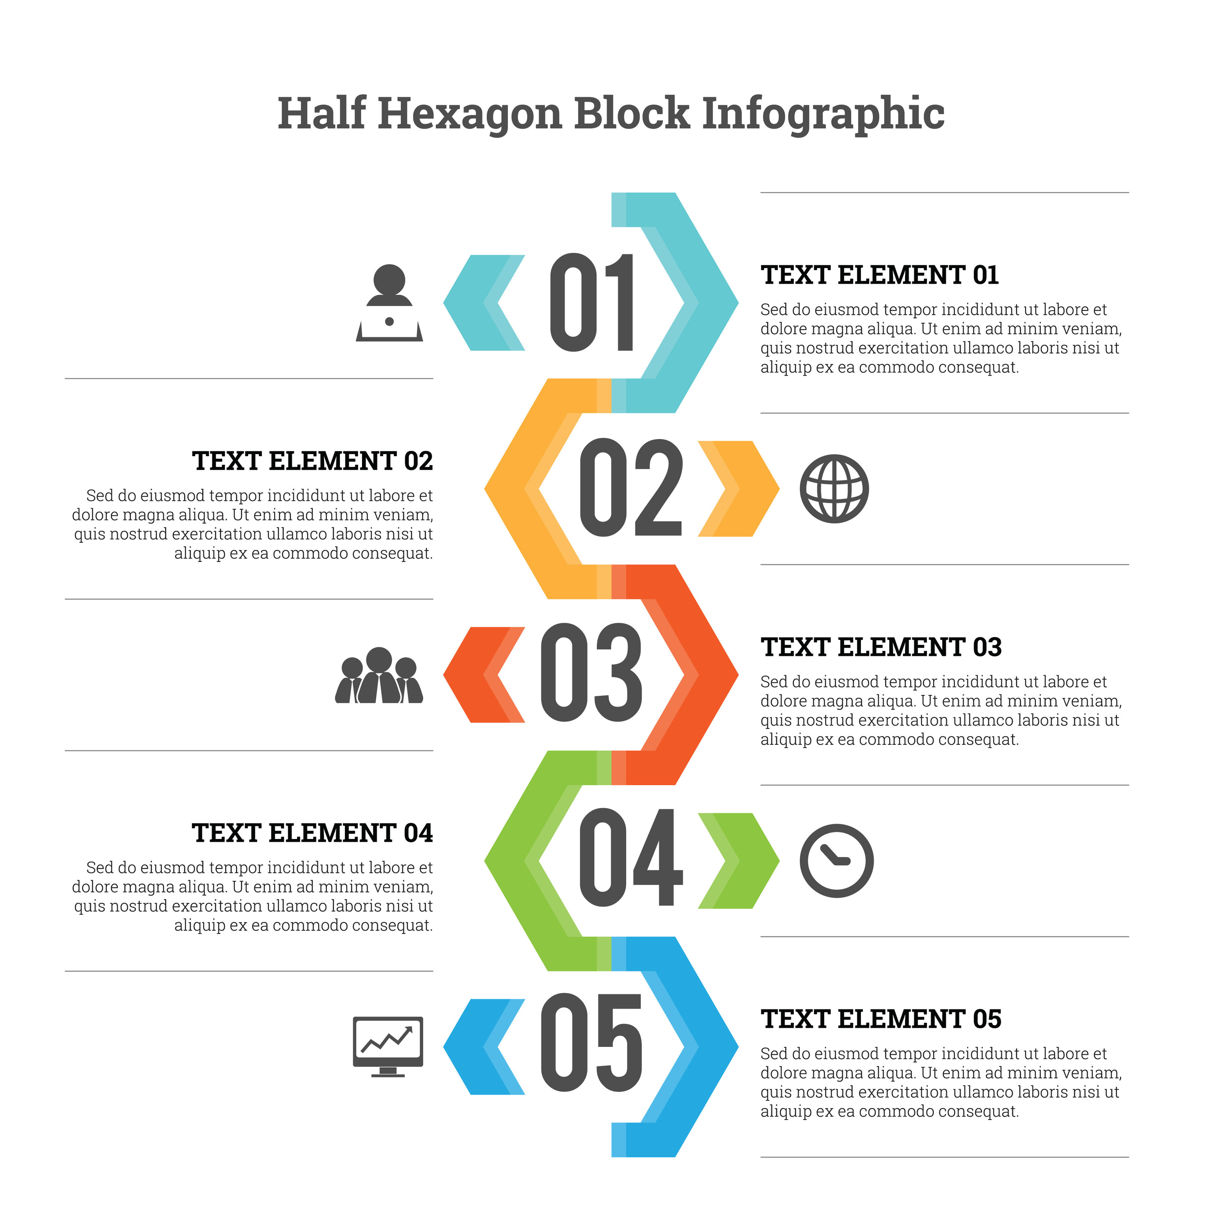





1 COR. 7:6-7
See yourself the way God sees you.
1 COR. 7:25-28
See the blessings of singleness!
1 COR. 7:29-31
Maintain a heavenward focus!
1 COR. 7:32-35
Serve with less distraction.
1 COR. 7:36-38
Identify the struggles of this season of life.

Slide 10

How does God see you?
To: You
From: God
“I wish that all were as I myself am. But each has his own gift from God, one of one kind and one of another.”
1 Cor. 7:7
sdsdf
Notes:
God does not see you as somehow less
God does not see you as broken
He sees you in a circumstance in life that is precious and valuable! Make the most of it for Him! Don’t waste it. You are not in some kind of in between stage of life, although it can feel that way.
You have been entrusted with something of which you will have to give an account someday. Steward this season of life well!!!
There is a temptation to see yourself the way that others might:
Can I offer a phrase that might help?
YOU ARE MORE THAT YOUR RELATIONSHIP STATUS
There is so much more to you as a person, as an image bearer of God, than whether or not you single, dating, engaged or married!
Our relationship status should not be the defining aspect of our lives!
Whether we are in Christ or not is the most important thing in God’s eyes! Are you in Christ?

Slide 11

sdv
dv
  “Isn’t she just the sweetest thing? How on earth is she still single?”
  “He’s single, but he still has great leadership potential.”
  “No, I’m not married. Just single.”
Notes:
What is one of the reasons we need to talk about this together?
Consider the following statements you may have heard someone make.
We need to talk about this together because well-intentioned siblings in Christ may have a different perspective on singleness that is not the most helpful, and if that’s the case, out of love for them we need to become aware of that and see what we can do to better serve them…
Let’s think about the following chapter in Matthew together to realize how important the church family is in the life of every Christian, but especially those who are single.

Slide 12
1 COR. 7:6-7
See yourself the way God sees you.
1 COR. 7:25-28
See the blessings of singleness!
1 COR. 7:29-31
Maintain a heavenward focus!
1 COR. 7:32-35
Serve with less distraction.
1 COR. 7:36-38
Identify the struggles of this season of life.

Slide 13
Singles & Their Churches:
Helping Each Other Grow in Love
Notes:
Let’s get back to the title of the lesson, ”Singles and Their Churches”. So far we have been trying to develop a more Biblical perspective on what God says about singleness and how he sees singleness as a gift.
What about local congregations? How does God call on us to serve and build relationships with each other?

Slide 14

Matt. 19:29
“And everyone who has left houses or brothers or sisters or father or mother or children or lands, for my name’s sake, will receive a hundredfold and will inherit eternal life.”

Slide 15

Get to know them
Initiate discipleship
Ask, “How can I pray for you?”
Utilize singles in the church
Recognize their need for intimacy
Give them chances to lead
Reach out to them at assemblies
… assume singleness defines them
… start another program
… pray on your assumptions
… make them workhorses
… assume that relational intimacy is only met in the context of marriage
… wait until they’re married to ask them to lead
… reduce singles to a “project”
Notes:
Developing a congregational culture of hospitality
Encourage friendships that cross generational and marital divides.

