Slide 2
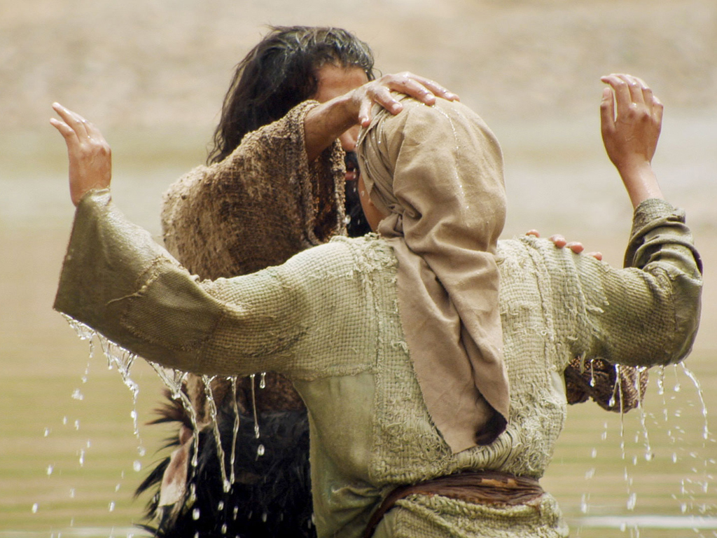
Profiles in Holiness
John the Baptist:
“Behold the Lamb of God!”

