Slide 2
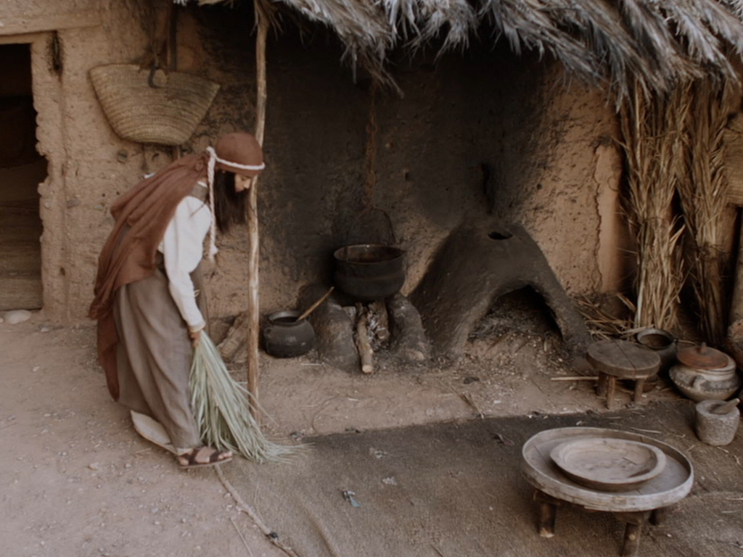
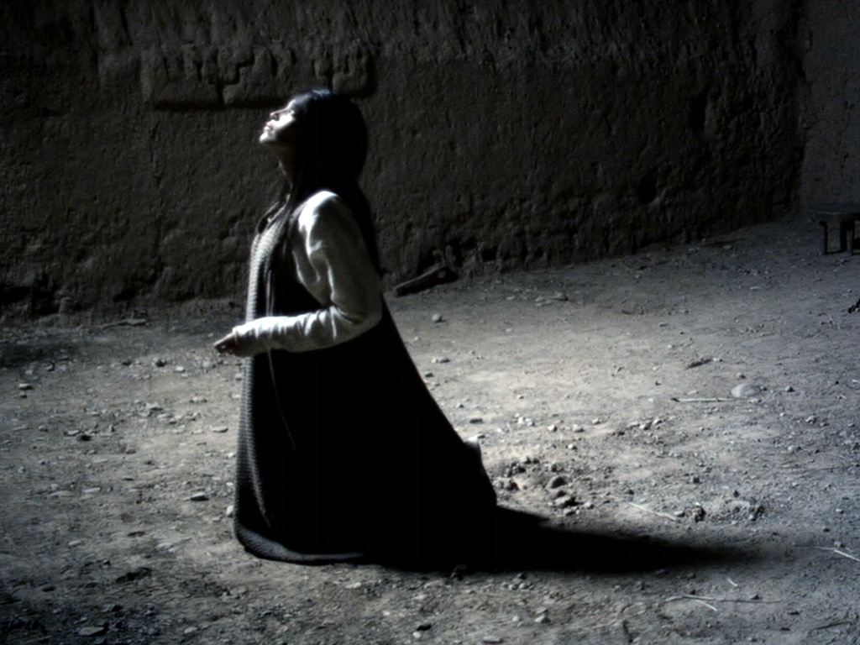
Profiles in Holiness Mary: Highly Favored

Slide 3
