Slide 2
Forgiveness & Mercy
Tonight’s Theme
Parables:
Vineyard workers
Two Debtors
Unforgiving servant
Pharisee and Publican

Slide 3
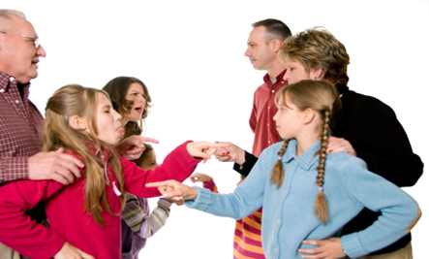
Forgiving One Another
We should be ready to forgive because…

Slide 4
We Need Mercy Ourselves
We need God’s mercy (Matt. 18:23-27)

Slide 5
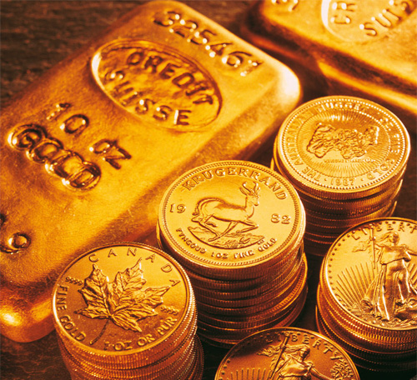
“one was brought to him who owed him ten thousand talents.”
Talent = 71 lbs.
Gold ($1340 / oz) (silver is $21)
16 oz X $1340 = $21,440 (pound)
Talent = $1,522,240
10,000 Talent (gold) = $15.2 Billion (Silver: $238M)

Slide 6
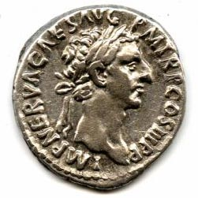
“one of his fellow servants owed him a hundred denarii” (vv. 28-30)
The basic unit of Roman coinage was the silver denarius, probably equal to a laborer's daily wage
Nelson's Bible Dictionary

Slide 7

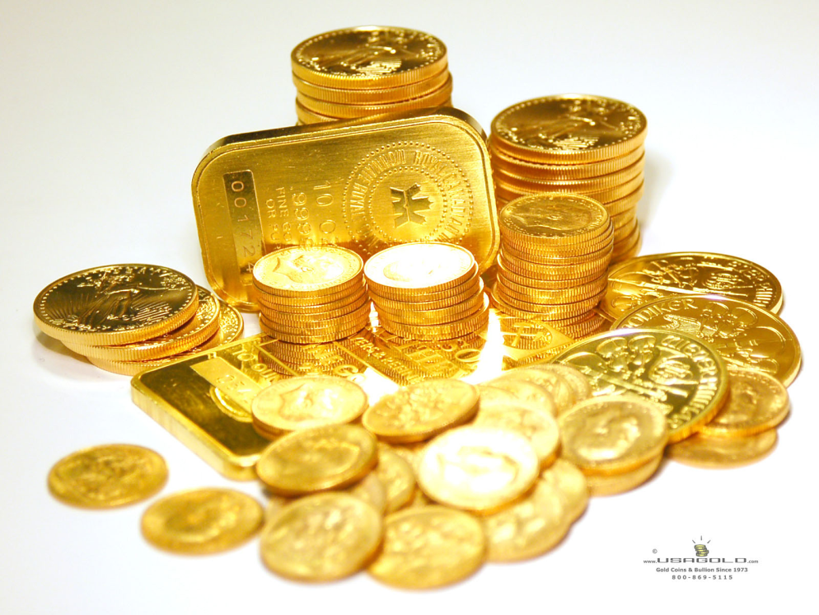
10,000 Talents
100 Denarii
$15 Billion
Forgiven
$150
Won’t Forgive!!

Slide 8
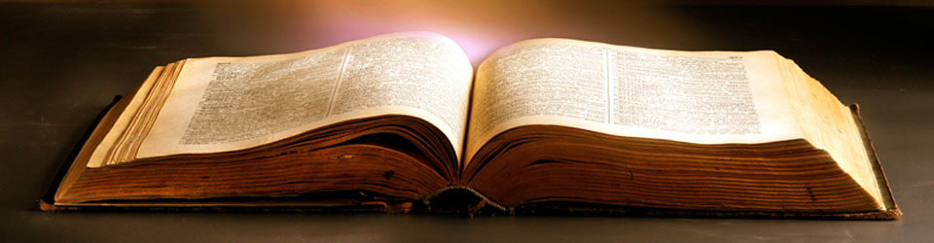
But now having been set free from sin, and having become slaves of God, you have your fruit to holiness, and the end, everlasting life. For the wages of sin is death, but the gift of God is eternal life in Christ Jesus our Lord.
Rom. 6:22-23

Slide 9
We Need Mercy Ourselves
We need God’s mercy (Matt. 18:23-27)
We must show the same to others (vv. 32-35; vv. 21-22)
Song # 394
Love One Another

Slide 10

God Commands It
Affects His Forgiving Us (Mark 11:25-26)
We Must Work Out Problems (Matt. 5:23-24)
Song # 219
How Sweet, How Heavenly

Slide 11

Love Demands It
God forgave us with tender mercy (Col. 3:12-13)
God’s people love and forgive (Matt. 5:43-48)
Song # 302
Blest Be The Tie

Slide 12
Forgiving One Another
We should be ready to forgive because…
We Need Mercy Ourselves
God Commands It
Love Demands It

Slide 13
For You, Lord, are good, and ready to forgive, and abundant in mercy to all those who call upon You.
Psa. 86:5

Slide 14
What Must I Do To Be Saved?
Hear the gospel (Rom. 10:17)
Believe Jesus is Christ (John 3:16)
Repent of your sins (Acts 17:30)
Confess your faith (Rom. 10:9, 10)
Baptized for forgiveness (Acts 2:38)
Be faithful unto death (Rev. 2:10)

