Slide 2
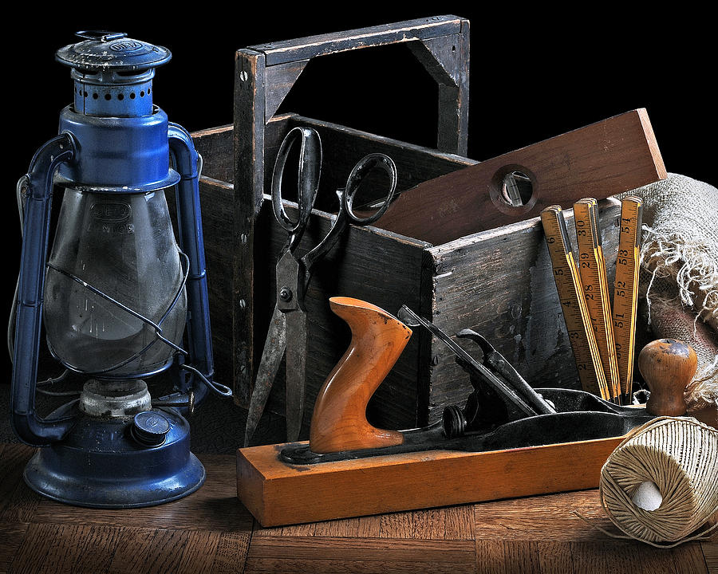
Tonight’s Theme: Service & Work
Good Samaritan
Two Sons
Talents
Rich Fool

Slide 3
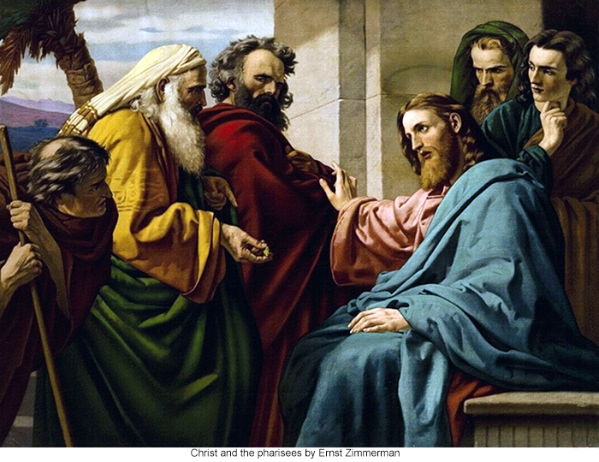
Luke 10:25-37
Notes:
Jesus was “tested” by Jews who wanted to make Him appear incompetent and unlearned (Luke 10:25-27)
Man knew the law and quoted it correctly … Jesus acknowledged (v. 27) [Lev. 19:17-18; Deut. 6:5]
Wanted to justify himself for not demonstrating

Slide 4
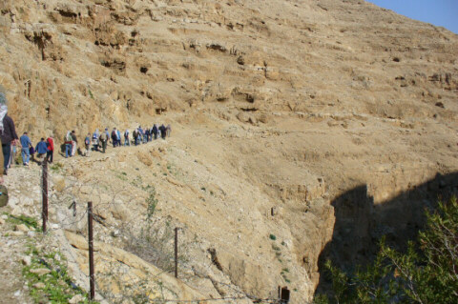
Road from Jericho to Jerusalem
Notes:
Distance from Jerusalem to Jericho is less than 20 miles, but the road drops nearly 3,600 feet … “went down from Jerusalem” (v. 30): accuracy of Bible
Known as “The Red Way” or “The Pass of Blood” … because of danger of travel … many steep drops and narrow spaces … notorious for bandits
According to William Barclay, Even as recent as 19th century, “travelers had to pay local sheiks for protection before they could travel on it safely”
Ex.: dark alley at night … not unless absolutely necessary … no other way between Jerusalem and Jericho w/o going long distances around … hope for the best in taking shorter, easiest route

Slide 5
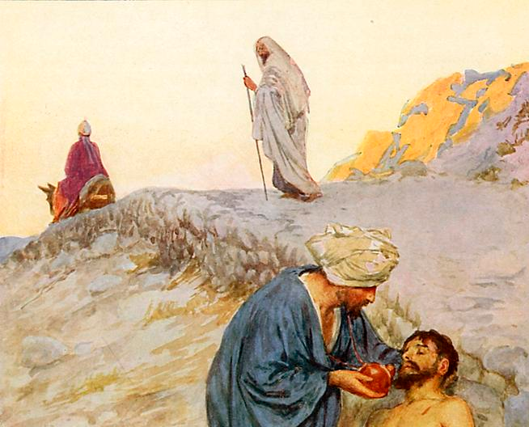
The Good Samaritan
Three Philosophies of Giving

Slide 6
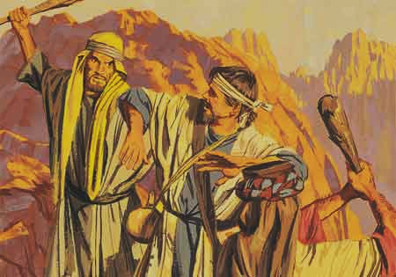
What’s Yours is Mine
Philosophy of the
Thieves
Luke 10:30

Slide 7
What’s Yours is Mine
Work for Increase (Eph. 4:28)
No Pilfering (Titus 2:10)
Gambling (Rom. 13:9-10)

Slide 8
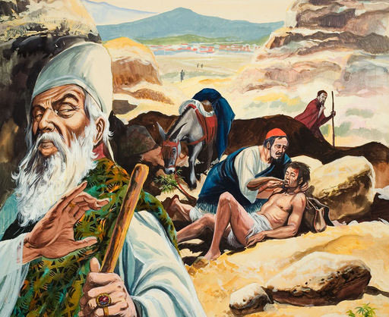
What’s Mine is Mine
Philosophy of the
Jews
“passed by on the other side”
(vv. 31-32)

Slide 9
Sons of Israel
Reuben, Simeon, Levi, Judah, Issachar, Zebulun, Joseph, Benjamin, Dan, Naphtali, Gad, Asher
-Gen. 35:23-26
Levites
Servants / assistants to priests (Num. 3:6)
Aaron
Priesthood (Num. 3:10)

Slide 10
Priest
Should Have Compassion (Heb. 5:2-3)
Levite
To lead people in serving God (Deut. 17:9-11)
Christian
(1Pet. 2:9-12)

Slide 11
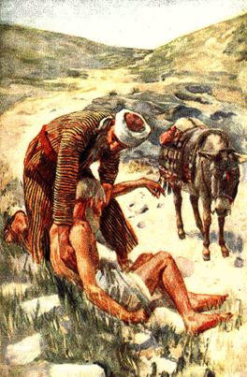
Pro. 21:13
Whoever shuts his ears to the cry of the poor will also cry himself and not be heard.

Slide 12
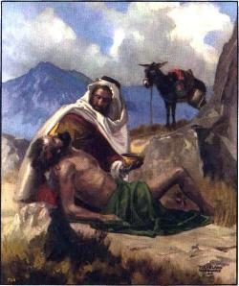
What’s Mine is Yours
Philosophy of the
Samaritan

Slide 13
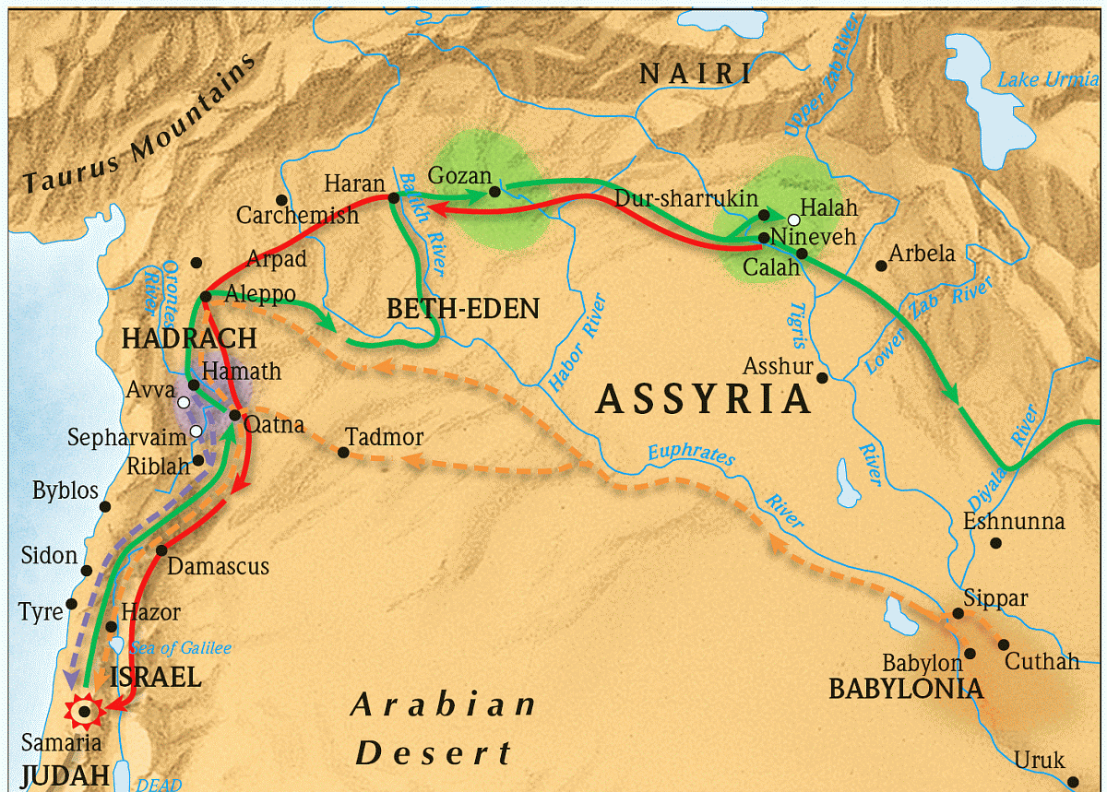
Descendant of Israelites in Assyrian Captivity; mixed race
Hostility
(John 4:9)

Slide 14
Division Between Samaritans & Jews
Not permitted to help in rebuilding Temple in 536 BC
Ezra 4:1-5
John Hyrcanus destroyed Samaritan temple at Mt. Gerizim in 110 BC … forced conversions

Slide 15
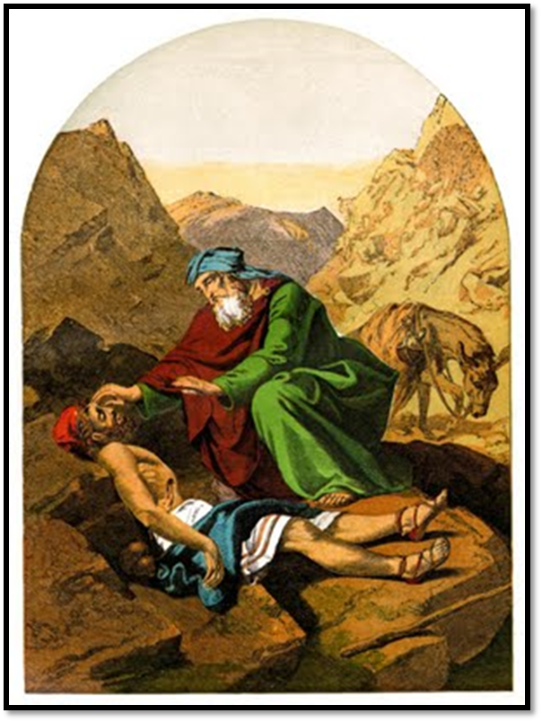
Not every Samaritan righteous, not every Levite uncaring
(Luke 9:52-53; Acts 4:36)
He demonstrated genuine compassion and love for a neighbor
(Luke 10:35)

Slide 16
Genuine Compassion
Samaritan sacrificed his own:
“as he journeyed” (plans)
“bandaged” (supplies)
“own animal” (comfort)
“took care” (rest)
“next day” (time)
“to the innkeeper” (money)
“come again” (future efforts)
GOOD
Samaritan
Luke 10:33-36

Slide 17
“Be merciful, just as your Father is merciful.”
Luke 6:36

Slide 18
“Pure and undefiled religion before God and the Father is this: to visit orphans and widows in their trouble, and to keep oneself unspotted from the world.”
James 1:27

Slide 19
Most Meaningful Life
“…Tabitha, which is translated Dorcas. This woman was full of good works and charitable deeds which she did.”
“… And all the widows stood by him weeping, showing the tunics and garments which Dorcas had made while she was with them.” --Acts 9:36, 39

Slide 20
God Loves…
Giving
“But do not forget to do good and to share, for with such sacrifices God is well pleased.”
–Heb. 13:16

Slide 21
God Loves…
Cheerful Giving
“So let each one give as he purposes in his heart, not grudgingly or of necessity; for God loves a cheerful giver.”
--2 Cor. 9:7

Slide 22
Three Philosophies of Giving
What’s Yours Is Mine (thieves)
What’s Mine Is Mine (Jews)
What’s Mine Is Yours (Samaritan)
GOOD
Samaritan
Luke 10:33-36

Slide 23
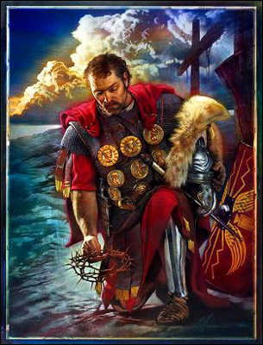
Feared God, Helped others (Acts 10:1-2)
Needed Forgiveness of Sin (11:13-14)
Obeyed Gospel (10:48)
Salvation in Christ (Col. 1:14)
Cornelius

