Slide 2
Mustard Seed
Leaven
Treasure / Pearl

Slide 3
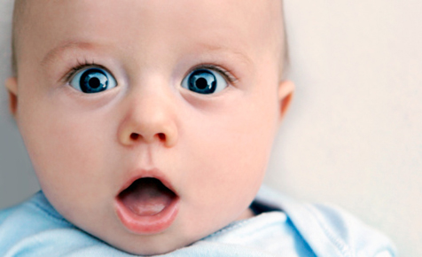
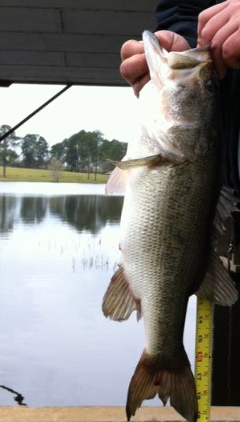
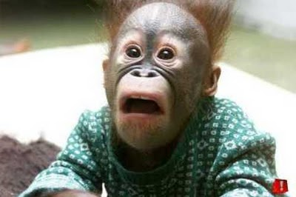

Slide 4
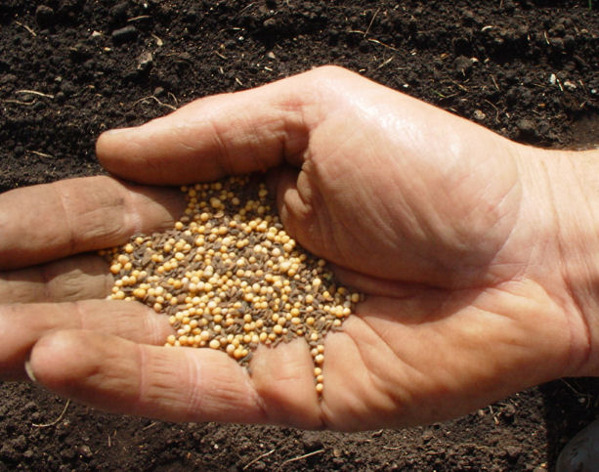
Parable
Mustard
Seed
Mark 4
Notes:
In what way is the kingdom of God like a mustard seed? -Mark 4:30-32

Slide 5
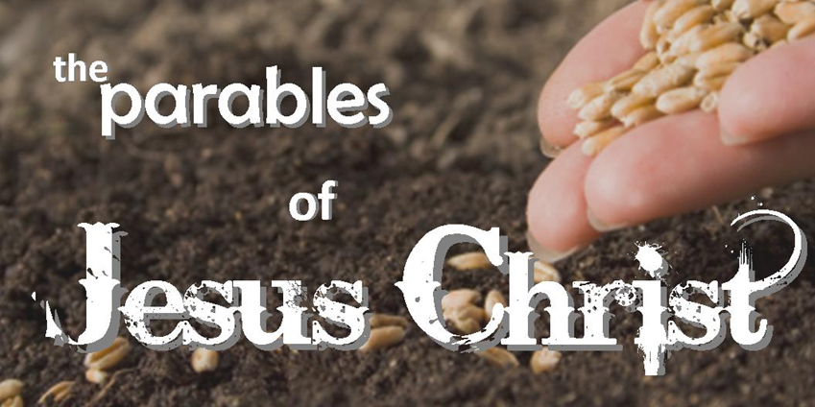
Jesus use of “seed” in Parables
The Sower (Mark 4:2-20)
Growing Seed (vv. 26-29)
Mustard seed (vv. 30-32)
Wheat and Tares (Matt. 13:24-30)

Slide 6
Seed Produces Growth
Context: Parable on “growing seed” (Mark 4:26-29)
Men must be taught God’s word
(John 6:45; Rom. 1:16-17; 10:14-17)
Notes:
Parable on growing seed … seed produces growth

Slide 7
Titus 1:2-3
in hope of eternal life which God, who cannot lie, promised before time began, ³ but has in due time manifested His word through preaching, which was committed to me according to the commandment of God our Savior;

Slide 8
Christ’s Kingdom Will Grow
Began “small” but spread globally (Mark 4:31-32; Acts 1:8; 21:20)
Is still growing
(1 Pet. 1:23-25)
Notes:
Jesus spoke this parable to prepare His disciples for the global results produced by His kingdom
Many rejected Him during His earthly ministry (John 12:42-43) … Christianity was first viewed as another obscure religion (Acts 24:5, 14)
Ex.: Shakers … once a moderately influential religion is now dead and inactive … religions come & go all the time
Christianity grew from 3,000 on Pentecost in Jerusalem to 5,000 (Acts 4:4) … to myriads (21:20) … to generations … to Bowling Green
When we offer someone the gospel, we are offering them something that began in Jerusalem 2,000 years ago … Seed will continue to thrive

Slide 9
Isaiah 55:11
So shall My word be that goes forth from My mouth; it shall not return to Me void, but it shall accomplish what I please, and it shall prosper in the thing for which I sent it.

Slide 10
Power is in the Seed
Word converts, saves (Jas. 1:21)
Power to save is in God, not us
(1 Cor. 3:5-7)

Slide 11
What is the main lesson of these parables?
God’s people should faithfully teach His word –
leaving the results to God
(1 Cor. 3:6-9)

Slide 12
How does the body / kingdom of Christ grow?
When members relocate (or) when souls converted to Lord?
Luke 17:20-21

Slide 13
What makes a balloon grow?
Squeezing one side or adding more air?
How does the body / kingdom of Christ grow?
Adding souls to Christ!
(Acts 2:47)

Slide 14
To be in Christ’s church is to be in His kingdom! (Col. 1:13-14)
Church is His body (Eph. 1:22-23)

Slide 15
Sometimes attendance #s do not reflect kingdom growth
We may plant & water what another will reap (1 Cor. 3:6)
Glory be to God … His kingdom is increased! (v. 7)

Slide 16
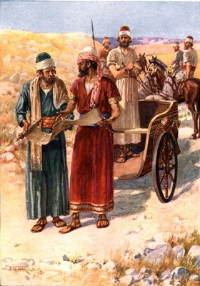
Converted a man who would not attend same local church
But both were brothers in kingdom of Christ!
Acts 8:36-38

Slide 17
But when they believed Philip as he preached the things concerning the kingdom of God and the name of Jesus Christ, both men and women were baptized.
Acts 8:12

Slide 18
Conversions in Acts
TAUGHT BELIEVE REPENT CONFESS BAPTISM
2:38-40
8:12-13
8:26-39
9:1-18
10:34-48
16:14-15
16:25-34
18:8
19:1-5
P
P
P
P
P
P
P
P
P
P
P
P
P
P
P
P

