Slide 2
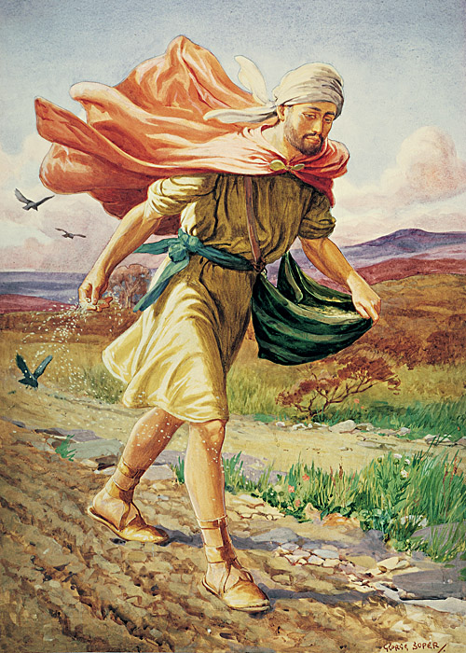
A Ready Heart
Tonight’s Theme
Parable of Sower
Parable of Wheat & Tares
Parable of Ten Virgins

Slide 3
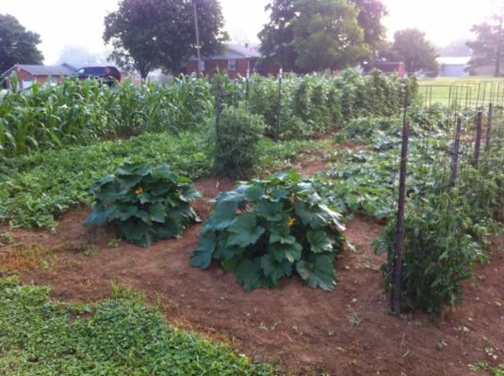
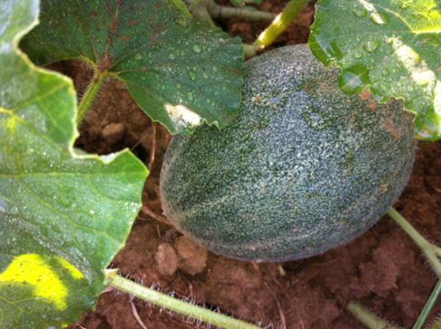
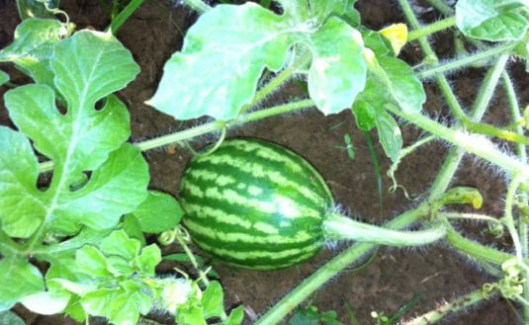

Slide 4
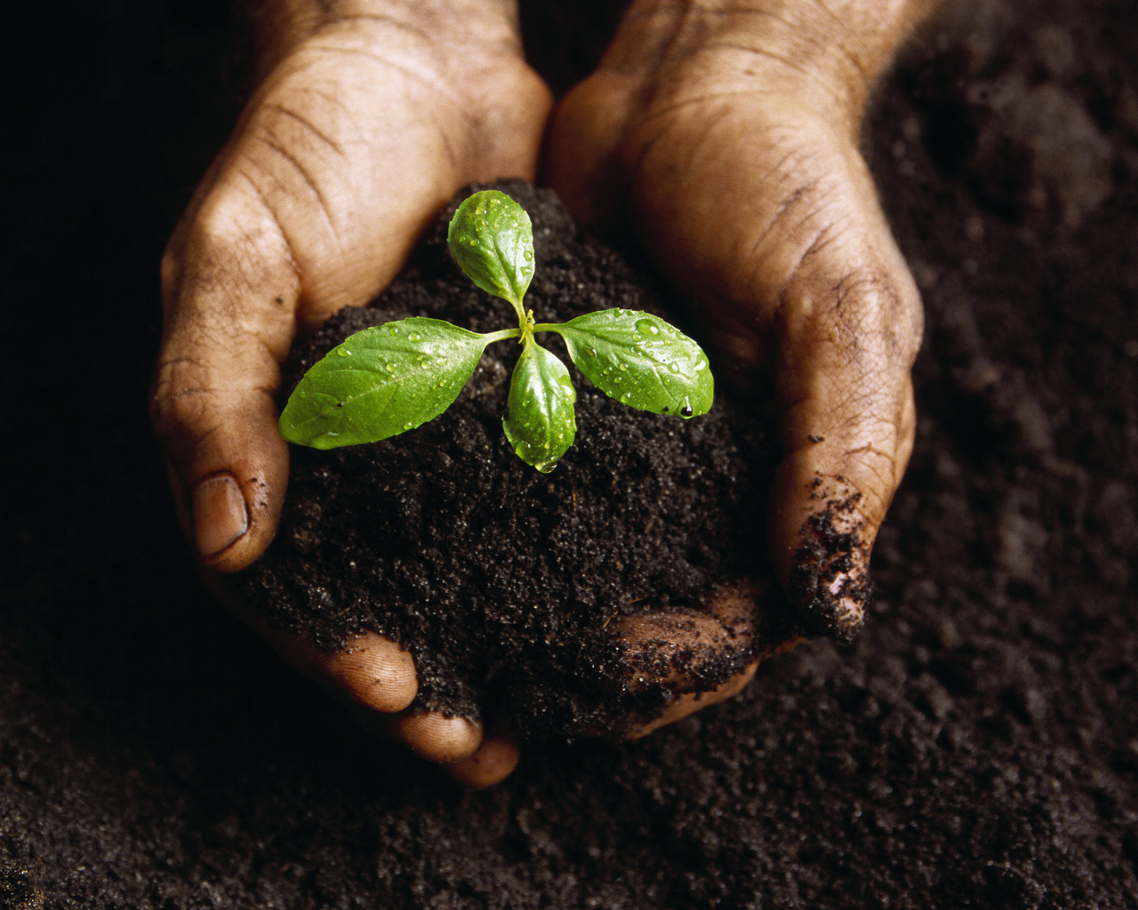
What Gardening Has Taught Me About God
Notes:
To insert this slide into your presentation
Save this template as a presentation (.ppt file) on your computer.
Open the presentation that will contain the image slide.
On the Slides tab, place your insertion point after the slide that will precede the image slide. (Make sure you don't select a slide. Your insertion point should be between the slides.)
On the Insert menu, click Slides from Files.
In the Slide Finder dialog box, click the Find Presentation tab.
Click Browse, locate and select the presentation that contains the image slide, and then click Open.
In the Slides from Files dialog box, select the image slide.
Select the Keep source formatting check box. If you do not select this check box, the copied slide will inherit the design of the slide that precedes it in the presentation.
Click Insert.
Click Close.

Slide 5
Soil Must Be Prepared
Much resistance to seed
Gen. 3:18

Slide 6
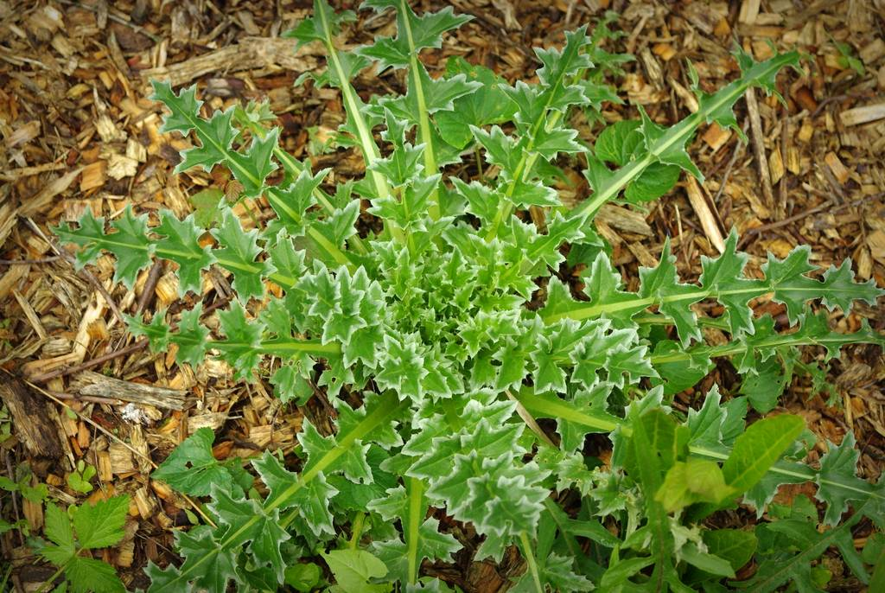
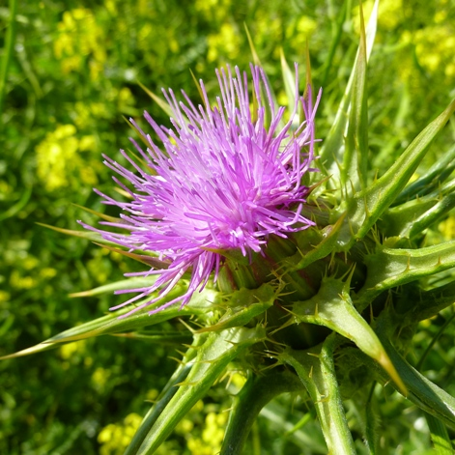
“Cursed is the ground for your sake; In toil you shall eat of it all the days of your life. Both thorns and thistles it shall bring forth to you…”
Genesis 3:18

Slide 7
Soil Must Be Prepared
Much resistance to seed
Gen. 3:18
Sin has cursed this world
Pro. 22:5

Slide 8
“Thorns and snares are in the way of the perverse; he who guards his soul will be far from them.”
Proverbs 22:5

Slide 9
Soil Must Be Prepared
Much resistance to seed
Gen. 3:18
Sin has cursed this world
Pro. 22:5
Men must be prepared to find God
1 Pet. 3:15

Slide 10
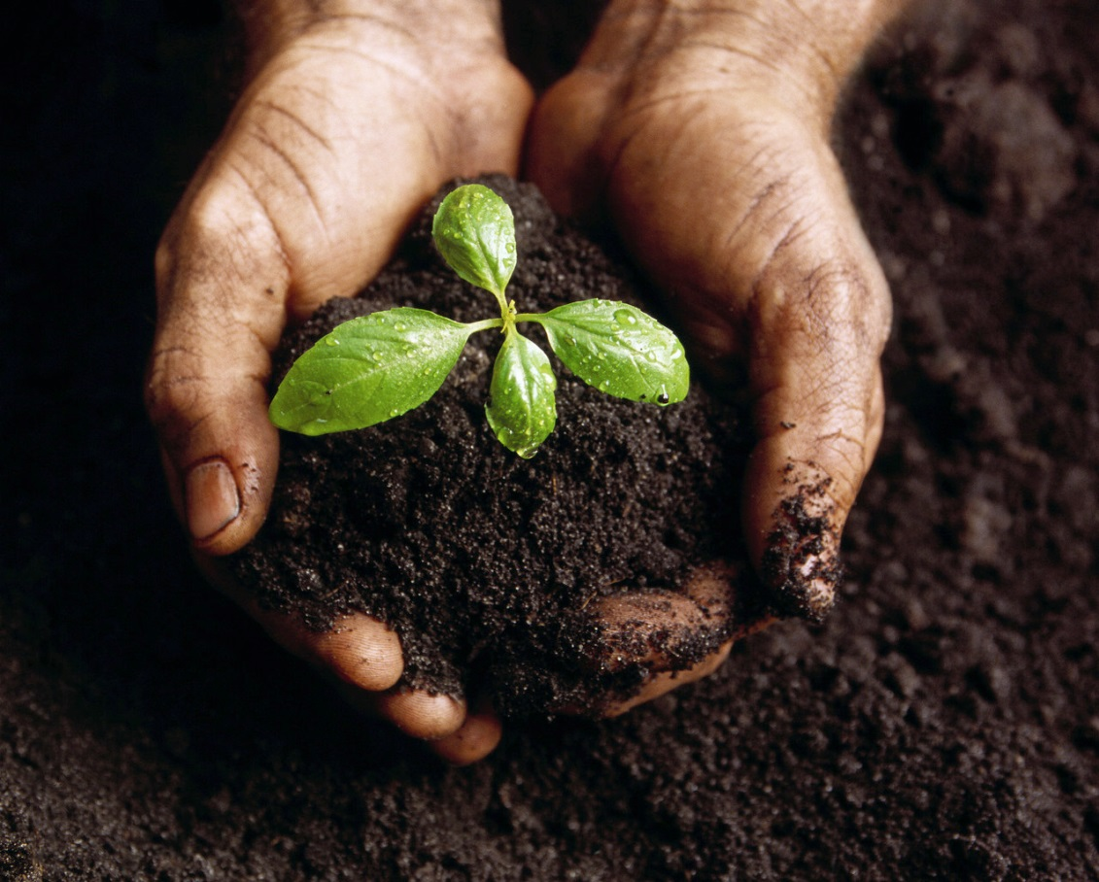
But sanctify the Lord God in your hearts, and always be ready to give a defense to everyone who asks you a reason for the hope that is in you, with meekness and fear;
1 Pet. 3:15
Notes:
To insert this slide into your presentation
Save this template as a presentation (.ppt file) on your computer.
Open the presentation that will contain the image slide.
On the Slides tab, place your insertion point after the slide that will precede the image slide. (Make sure you don't select a slide. Your insertion point should be between the slides.)
On the Insert menu, click Slides from Files.
In the Slide Finder dialog box, click the Find Presentation tab.
Click Browse, locate and select the presentation that contains the image slide, and then click Open.
In the Slides from Files dialog box, select the image slide.
Select the Keep source formatting check box. If you do not select this check box, the copied slide will inherit the design of the slide that precedes it in the presentation.
Click Insert.
Click Close.

Slide 11
And a servant of the Lord must not quarrel but be gentle to all, able to teach, patient, in humility correcting those who are in opposition…
2 Tim.
2:24-25
Notes:
To insert this slide into your presentation
Save this template as a presentation (.ppt file) on your computer.
Open the presentation that will contain the image slide.
On the Slides tab, place your insertion point after the slide that will precede the image slide. (Make sure you don't select a slide. Your insertion point should be between the slides.)
On the Insert menu, click Slides from Files.
In the Slide Finder dialog box, click the Find Presentation tab.
Click Browse, locate and select the presentation that contains the image slide, and then click Open.
In the Slides from Files dialog box, select the image slide.
Select the Keep source formatting check box. If you do not select this check box, the copied slide will inherit the design of the slide that precedes it in the presentation.
Click Insert.
Click Close.

Slide 12
Results Unpredictable
Not all soil receives seed
Luke 8:5-8
vv. 11-15

Slide 13
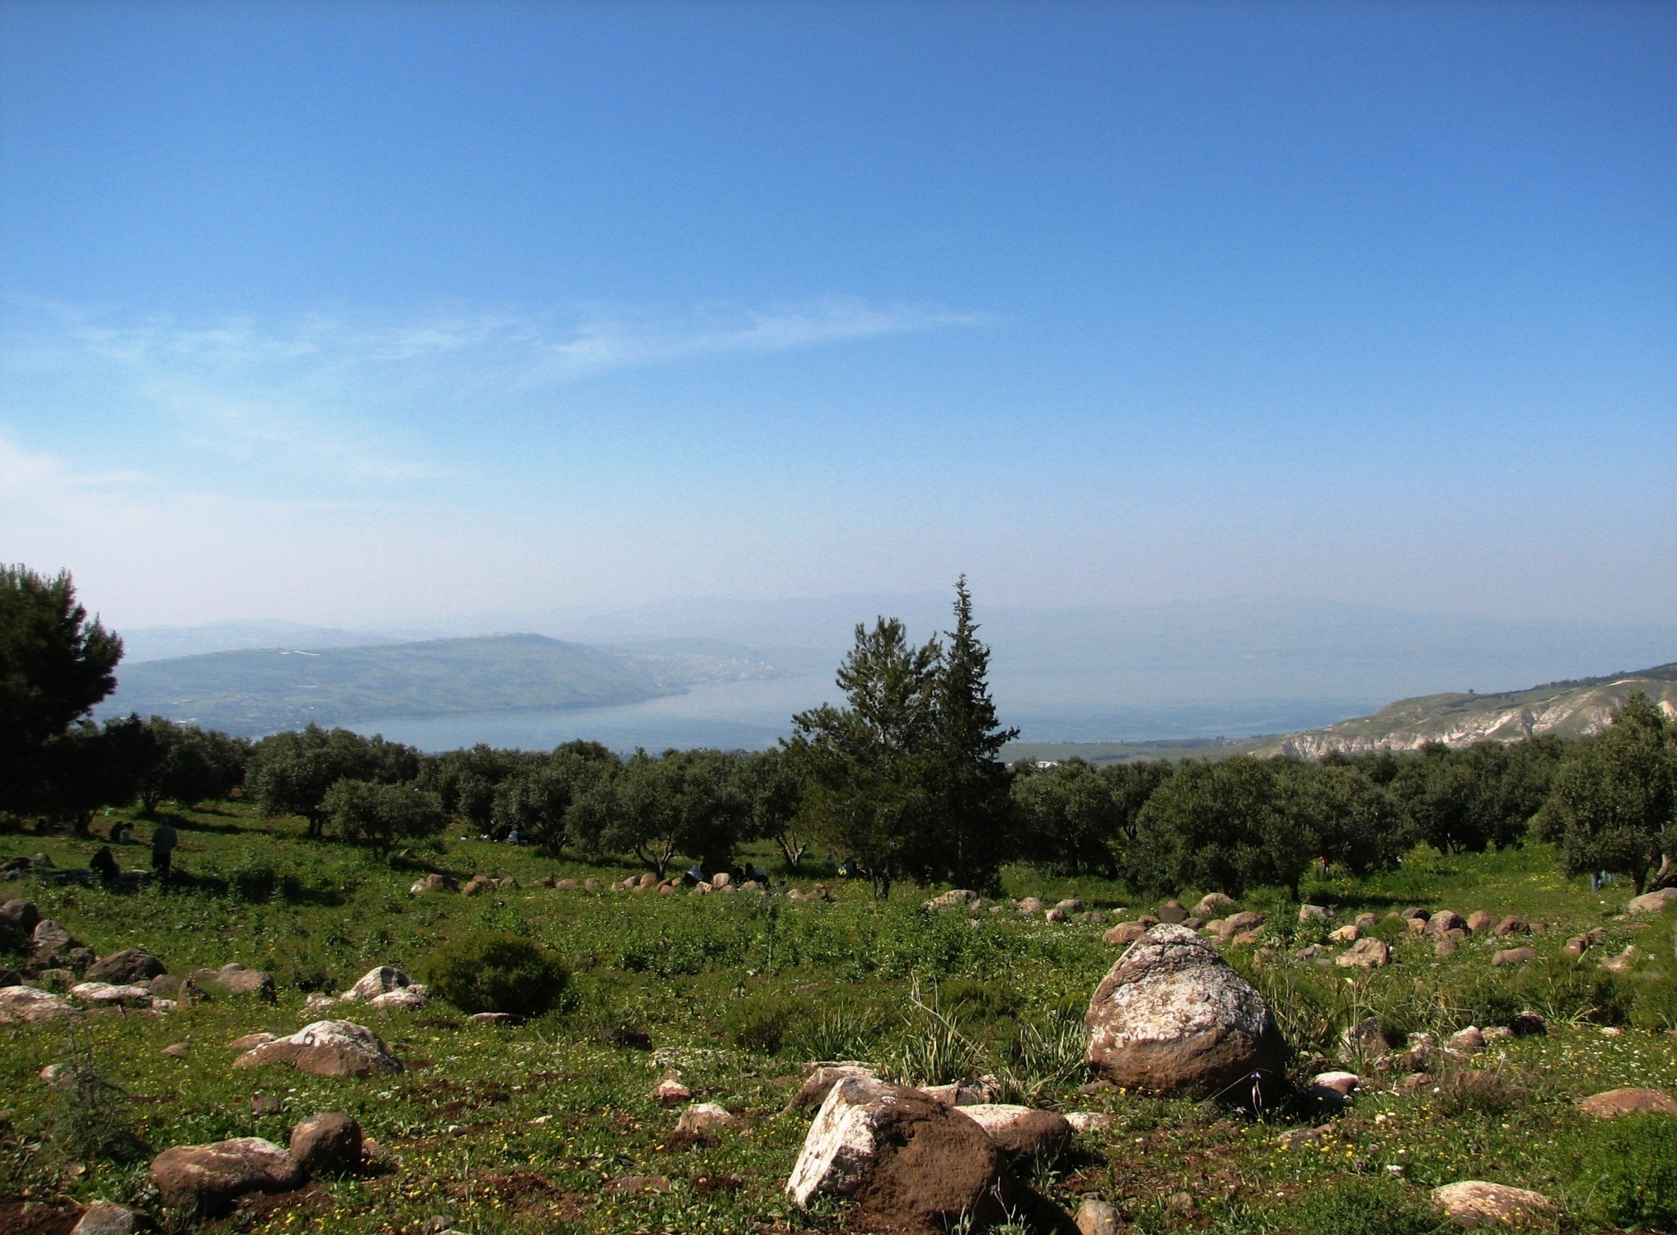
Wayside
Stony
Thorny
Good

Slide 14
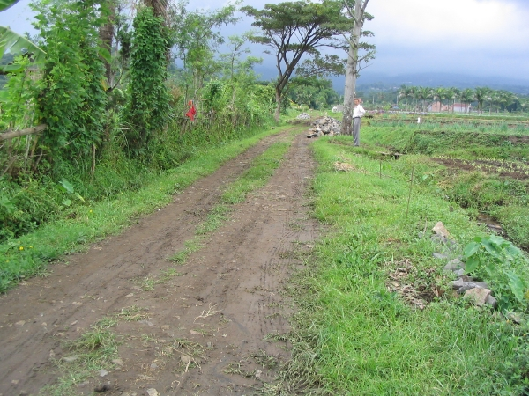
Wayside Soil
“beside the road”
“along the path”
Easily Removed
(Acts 13:44-50)

Slide 15
“What will my family & friends say?”
“What if I can’t change?”
“What will it say about dead loved ones who believed error?”
Matt. 10:34-38
Matt. 19:26
2 Cor. 5:10

Slide 16
Stony Soil
“rocky places”
“receive with joy”
Persecution
(Matt. 10:38; 11:6)

Slide 17
Distracted
(Lk. 21:34; Phil. 3:19)
Thorny Soil
“weeds”
“worries of world”

Slide 18
Good Soil
Only one kind!
Keep Seed,
Bear Fruit
(John 14:15, 21; 15:8)

Slide 19
God has a Harvest Day
Purpose of Garden is Produce
John 15:2, 8
God waits patiently to Save
2 Pet. 3:9; 1 Tim. 2:3-4
Permits weeds & plants to co-exist … for now
Matt. 13:29-30

Slide 20
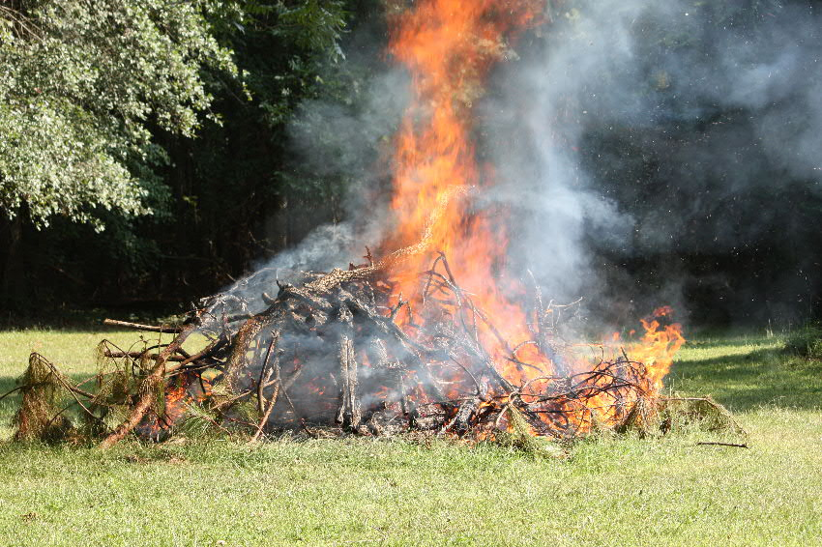
If anyone does not abide in Me, he is cast out as a branch and is withered; and they gather them and throw them into the fire, and they are burned. --John 15:6

Slide 21
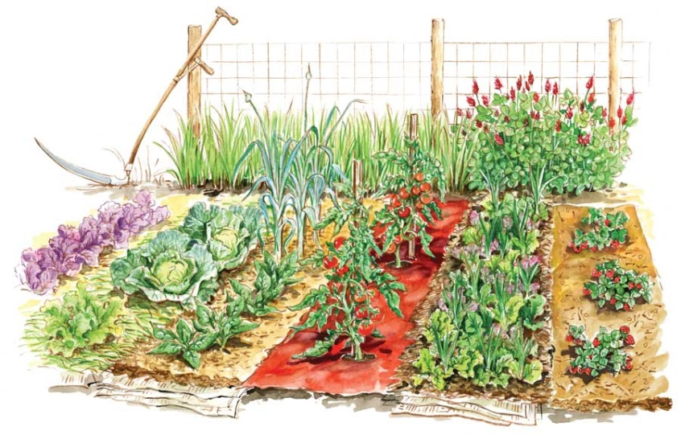
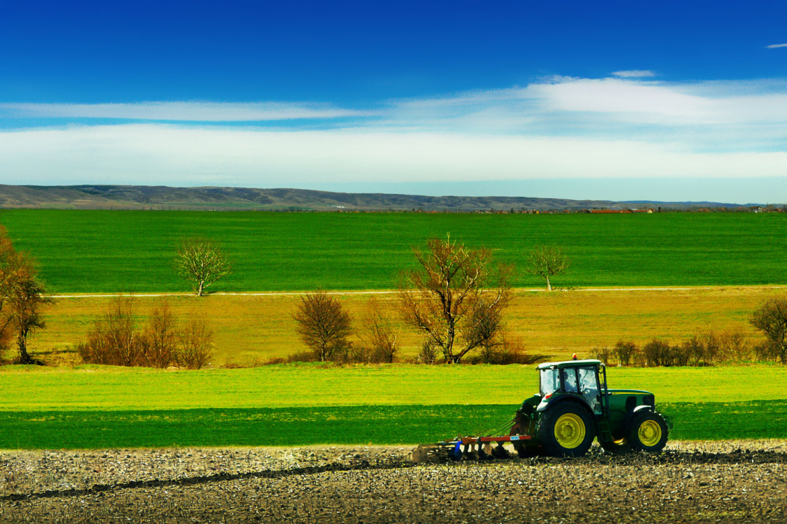
Soil Must be Prepared
Results Unpredictable
God
has a Harvest Day

Slide 22
What Must I Do To Be Saved?
Hear the gospel (Rom. 10:17)
Believe Jesus is Christ (John 3:16)
Repent of your sins (Acts 17:30)
Confess your faith (Rom. 10:9, 10)
Baptized for forgiveness (Acts 2:38)
Be faithful unto death (Rev. 2:10)

