Slide 2
Review of the Work Summer 2014

Slide 3
Introduction
Acts 14:27–28
27 Now when they had come and gathered the church together, they reported all that God had done with them, and that He had opened the door of faith to the Gentiles. 28 So they stayed there a long time with the disciples.
Acts 15:3–4
3 So, being sent on their way by the church, they passed through Phoenicia and Samaria, describing the conversion of the Gentiles; and they caused great joy to all the brethren. 4 And when they had come to Jerusalem, they were received by the church and the apostles and the elders; and they reported all things that God had done with them.

Slide 4
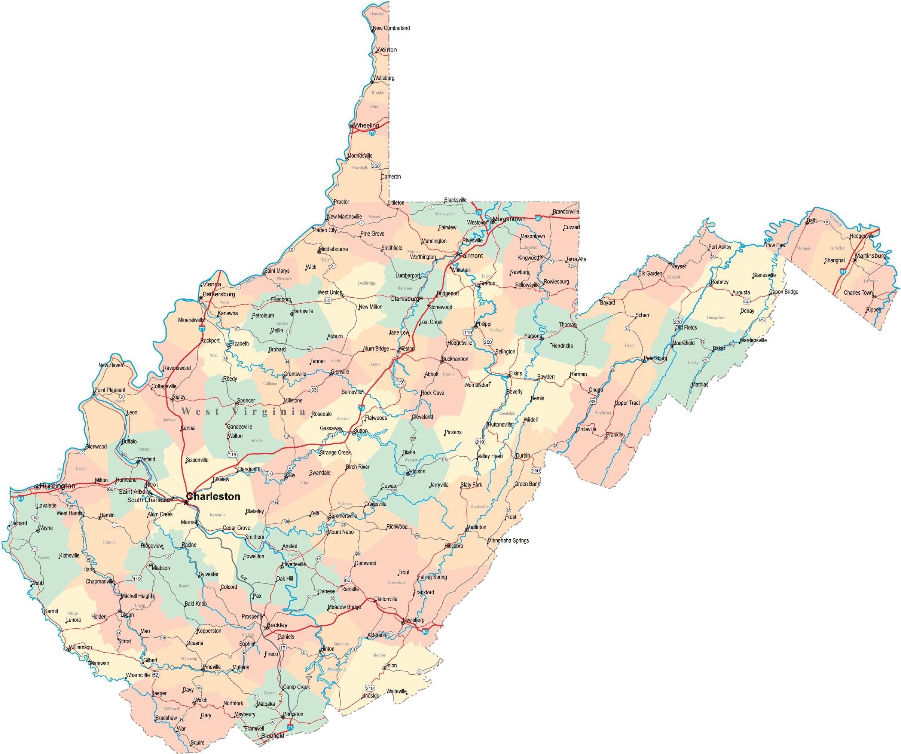
Huntington, WV

Slide 5
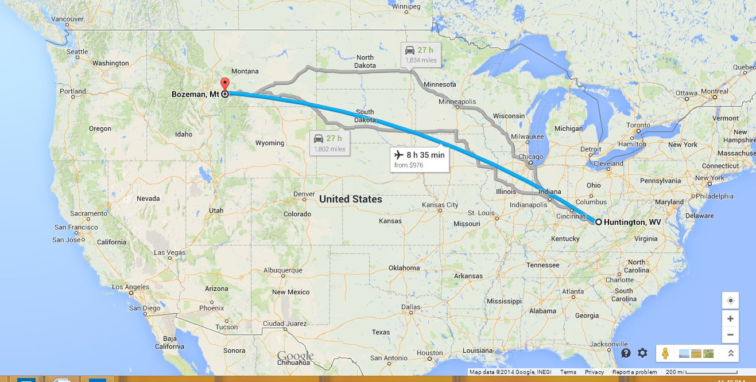
Planning the Move

Slide 6
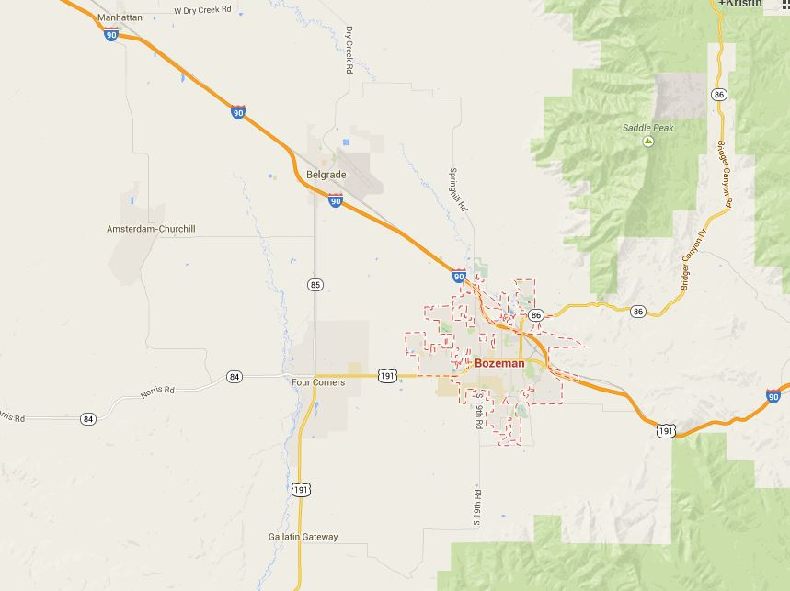
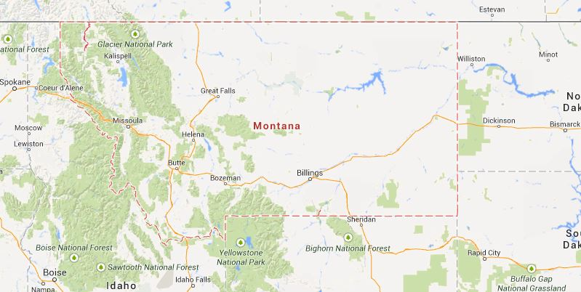
Bozeman, MT

Slide 7
What Are You Doing Here?
1 Kings 17-19—Ups and Downs of Elijah
Prayed for a drought on the land
Raised the widow’s son from the dead
Defeated the 450 prophets of Baal, 400 prophets of Asherah
Prayed for rain to come
Fled from Jezebel to the wilderness

Slide 8
What Are You Doing Here?
Discouragement of Elijah
Called for death: 1 Kings 19:4
Fatigue
Escaped the danger, and then slept (19:5)
Hunger
God took care of Elijah’s needs (19:5-8)
Loneliness
1 Kings 19:9
9 And there he went into a cave, and spent the night in that place; and behold, the word of the Lord came to him, and He said to him, “What are you doing here, Elijah?”
1 Kings 19:10
10 So he said, “I have been very zealous for the Lord God of hosts; for the children of Israel have forsaken Your covenant, torn down Your altars, and killed Your prophets with the sword. I alone am left; and they seek to take my life.”

Slide 9
What Are You Doing Here?
Focus on self, rather than on God
1 Kings 19:11-12
Second call of challenge:
1 Kings 19:13
13 So it was, when Elijah heard it, that he wrapped his face in his mantle and went out and stood in the entrance of the cave. Suddenly a voice came to him, and said, “What are you doing here, Elijah?”
1 Kings 19:14
14 And he said, “I have been very zealous for the Lord God of hosts; because the children of Israel have forsaken Your covenant, torn down Your altars, and killed Your prophets with the sword. I alone am left; and they seek to take my life.”

Slide 10
What Are You Doing Here?
God’s answer: Get to work! (19:15-17)
Gave Elijah work to do
Always work to accomplish in the kingdom!

Slide 11
Here Am I, Send Me!
Looking for help!
Serve the Lord right here…
Serve the Lord “back home”…
Serve the Lord where His church is small and in need of help…
What are you doing here?
Isaiah 6:8
8 Also I heard the voice of the Lord, saying: “Whom shall I send, And who will go for Us?” Then I said, “Here am I! Send me.”

Slide 12
What Are You Doing Here?
1 Peter 5:8–9
8 Be sober, be vigilant; because your adversary the devil walks about like a roaring lion, seeking whom he may devour. 9 Resist him, steadfast in the faith, knowing that the same sufferings are experienced by your brotherhood in the world.
God’s further answer: You are not alone… (19:18)
Knowing others are faithful serves as an encouragement

Slide 13
Conclusion
Discouraged?
Tired? Get rest!
Hungry? Get food!
Get to work!
You are not alone!

