Slide 2
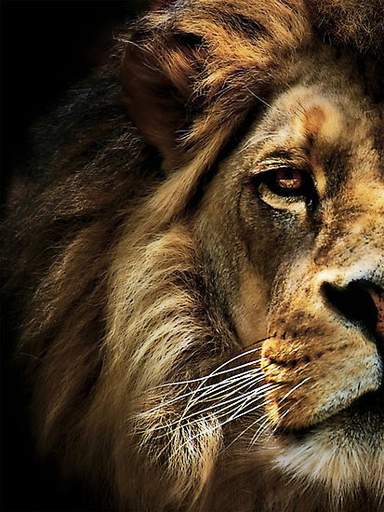
The Book of Daniel

Slide 3
Sun, class Introduction Sun a.m. Chapter 1 Sun p.m. Chapter 2 Monday Chapter 3 Tuesday Chapter 4 Wednesday Chapter 5 Thursday Chapter 6 Friday Evangelism

Slide 4
Daniel
Law
History
Wisdom
Old Testament – 39
New Testament – 27
Total – 66
Major Prophets
Minor Prophets
Gospels
Acts
Letters
Rev

Slide 5
Daniel
Creation & Fall
Exodus & Conquest
Kings & Prophets
Life of Jesus
The Patriarchs
The
Judges
Exile & Return
Early Church
Law
History
Gospels
Acts
Wisdom
Letters
Prophets
Rev

Slide 6
“And your house and your kingdom shall be made sure forever before me. Your throne shall be established forever.” 2 Samuel 7:16
931 BC
722 BC
Northern Kingdom:
ISRAEL
586 BC
597 BC
Saul
David
Solomon
605 BC
Southern Kingdom:
JUDAH

Slide 7
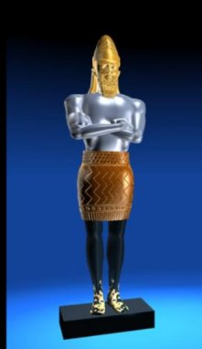
1 2 3 4 5 6 7 8 9 10 11 12
The Book of Daniel
Four empires will rise & fall before the everlasting kingdom.
2
3
4
5
6
7
God rescues & exalts those who are faithful.
Babylonian
Medo-Persian
Grecian
Roman
Aramaic
God humbles the proud.
Fiery Furnace
Lion’s Den
Nebuchad-nezzar
Belshazzar
2
3
4
5
6
7

Slide 8
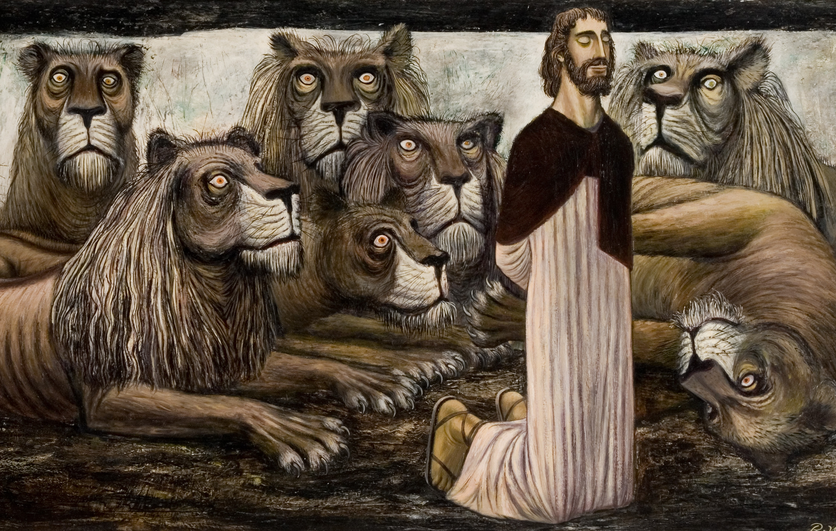

Slide 9
Daniel didn’t change his behavior
1 Peter 2:12 Keep your conduct among the Gentiles honorable, so that when they speak against you as evildoers, they may see your good deeds and glorify God on the day of visitation.

Slide 10
Daniel didn’t change his prayers.
10 When Daniel knew that the document had been signed, he went to his house where he had windows in his upper chamber open toward Jerusalem. He got down on his knees three times a day and prayed and gave thanks before his God, as he had done previously.

Slide 11
Daniel didn’t change his prayers.
1 Thessalonians 5:17 …pray without ceasing
Ephesians 5:20 …giving thanks always and for everything to God the Father in the name of our Lord Jesus Christ.

Slide 12
Daniel didn’t change his God.
16 Then the king commanded, and Daniel was brought and cast into the den of lions. The king declared to Daniel, “May your God, whom you serve continually, deliver you!”

Slide 13
Daniel didn’t change his God.
1:8 But Daniel resolved that he would not defile himself with the king’s food, or with the wine that he drank.
Jeremiah 12:5 “If you have raced with men on foot, and they have wearied you, how will you compete with horses? And if in a safe land you are so trusting, what will you do in the thickets of the Jordan?

Slide 14
Exhortation for Exiles
When you get thrown to the lions, don’t change a thing!

