Slide 1
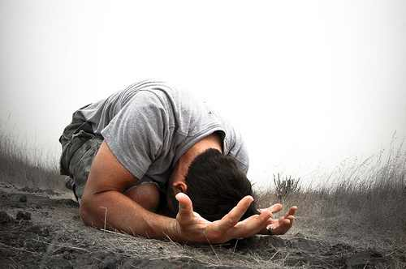
Tough Prayers
Jeremiah 20.7-13

Slide 2
Jeremiah’s Prayers
1.6
4.10, 19-21, 23-26
5.3-6
8.18 – 9.2
10.19-26
11.18-20
12.1-4
14.7-9, 13, 19-22
15.10-11, 15-18
16.19-20
17.12-18
18.19-23
20.7-18
32.16-25

Slide 3
Jeremiah’s so-called life
Called as a young man
Told he would be opposed
Forbidden to marry, mourn, feast, pray
Hometown tried to kill him
Officials tried to kill him

Slide 4
Jeremiah’s prayers
Despair
Perplexity
Vengeance
Vindication
Pain
Anger

Slide 5
One Example
Jeremiah 20.7
Lord, You have deceived me
and I was deceived;
You have overcome me and prevailed.
I have become a laughingstock
all day long;
Everyone mocks me.

Slide 6
Lord’s Answers
Assurance
Call to repentance
Re-establish priorities
Offer of renewal
Sympathy

Slide 7
Some Lessons
Frequency in Prayer
Intensity in Prayer
Honesty in Prayer

Slide 8
“What a man is on knees before God, that he is and nothing more.”
— Robert Murray McCheyne

