Slide 2
Work in Africa

Slide 3
Size of Africa

Slide 4
The Gospel is preached
South Africa >
White River
Madras
Preacher Training
Kenya>
Keratina
Nyeri >

Slide 5
South Africa

Slide 6
Return

Slide 7
White River
Congregation started in 1993
It has 32 members
Challenges
Fornication
Divorce and remarriage
Denominational doctrines
Opportunities
Denominational doctrine
Training young men.

Slide 8
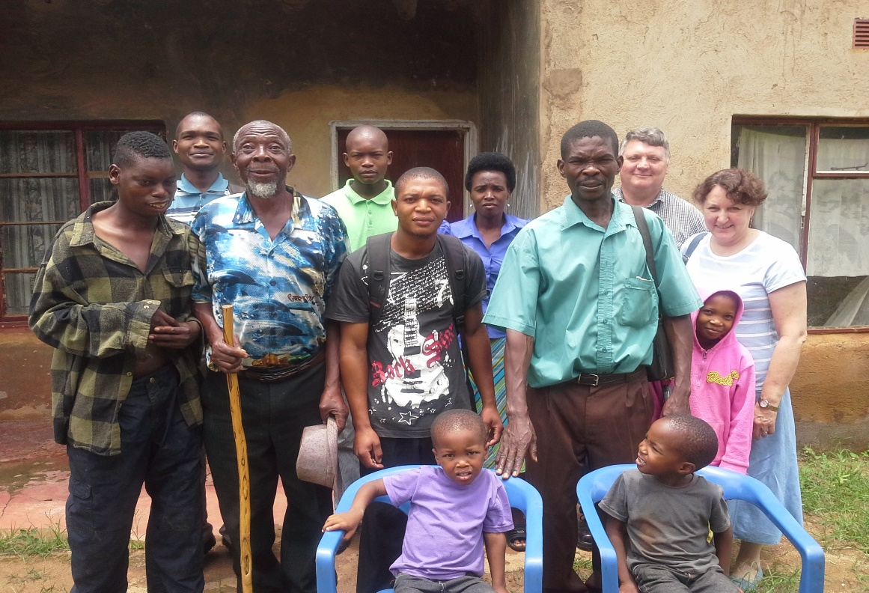
Madras
Tribal custom and tradition
The problem of sin
Jealousy
Ancestor worship
Polygamy
Fornication
There is much work to do.

Slide 9
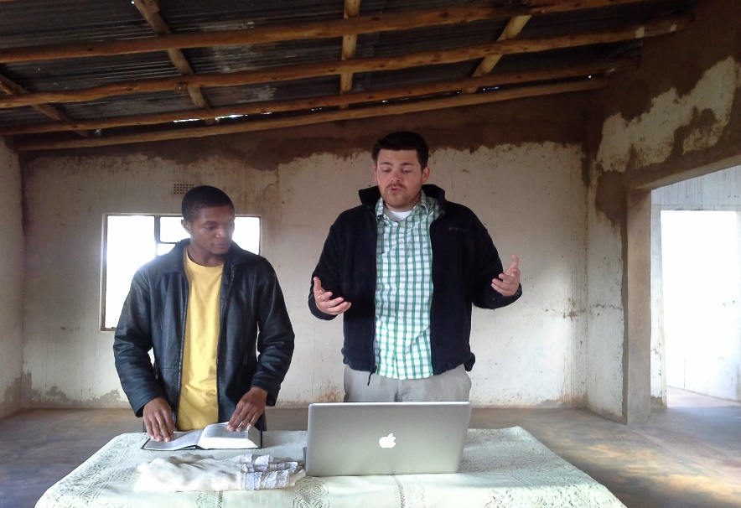
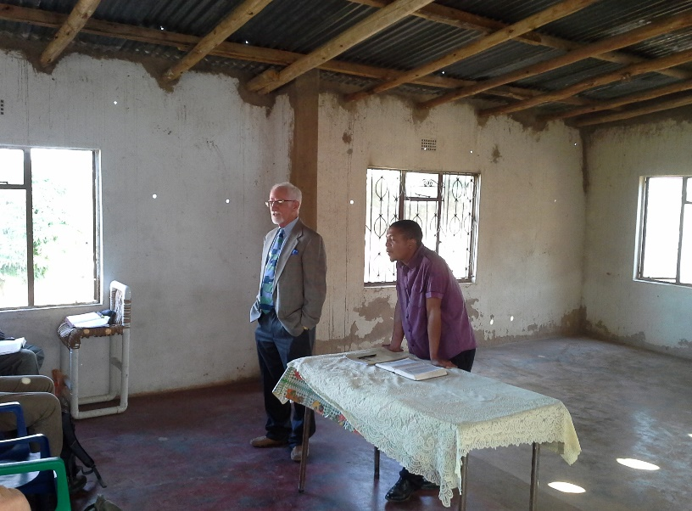
Preacher training
Young men of Madras and White River
Weekly study
Starting from the beginning
Putting them to the test.
Invited preachers.
Young men from other areas (United States)
Return

Slide 10
Kenya

Slide 12
Karatina
A unique congregation
Servants
Strong leadership in the men
Devoted to the truth.

Slide 13
Nyeri
Number of congregations around this area.
Word spreading.
Opportunities for the work to spread to other areas.
They have had some set backs.
Return

Slide 14
The Gospel needs to be preached
Wales
Abbergavenny
Scotland
Dundee
Glasgow

Slide 16
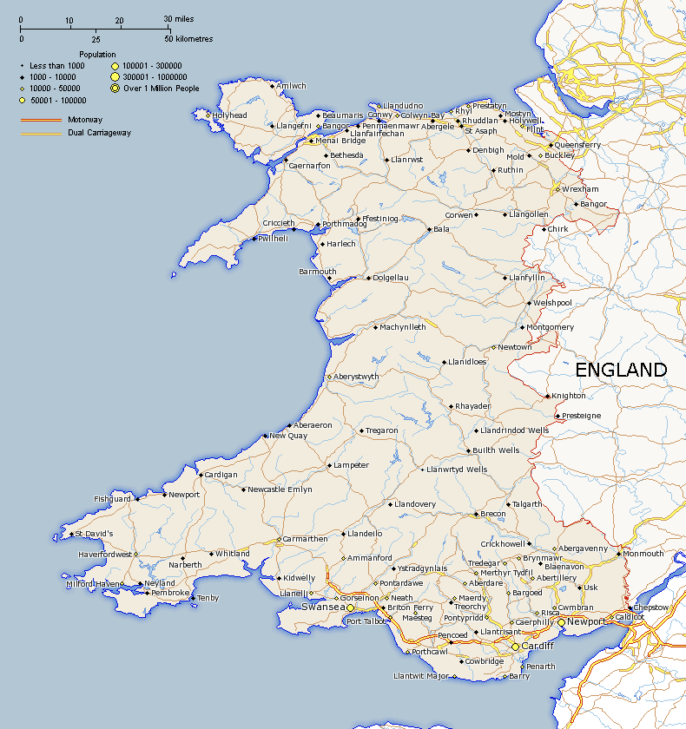

Slide 17
Abergavenny
No congregation as yet, two Christians living in area.
Village population 8000
Opportunities
Morning markets
Community halls
Old age homes

Slide 18
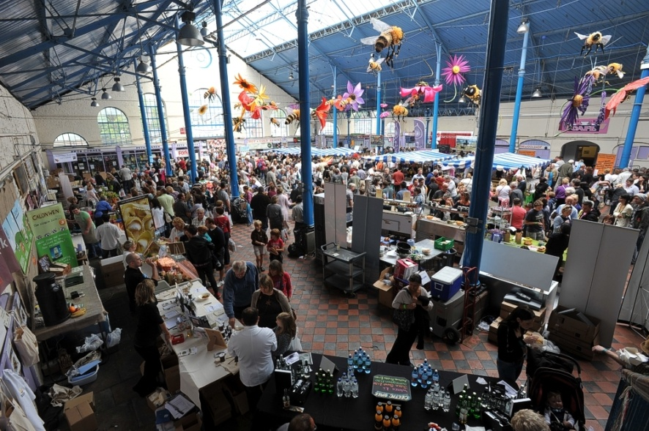
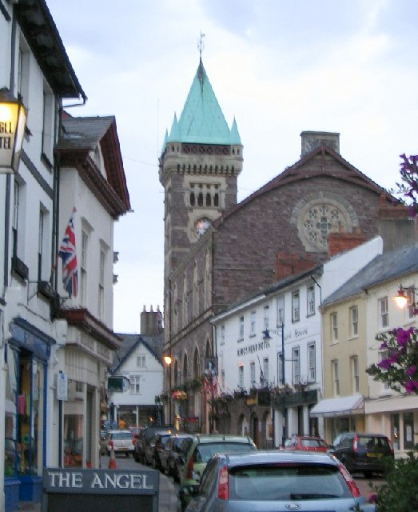
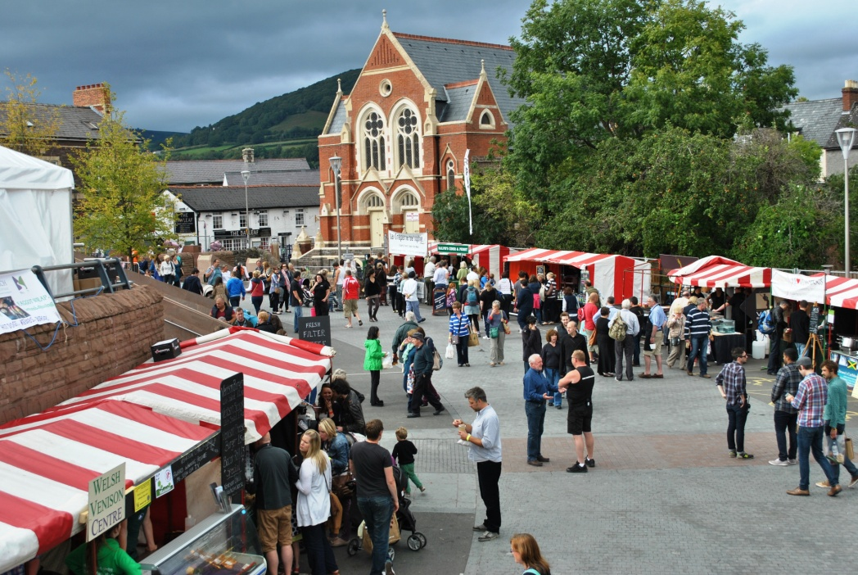
Markets a place to setup a tract table.

Slide 20
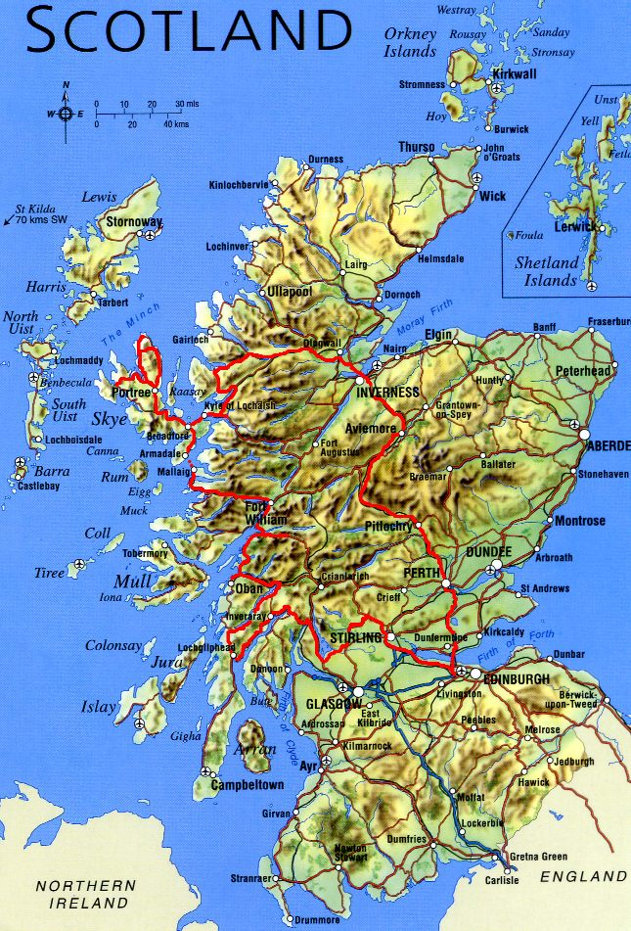

Slide 21
Dundee
Liberalism (Lipscomb University)
Outreach programs (social gospel)
Weak knowledge of scripture
Fertile soil

Slide 22
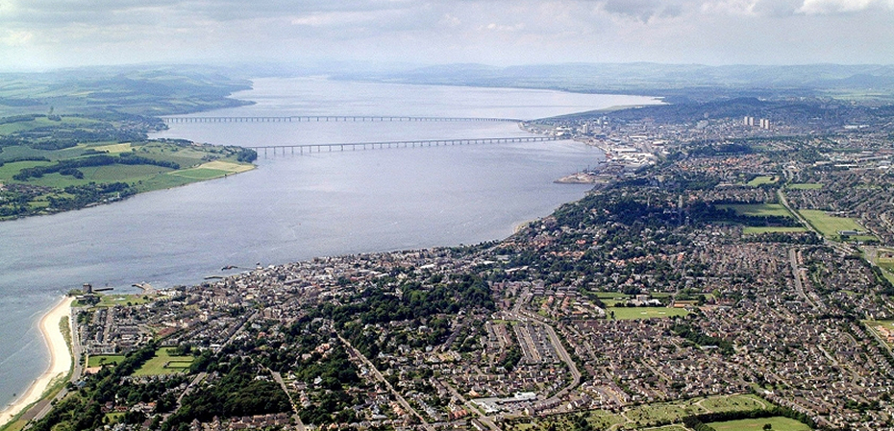
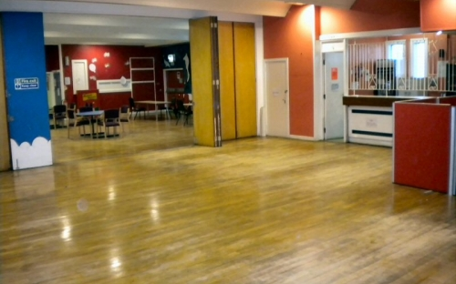
Dundee from the air
Community hall

Slide 23
Glasgow
One faithful congregation. (that we know of)
Authority not taught. (Mostly liberal congregations)
Bible knowledge
Many opportunities.

Slide 24
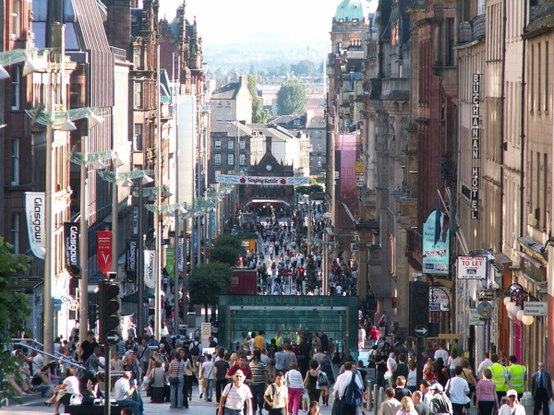
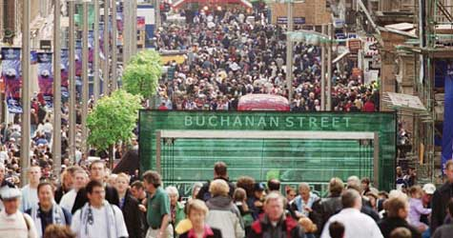
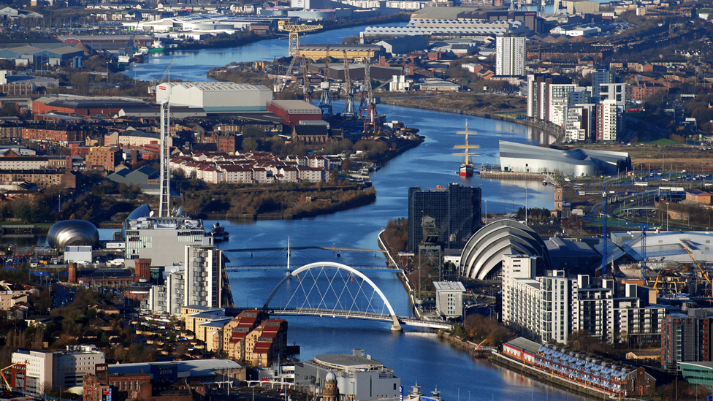

Slide 25
Using Technology
Webex Classes
Classes
Courses

Slide 26
The Future
South Africa
Political situation
Radical uprising
Africa
Kenya
Zimbabwe
Zambia
Wales/Scotland

