Slide 2
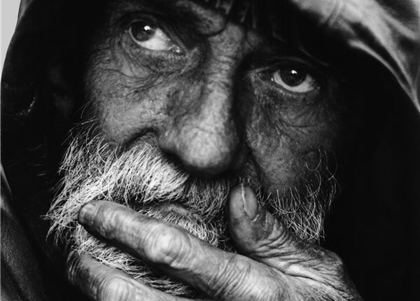
Parenting Advice From
KING
DAVID

Slide 3
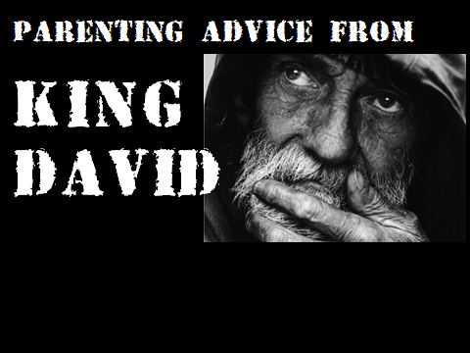
Don’t Be A Bad Example
Don’t Fail To Discipline Your Children
DO Show Them How To Repent
DO Help Them Prepare For The Future

