Slide 1
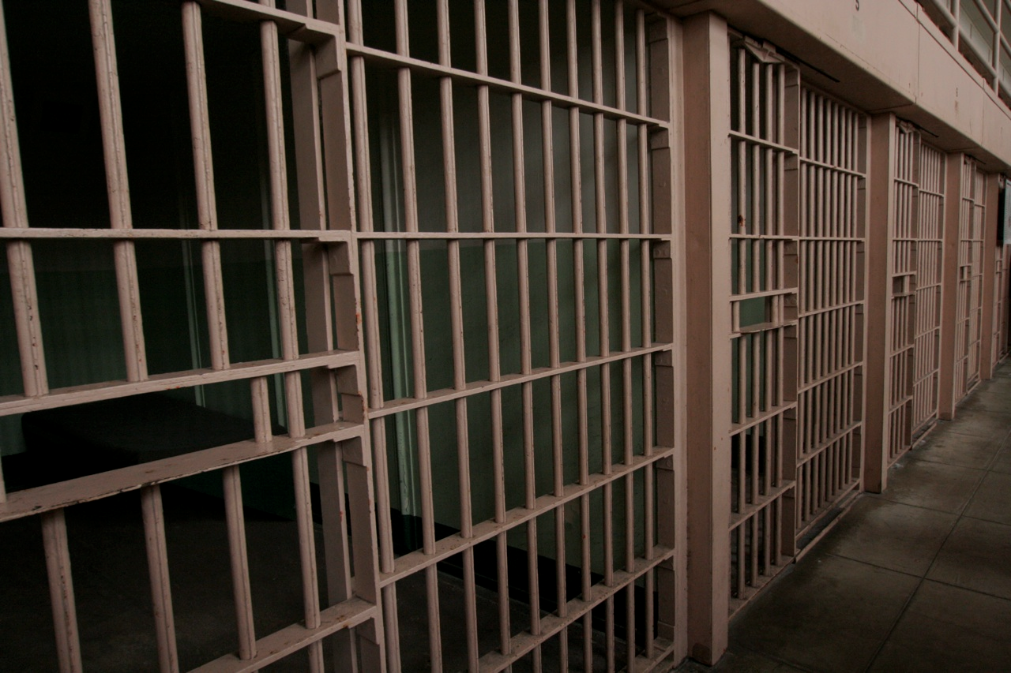
Lessons From Death Row

Slide 2
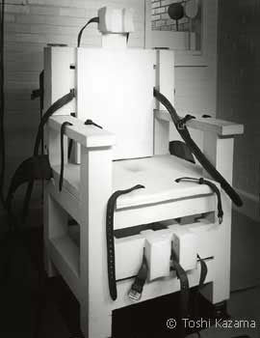
David Ray Duren
On January 7, 2000, David Ray Duren was executed in Alabama’s electric chair.
On October 20, 1983, Duren, with a friend, approached a car to use in a robbery. They overpowered a young couple and put them into the trunk. After the robbery attempt, they killed the young woman and left the young man for dead.
Notes:
1. On January 7, 2000, David Ray Duren, age 37, was executed in Alabama’s electric chair.
2. On October 20, 1983, Duren, with a friend, approached a car to use in a robbery. They overpowered a young couple and put them into the trunk. After the robbery attempt, for fear they would be identified, they killed the young girl and left the young man for dead. – he requested death penalty
3. You may be asking yourself, “What does this have to do with our lesson from God’s word?” As a young man, David Ray Duren attended the Huffman Church of Christ in AL.

Slide 3
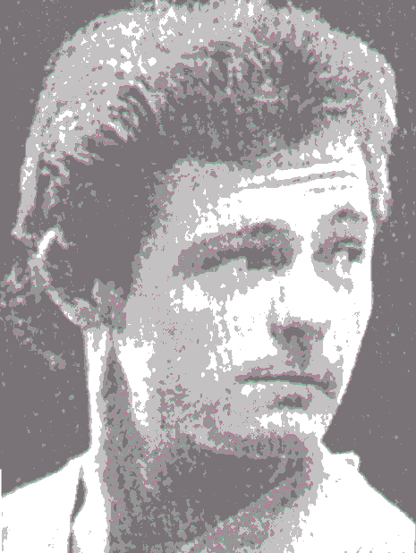
David Ray Duren
On September 14, 1984, David Duren was convicted and sentenced to death. During this time, there were those who studied with him and he was baptized into Christ.
As a Christian, Duren focused his attention on trying to help others to avoid the same tragic mistakes that he made, and wrote a letter entitled, “An Attitude Adjustment” to help others.
Notes:
On September 14, 1984, David Duren was convicted and sentenced to death. During this time, there were those who studied with him (huffman CofC) and he was baptized into Christ.
As a Christian while sitting on death row, Duren focused his attention on trying to help others to avoid the same tragic mistakes that he made, and wrote a letter entitled, “An Attitude Adjustment” to help others, in his words “avoid making the same poor choices…” published in local newspaper

Slide 4
LESSONS FROM DEATH ROW
MAKING DECISIONS
Notes:
Our lesson is not to focus on David Duren. Emphasize God in this lesson
Prodigal Son
(CLICK)
Wherever any of us end up in this life, it will be a direct reflection of the decisions that we have made. Everyone of us are a product of our decisions.
There is no decision that does not have a consequence. Every decision has a consequence, whether good or bad
2. I see a 37 year old man who end up sitting in an electric chair and being put to death for killing someone, how does that happen? How does a man get from a high chair to the electric chair?
3. When you look at his letter you hope he can give you some answers to that question. And he does, he tells us where it all began

Slide 5
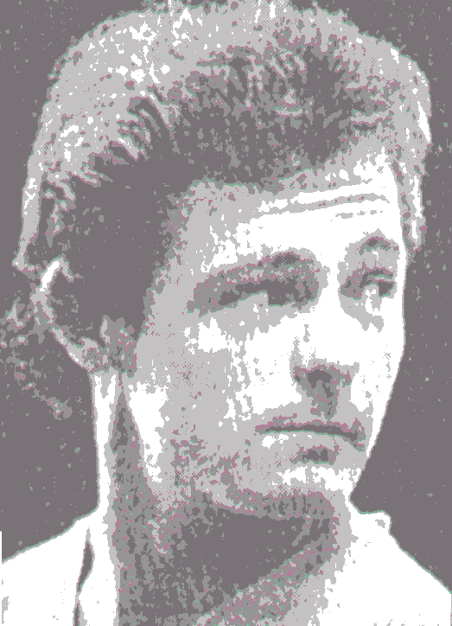
MAKING DECISIONS
“I have spent the last sixteen years waiting for the sentence to be carried out. So, as you can imagine. I’ve had a lot of time to look back at my life and see where I went wrong. I can honestly say, that it all began at the age of thirteen, when I stopped attending church. I know that’s what you would expect me to say but it is absolutely true. It was about this time, that I started smoking, cursing, lying, and not caring about God. This marked a change in my life – not so much the cigarettes and lies themselves, but the attitude which led to the decision to smoke, lie, and curse; knowing these things were wrong.”
Notes:
Satan wants to draw you away from where you sit this morning
There is safety in this building. There is safety in being with other Christians and Satan knows it
He knows that when we are with other Christians, that generally, there is not going to be much trouble with us
I have never struggled to do right when I am with my fellow Christians. Have you? I don’t have any problem doing right when I have my brothers and sisters around me
So what Satan wants to do is draw me away from that environment. And that is what he did to David Duren

Slide 6
13 And not many days after, the younger son gathered all together, journeyed to a far country, and there wasted his possessions with prodigal living. 14 But when he had spent all, there arose a severe famine in that land, and he began to be in want. 15 Then he went and joined himself to a citizen of that country, and he sent him into his fields to feed swine. 16 And he would gladly have filled his stomach with the pods that the swine ate, and no one gave him anything. 17 But when he came to himself, he said, 'How many of my father's hired servants have bread enough and to spare, and I perish with hunger! 18 I will arise and go to my father, and will say to him, "Father, I have sinned against heaven and before you, 19 and I am no longer worthy to be called your son. Make me like one of your hired servants." ' Luke 15

Slide 7
“And let us consider one another in order to stir up love and good works, not forsaking the assembling of ourselves together, as is the manner of some, but exhorting one another, and so much the more as you see the Day approaching.” Heb. 10:24-25
“Let no one say when he is tempted, "I am tempted by God"; for God cannot be tempted by evil, nor does He Himself tempt anyone. But each one is tempted when he is drawn away by his own desires and enticed.
Then, when desire has conceived, it gives birth to sin; and sin, when it is full-grown, brings forth death” Jas. 1:13-15
Notes:
A lion hardly ever attacks a flock of sheep that are in a large population (ecology 101)
He has learned his chances of success are not very good
He sits back in the bushes, and he waits for one of those sheep to be drawn away from the group and all by itself
When that sheep gets out on the edge and away from the safety of the rest of the flock, that is the moment the lion comes to pounce on its prey
He drew him away from the place of safety. That is what David Duren said happened to him (I quit attending services)

Slide 8
LESSONS FROM DEATH ROW
MAKING DECISIONS
LOOKING FOR ACCEPTANCE

Slide 9
“..I was looking for a place to fit in – a group or someone who would accept me as I was. But it occurred to me that if I wanted to “fit in” I would have to act like the group I wanted to fit into… Strangely enough, I chose the group that picked on and made fun of me. Whatever they did, I did, being too afraid to say “no” for fear of what they would think of me. So, by age fourteen, I had drank my first drink, smoked my first joint, and popped my first pill. I was ignoring God’s warning… This was the kind of people I surrounded myself with, and the kind of person I became. By age 20 I was deep into drugs and alcohol, and though still living with my parents, I made my own rules; staying out all hours of the night, sometimes not coming home at all, failing in school – I just didn’t care.”

Slide 10
“Be not deceived: Evil companionships corrupt good morals” 1 Cor. 15:33
“And even as they did not like to retain God in their knowledge, God gave them over to a debased mind, to do those things which are not fitting; 29 being filled with all unrighteousness, sexual immorality, wickedness, covetousness, maliciousness; full of envy, murder, strife, deceit, evil-mindedness; they are whisperers, 30 backbiters, haters of God, violent, proud, boasters, inventors of evil things, disobedient to parents, 31 undiscerning, untrustworthy, unloving, unforgiving, unmerciful; 32 who, knowing the righteous judgment of God, that those who practice such things are deserving of death” Rom. 1:28-32
Notes:
1. Duren said this is the type of people I surrounded myself with, and the kind of person I became

Slide 11
12 giving thanks to the Father who has qualified us to be partakers of the inheritance of the saints in the light.
13 He has delivered us from the power of darkness and conveyed us into the kingdom of the Son of His love,
14 in whom we have redemption through His blood, the forgiveness of sins. Col. 1

Slide 12
LESSONS FROM DEATH ROW
MAKING DECISIONS
LOOKING FOR ACCEPTANCE
SIN SEPERATES
Notes:
I have seen it in cases where it absolutely grieves my heart
Satan is in the dividing business
He wants to divide husband/wife mother and father/ children best friends you/from your better self
Satan can so easily take you, the person we care for, the person we love, the person we knew, and he can make you into somebody else
You’ll begin to look different, talk different, act different…and you know why you are different.
The real you has been squashed and Satan has made something else out of you. Satan does this time and time again…

Slide 13
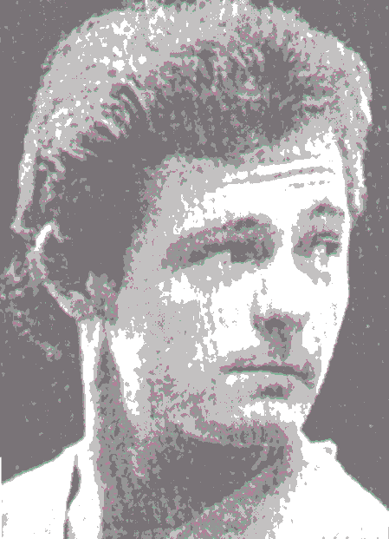
“I listened and watched as my family and friends were stripped of pride and dignity as they were forced by my actions to beg judge and jury to spare my life. At one point, as my dad testified, he made the statement, “We encouraged him to join the army, thinking it would make a man of him.” To which the prosecutor asked, “And did it?” And I watched my dad, with head already bowed in shame, bow even lower as he was forced to respond with the truth, “No.” I had never taken responsibility for myself and my actions. And because of it, my actions, my irresponsibility and the consequences thereof impacted and destroyed not just my life, but far more importantly, the lives of countless innocent people, many of whom I did not even know.”
Notes:
1. Paid the price – death penalty
2. We see people “find religion” in prison. Sometime doubt God could save such a person
3. Truth is, God can save a murder
4. Death penalty commonwealth of VA, judge imposes the sentence (up to the judge)
5. One thing we need to understand about God is that every one of us sit on death row

Slide 14
“And the LORD God commanded the man, saying, "Of every tree of the garden you may freely eat; but of the tree of the knowledge of good and evil you shall not eat, for in the day that you eat of it you shall surely die” Gen. 2:16-17
“What fruit did you have then in the things of which you are now ashamed? For the end of those things is death. But now having been set free from sin, and having become slaves of God, you have your fruit to holiness, and the end, everlasting life. For the wages of sin is death, but the gift of God is eternal life in Christ Jesus our Lord.” Rom. 6:21-23
Notes:
verses
God says the wages of sin is death. You sin, you die. He cannot just say, well…I know you did what I told you not to do, but we will just forget it this time
God cannot do that (Just)
When God said the penalty for sin is death, He meant it
And in the eternal mind of God, there was only 2 things that could be done to fix this situation:
Somebody can die for you, die in your place (Jesus).
That penalty was so set that God would not remove it even when it cost Him His Son.
The only way the death penalty can be removed is for somebody to pay the penalty for you (He gave Jesus to pay penalty)
b. Obey the gospel
Jesus died on a cross, but that by itself does not save everybody
Obedience to His gospel does

Slide 15
LESSONS FROM DEATH ROW
MAKING DECISIONS
LOOKING FOR ACCEPTANCE
SIN SEPERATES
GOD CAN SAVE MURDERS

Slide 16
“While awaiting sentencing I was visited by brother Corelly. He encouraged me to write to the church of Christ in Huffman asking their forgiveness. I was sentenced to be taken to death row on Sept. 15th 1984. There in a cell, 8 feet long and 5 feet wide, I finally came the attitude adjustment that I desperately needed. Seeing the complete disaster I had made of my life, I focused my mind on eternity. I thought to myself how foolish it would be to accept an eternity in hell, that would be infinitely more miserable than the hell I had created in the life of others. It is shameful that I did not change my attitude before destroying so many lives. So I wrote to the church and asked for forgiveness and prayers. Several responded with letters of encouragement. After studying for 3 weeks with brother Corelly, I turned my life over to God, I was baptized into Christ for the forgiveness of my sins in a prison bathtub, and the Lord added me to His church.”
Notes:
Look at God’s tremendous grace
Some can laugh at it, smirck at it
But the truth is, God does save murders who genuinely come to Him and obey the gospel

Slide 17
Acts 2
22 “Men of Israel, hear these words: Jesus of Nazareth, a Man attested by God to you by miracles, wonders, and signs which God did through Him in your midst, as you yourselves also know Him, being delivered by the determined purpose and foreknowledge of God, you have taken by lawless hands, have crucified, and put to death; whom God raised up, having loosed the pains of death, because it was not possible that He should be held by it.”
37 "Men and brethren, what shall we do?

Slide 18
LESSONS FROM DEATH ROW
MAKING DECISIONS
LOOKING FOR ACCEPTANCE
SIN SEPERATES MAN
GOD CAN SAVE MURDERS
YOU CAN HAVE PEACE
Notes:
8 People from the local congregation were allowed to spend 1 hour with David just before he went to the electric chair
Read letters from people he touched, few scriptures, sang hymns about heaven and salvation. Can you imagine a man sitting on death row and he is singing praise to God with other Christians
2. In the newspaper the warden of the correctional facility said “Out of the 15 executions I have witnessed, he was the most calm that I have ever seen, and the most determined to get this over with”
The news article said he did not falter even once (kicking and screaming). He just walked to the chair with determination and sat down, they put the straps on him
3. I think that is an indication that, even though he had done all that he had done, he went to that chair with peace

Slide 19
27 Peace I leave with you, My peace I give to you; not as the world gives do I give to you. Let not your heart be troubled, neither let it be afraid. John
4 Rejoice in the Lord always. Again I will say, rejoice!
5 Let your gentleness be known to all men. The Lord is at hand.
6 Be anxious for nothing, but in everything by prayer and supplication, with thanksgiving, let your requests be made known to God;
7 and the peace of God, which surpasses all understanding, will guard your hearts and minds through Christ Jesus. Philippians

Slide 20
“Yea, though I walk through the valley of the shadow of death, I will fear no evil; For You are with me” Ps. 23:4
“The time of my departure is at hand. I have fought the good fight, I have finished the race, I have kept the faith. Finally, there is laid up for me the crown of righteousness, which the Lord, the righteous Judge, will give to me on that Day, and not to me only but also to all who have loved His appearing”
2 Tim. 4:6-8
Notes:
Paul said (I have)
There’s a whole lot of difference in coming to the end of your life, and being able to say “I have” rather than having to say “oh I wish I had”
David Duran had messed up his life miserably, but he did not intend to mess up his eternity, and (if all he did was with a sincere heart) he was able to go to that chair and say “I have now finished the race”

Slide 21
LESSONS FROM DEATH ROW
Hear John 12:48
Believe John 8:24
Repent Luke 13:3
Confess Matt. 10:32-33
Baptized Mark 16:16
Faithful Matt. 24:13
Notes:
1. One excuse I hated to hear, “I’m not ready”. I was guilty of this for a long time
2. When I hear this excuse from someone on death row, it just baffles and irritates me
3. Yet, that is where you sit, if your not a Christian

Slide 23
LESSONS FROM DEATH ROW
MAKING DECISIONS
LOOKING FOR ACCEPTANCE
SIN SEPERATES
PAYING THE PRICE

