Slide 1
God’s Royal Priesthood

Slide 2
God’s Royal Priesthood
To Become A Priest:
A Man Had To be Washed: Leviticus 8:12; Exodus 29:4

Slide 3
God’s Royal Priesthood
To Become A Priest:
A Man Had To be Washed: Leviticus 8:12; Exodus 29:4
A Man Had To Put On the Priestly Garments: Leviticus 8:7-9; Exodus 29:4,5

Slide 4
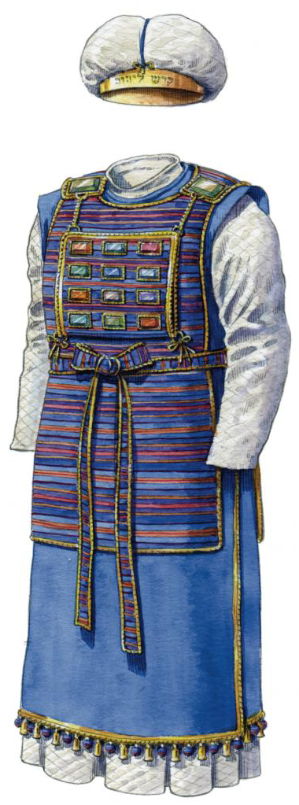
God’s Royal Priesthood

Slide 5
God’s Royal Priesthood
To Become A Priest:
A Man Had To be Washed: Leviticus 8:12; Exodus 29:4
A Man Had To Put On the Priestly Garments: Leviticus 8:7-9; Exodus 29:4,5
A Man Had To Be Anointed: Leviticus 8:10-12; Exodus 29:7

Slide 6
God’s Royal Priesthood
To Become A Priest:
A Man Had To be Washed: Leviticus 8:12; Exodus 29:4
A Man Had To Put On the Priestly Garments: Leviticus 8:7-9; Exodus 29:4,5
A Man Had To Be Anointed: Leviticus 8:10-12; Exodus 29:7
A Man Had To Be Sprinkled With Blood: Leviticus 8:23,24,30; Exodus 29:19-21

Slide 7
God’s Royal Priesthood
To Become A Priest:
A Man Had To be Washed: Leviticus 8:12; Exodus 29:4
A Man Had To Put On the Priestly Garments: Leviticus 8:7-9; Exodus 29:4,5
A Man Had To Be Anointed: Leviticus 8:10-12; Exodus 29:7
A Man Had To Be Sprinkled With Blood: Leviticus 8:23,24,30; Exodus 29:19-21
A Man Had To Constantly Offer Sacrifices: Leviticus 8:14,18,21,22,28

