Slide 2
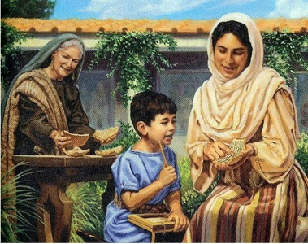
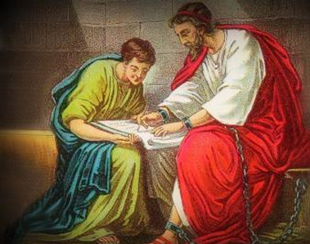
Sowing in All of Life’s Seasons

Slide 3
The Formative Years: Laying a Foundation of Faith
2 Timothy 1:1-5
2 Timothy 3:14-17
Parents, it is up to us to lay a foundation of faith in our infants, toddlers and school-aged children!
Sowing in All of Life’s Seasons
Season #1

Slide 4
The Teens-Early Twenties: Faith Grows from Potential to Production
Sowing in All of Life’s Seasons
Season #2
Acts 16:1-5
Young people, are you identifying, developing and using your God-given abilities not only to grow your faith, but to begin helping others grow their faith (1 Timothy 4:13-14; 2 Timothy 1:6)?

Slide 5
The Teens-Early Twenties: Faith Grows from Potential to Production
Sowing in All of Life’s Seasons
Season #2
Acts 16:1-5
Are you growing your faith to the point that fellow Christians are taking notice (1 Timothy 4:12, 15)?

Slide 6
The Teens-Early Twenties: Faith Grows from Potential to Production
Sowing in All of Life’s Seasons
Season #2
Acts 17:13-15
1 Thessalonians 3:1-3

Slide 7
The Thirties: Faith’s Potential Produces
Philippians 2:19-22
Young people, this is the direction your faith ought to be going!
Older folks, this is where your faith needs to be!
Sowing in All of Life’s Seasons
Season #3

Slide 8
The Thirties: Faith’s Potential Produces
2 Timothy 3:10-14
Now is NOT the time to make shipwreck of your faith!
Now is the time to turn your faith’s potential into much produce for the Lord!
Sowing in All of Life’s Seasons
Season #3

