Slide 2
Good evening

Slide 3
Peter Preaching To Himself
A synopsis of Acts 10

Slide 4
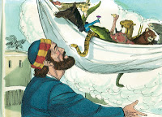
Acts 10
This is a “Jackie Robinson” story!!!
Peter has a vision…

Slide 5
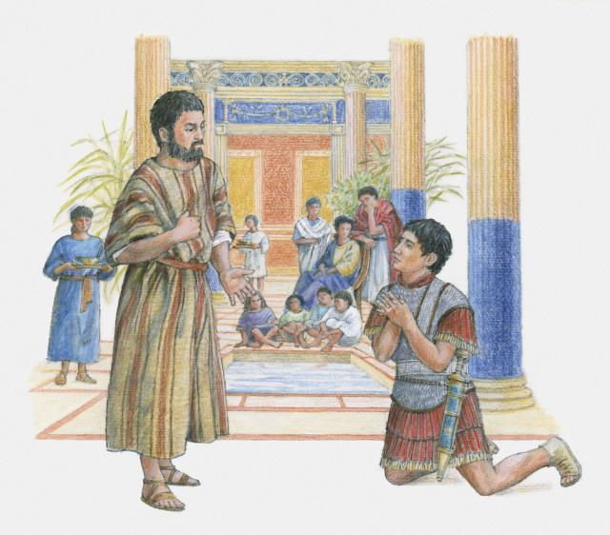
Acts 10
Peter struggles with his obedience and the uncomfortable situation.
Cornelius tells of the vision.

Slide 6
Acts 10
Peter preaches the Gospel.
The Holy Spirit sends a message.
Peter commands them to obey.

Slide 7
Peter Preaching To Himself
A synopsis of Acts 10

Slide 8
Peter Preaching To Himself
Preaching to ourselves is part of the Gospel process.
Peter had to …
Philippians 2:12-13

Slide 9
Preaching To Ourselves
The Gospel is not a “One Hit Wonder.”
Transformation Process
Revelation 5:10, Romans 12:2
Colossians 2:12, 2 Corinthians 3:18

Slide 10
Preaching To Ourselves - Topics
Love one another.
Love “THEM” like enemies.
Forgive one another.
Relationships are important to God!!!
…

Slide 11
Peter Preached To Himself
A problem …

