Slide 2
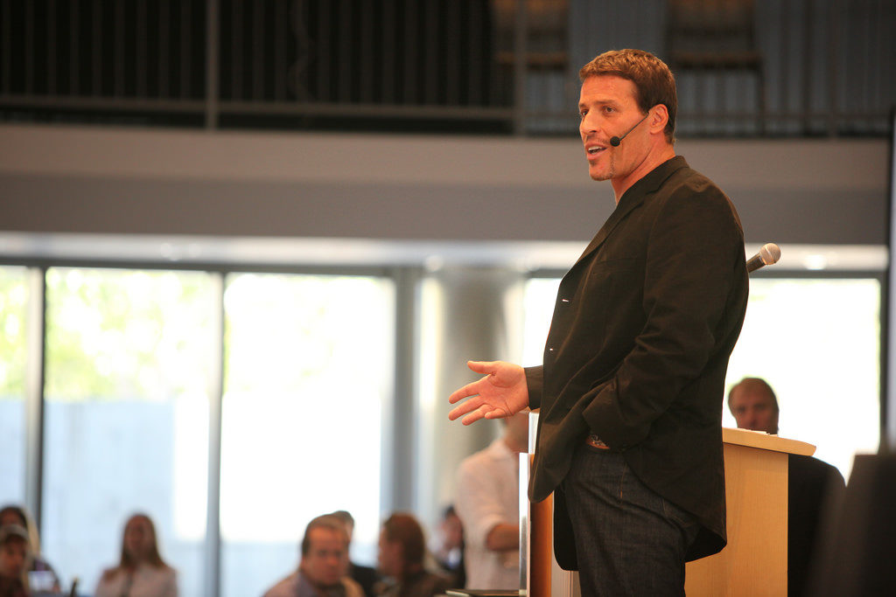

Slide 4
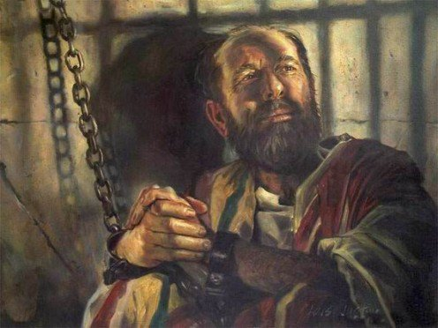
Awaken the Paul Within
2 Corinthians 5

Slide 5
Awaken the Paul Within 2 Corinthians 5
What Kept Paul Motivated?

Slide 6
Awaken the Paul Within 2 Corinthians 5
What Kept Paul Motivated?
1. PROSPECT OF A NEW “TENT” (vs 1-5)
All Christians share this hope (1 Cor. 15:50-57)
Should comfort us as we age (Eccl. 12:2-8)
The Holy Spirit guarantees it
If the thought of a “new tent” doesn’t appeal to us, we may love this world too much
It’s not about the accommodations, but the location

Slide 7
Awaken the Paul Within 2 Corinthians 5
What Kept Paul Motivated?
2. DESIRE TO BE AT HOME WITH THE LORD (vs 6-9)
Can we say we “prefer” it? (vs 8)
A challenge in 21st Century America
Stephen (Acts 7:59)
Paul (Phil. 1:21-24)
If we really want to be with the Lord, we will really want to be pleasing to Him (vs 9)

Slide 8
Awaken the Paul Within 2 Corinthians 5
What Kept Paul Motivated?
3. EXPECTATION OF JUDGEMENT (vs 10)
All of us will appear
We will get “whatever we deserve” [NLT]
Christians can be hopeful in Righteous Judgement

Slide 9
Awaken the Paul Within 2 Corinthians 5
What Kept Paul Motivated?
4. KNOWING THE FEAR OF THE LORD (vs 11)
God wants us to know and keep His ways (Heb. 3:7-11)
Don’t “insult the Spirit of grace” (Heb. 10:28-31)
Fear God and keep His commandments (Eccl. 12:13)
The fear of the Lord ought to drive us to “persuade men”

Slide 10
Awaken the Paul Within 2 Corinthians 5
What Kept Paul Motivated?
5. THE LOVE OF CHRIST (vs 14-15)
Eph. 3:19; 5:1-2
Love even for the “Foremost of Sinners” (1 Tim. 1:15)
“Controls” / “constrains” – literally “presses”
The Love of Christ “compels” us to no longer live for self
Tell others to live “for Him who died… on their behalf”

Slide 11
Awaken the Paul Within 2 Corinthians 5
What Kept Paul Motivated?
6. THE HOPE OF RECONCILIATION (vs 18-19)
God “brought us back”
All have been alienated by sin (Rom. 3:23)
All must be reconciled to God
God reconciled the world to Himself “in Christ”

Slide 12
Awaken the Paul Within 2 Corinthians 5
What Kept Paul Motivated?
Prospect of a new “tent”
Desire to be at Home with the Lord
Expectation of Judgement
Knowing the Fear of the Lord
The Love of Christ
The Hope of Reconciliation

