Slide 2
Digging for Facts about Dinosaurs

Slide 3
“All Scripture is given by inspiration of God, and is profitable for doctrine, for reproof, for correction, for instruction in righteousness, ¹⁷ that the man of God may be complete, thoroughly equipped for every good work.”
-II Timothy 3:16-17

Slide 4
^{“5} God called the light Day, and the darkness He called Night. So the evening and the morning were the first day.”
^{“31} Then God saw everything that He had made, and indeed it was very good. So the evening and the morning were the sixth day.”
^{“24} Then God said, “Let the earth bring forth the living creature according to its kind: cattle and creeping thing and beast of the earth, each according to its kind”; and it was so. ²⁵ And God made the beast of the earth according to its kind, cattle according to its kind, and everything that creeps on the earth according to its kind. And God saw that it was good.”
- Genesis 1

Slide 5
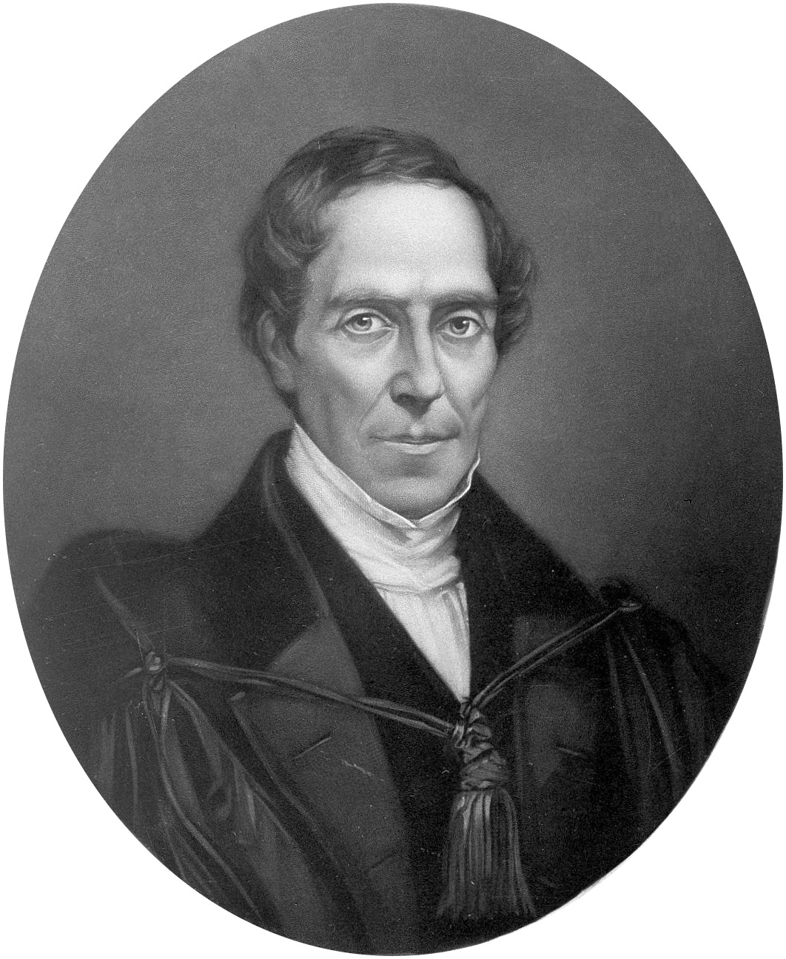
Dr. Gideon Mantell, circa 1830
Sir Richard Owen, circa 1841

Slide 6
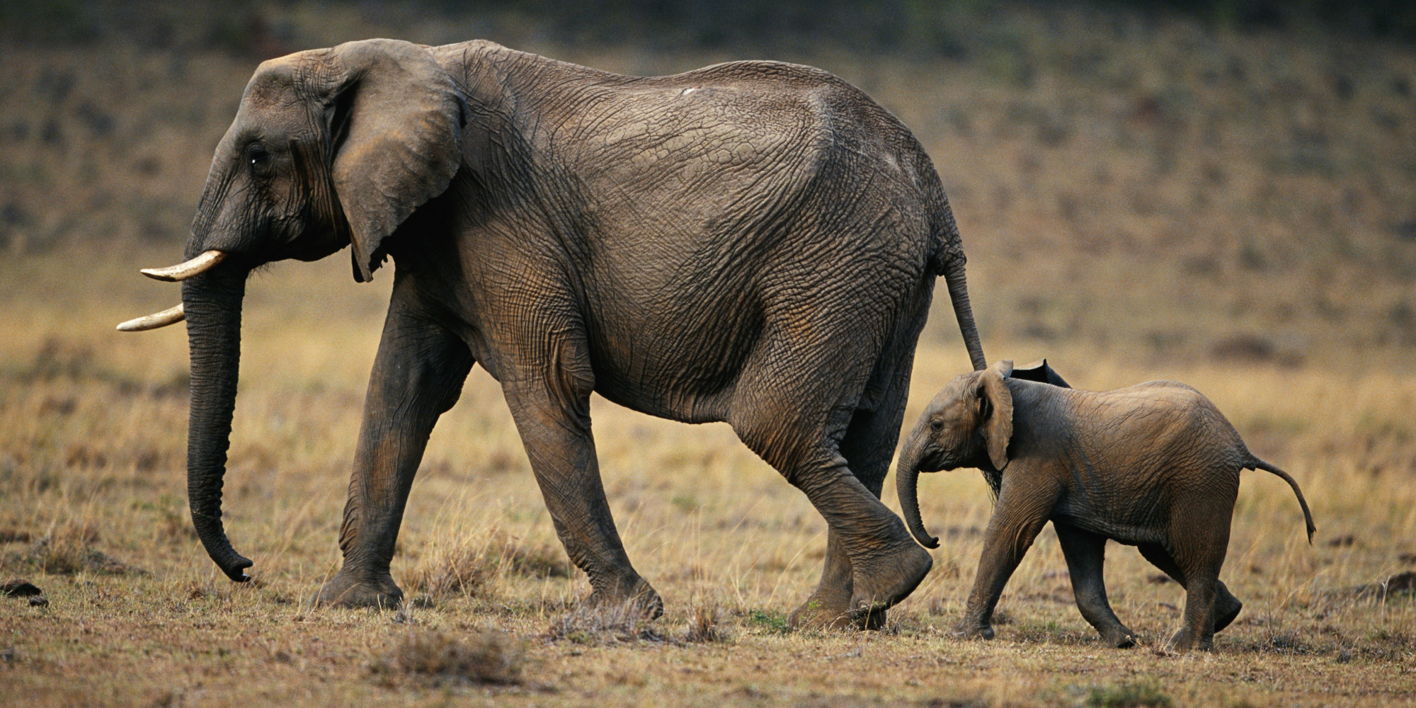
?

Slide 7
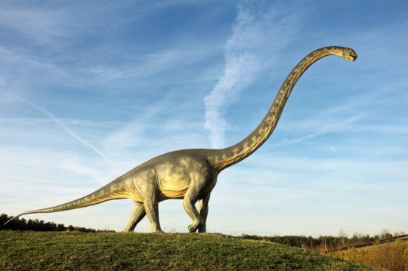
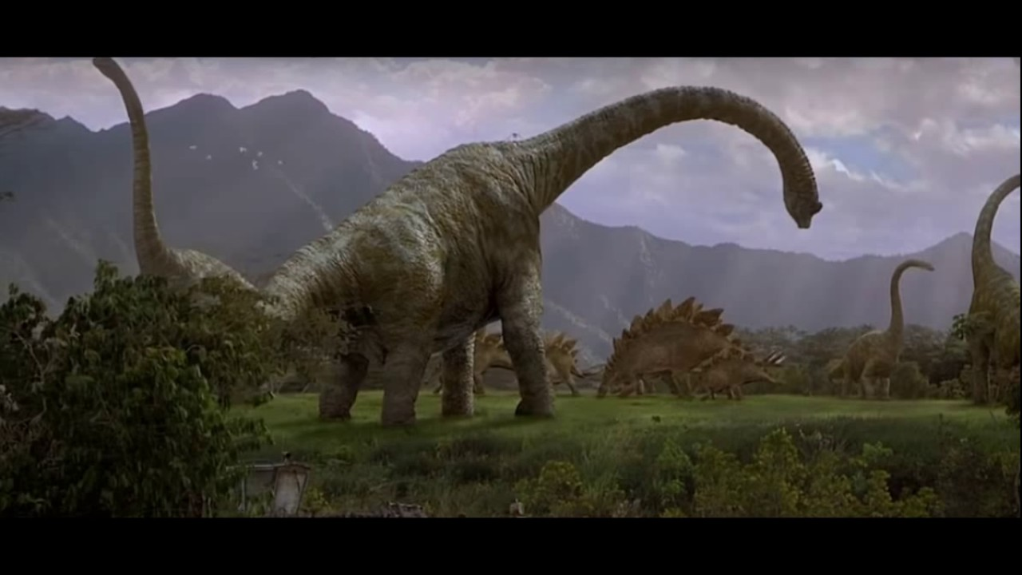
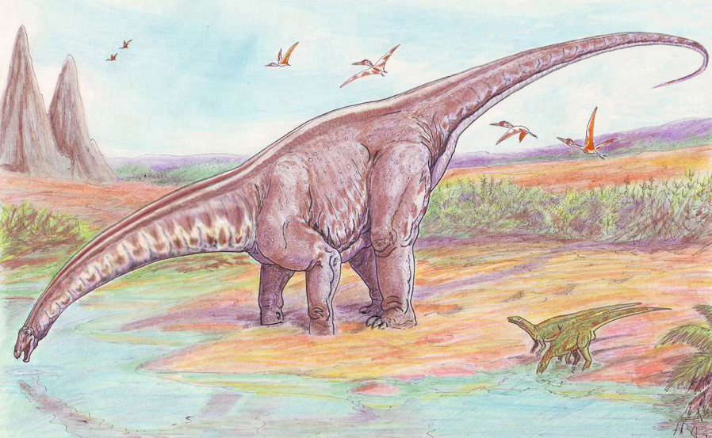

Slide 8
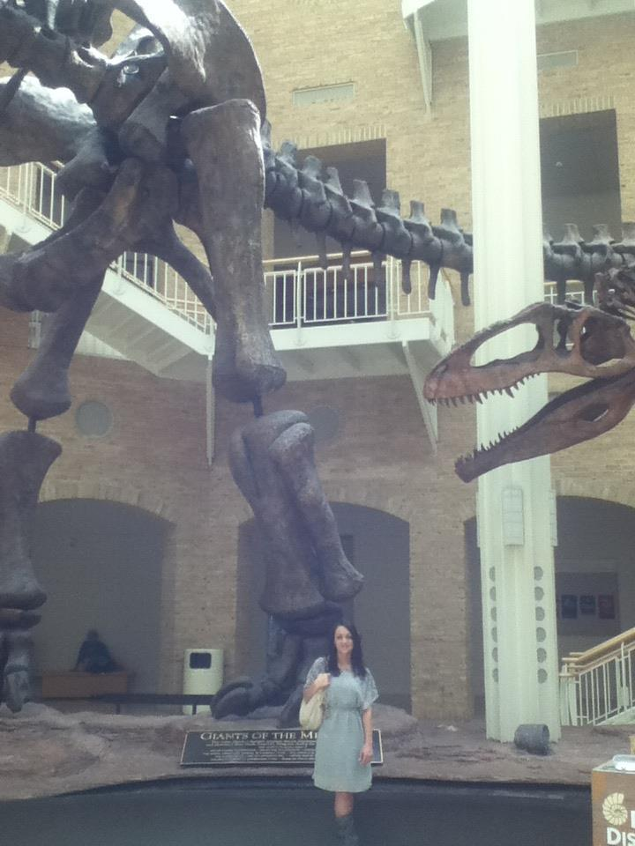
Argentinosaurus, Fernbank Museum of Natural History, Atlanta, GA. The Argentinosaurus is the largest ever known land animal, belonging to the “titanosaur” subgroup of sauropods. The rancher who discovered the first skeleton mistook one of the leg bones as a giant piece of petrified wood.

Slide 9
“In that day the Lord with His severe sword, great and strong, will punish Leviathan the fleeing serpent, Leviathan that twisted serpent; And He will slay the reptile that is in the sea.”
- Isaiah 27:1

Slide 12
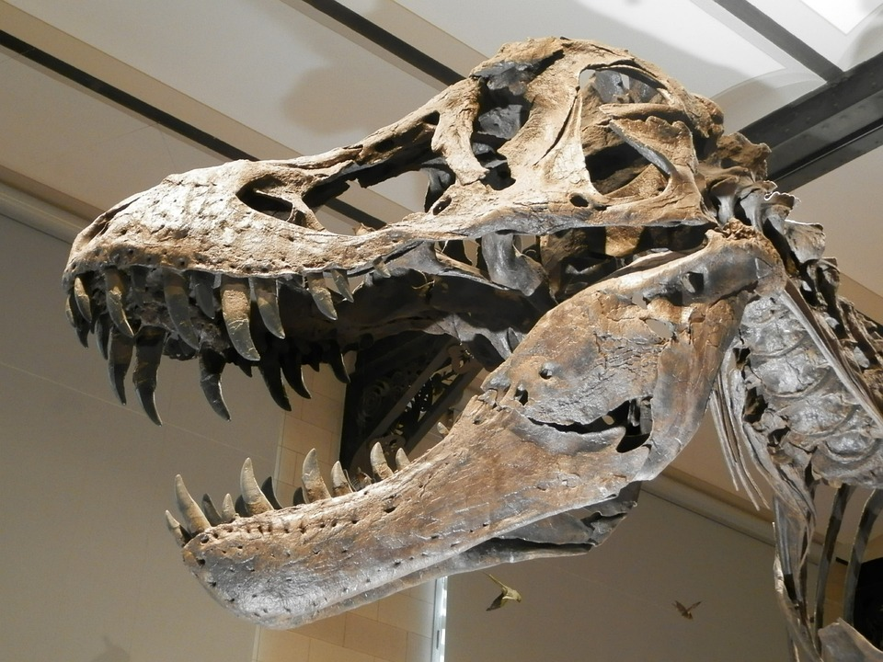
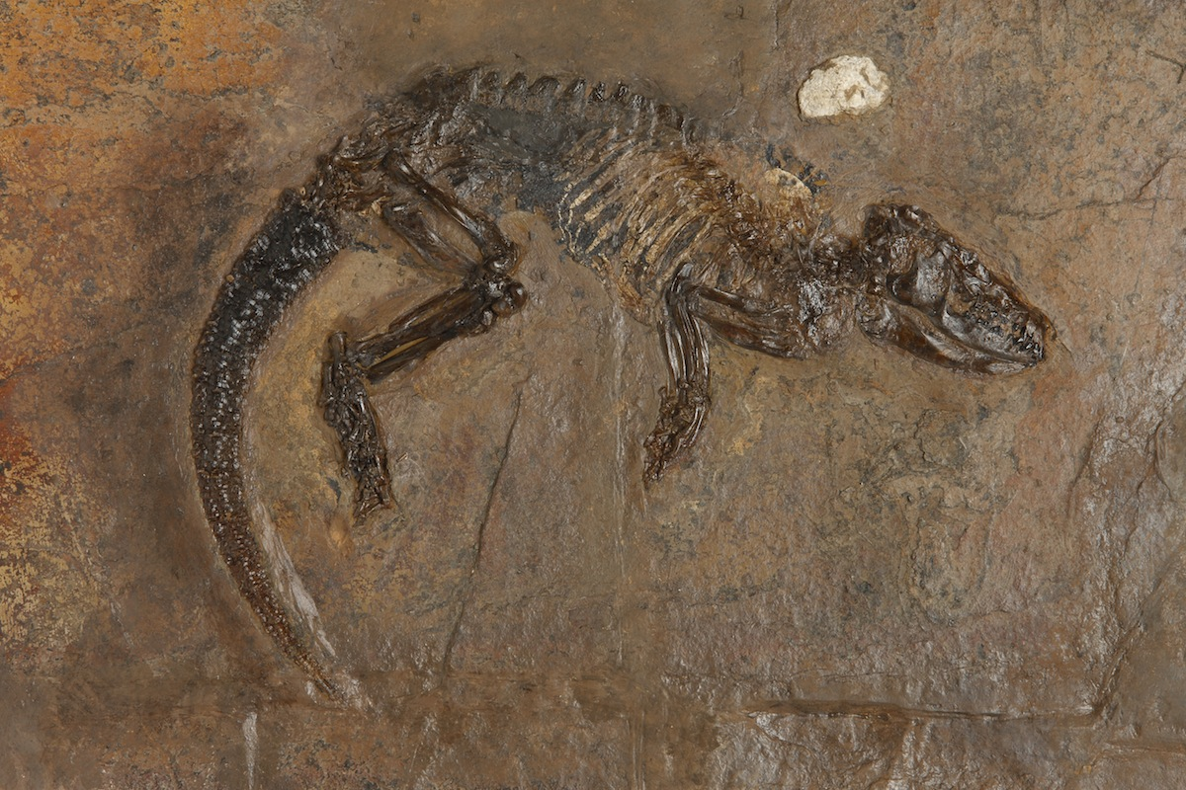

Slide 13
“But blood cells in a dinosaur bone should have disappeared eons ago. ‘I got goose bumps. ...It was exactly like looking at a slice of modern bone. ...The bones are, after all 65 million years old. How could blood cells survive that long?’”
(Mary Schweitzer, Science, Research News, V.261)

Slide 14
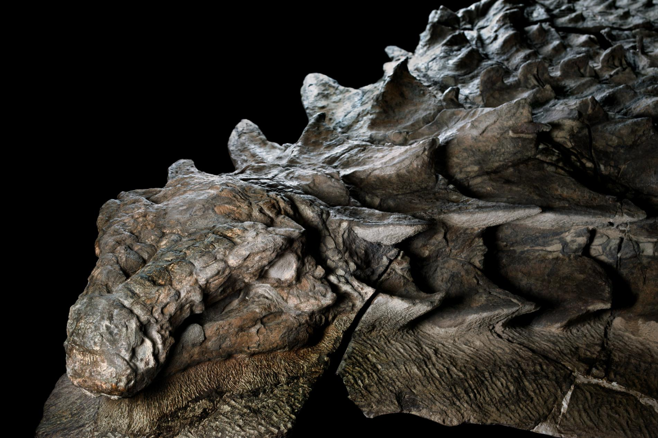
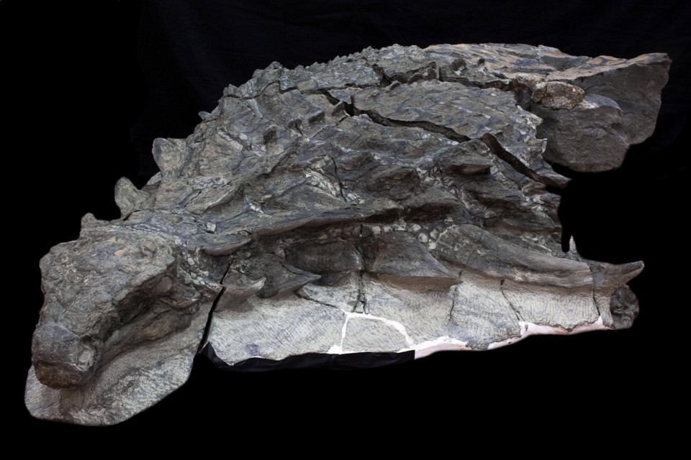
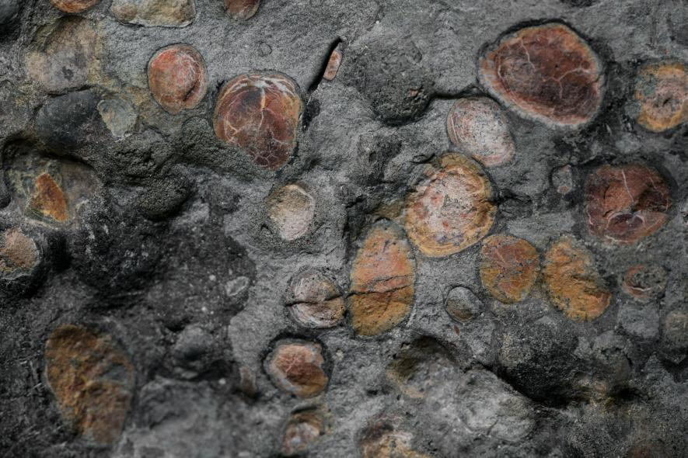
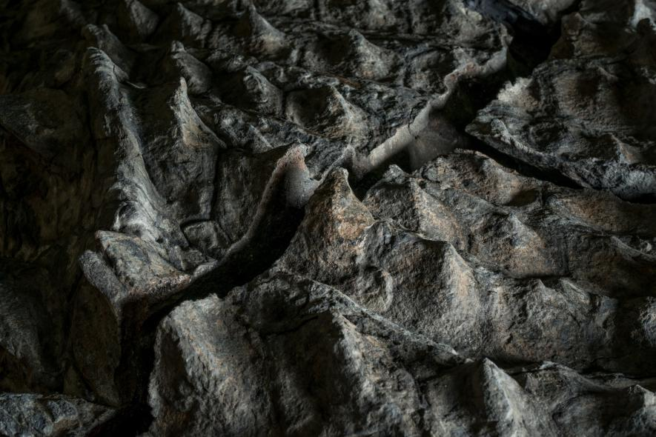
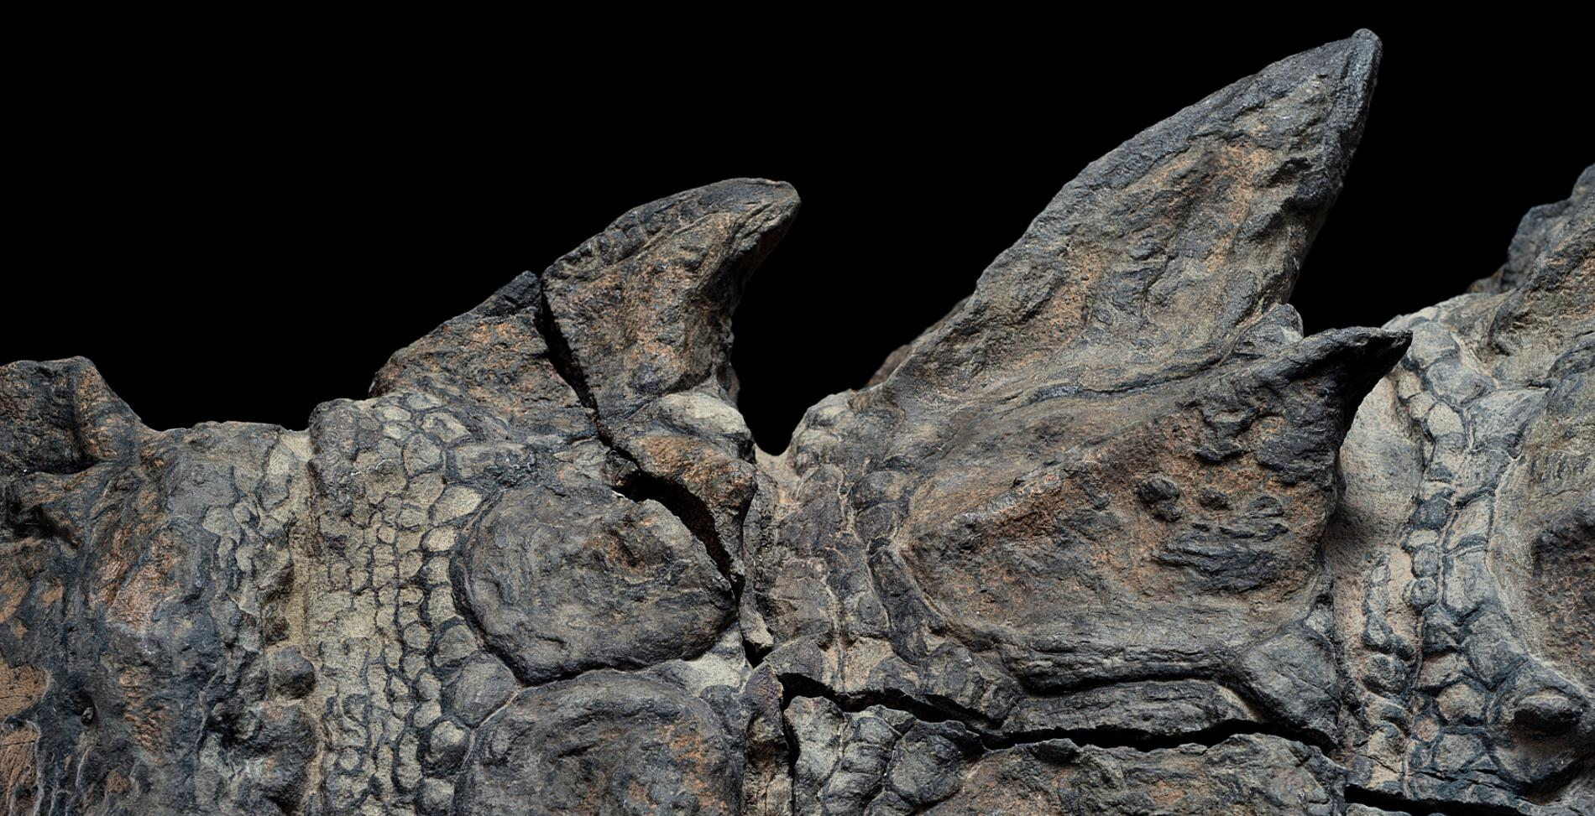

Slide 15
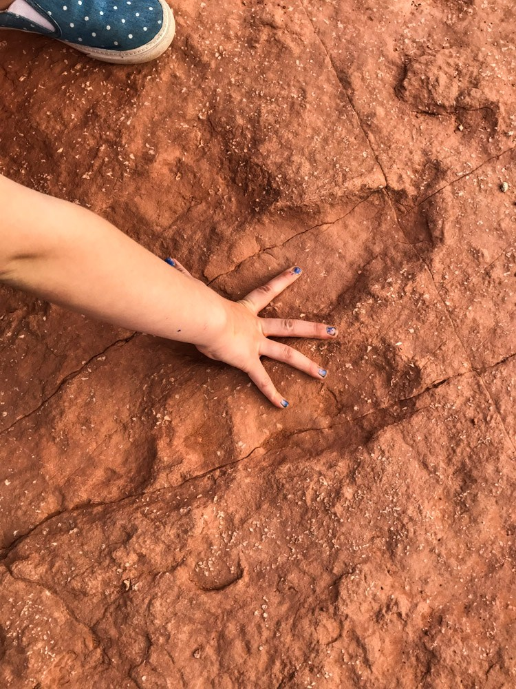

Slide 17
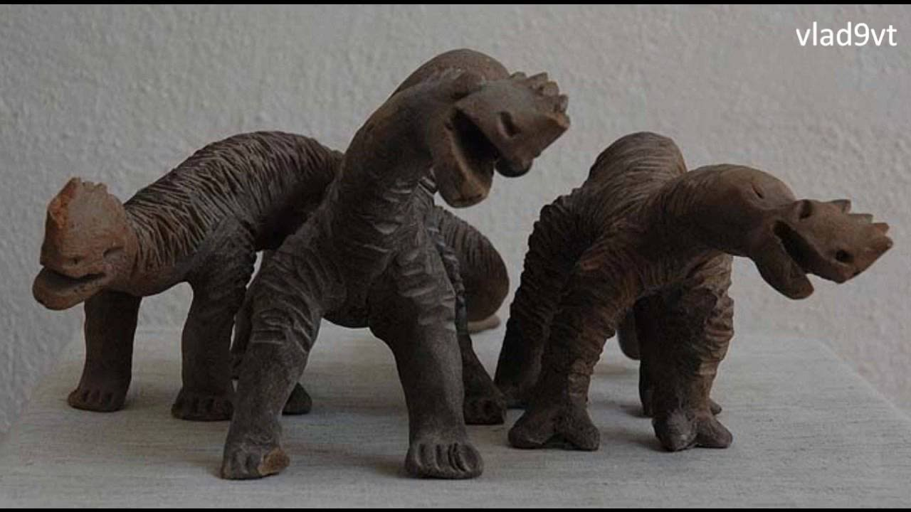
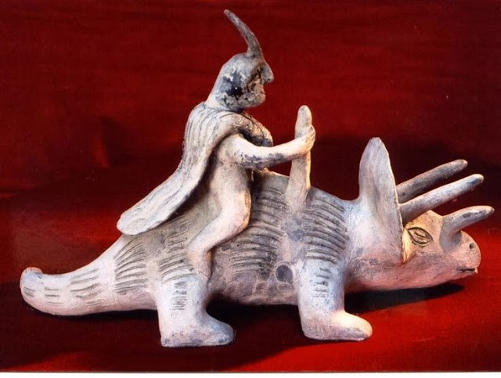

Slide 18
“Even though the Bible is not intended to be a time keeping device or document of record, if we counted all the apparent lapses of time in its vast history, we would come up with no more than even possibly 10,000 to 20,000 years. And strictly observed, there are only about 6,000 years.”
(Marc Smith, Wonderful Complex God Created Man)

Slide 21
" . . . we can only confess our supreme ignorance of the real causes of dinosaur extinction and say, quite simply: 'We don't know."
(Dinosaurmania Strikes Again, Kenneth Ham, Institute for Creation Research website)

Slide 22
"... there were 30 million fossil fragments in that area (Utah). At a conservative estimate, we had discovered the tomb of 10,000 dinosaurs ...there was a flood. This was no ordinary spring flood from one of the streams in the area but a catastrophic inundation.... That's our best explanation. It seems to make the most sense, and on the basis of it, we believe that this was a living, breathing group of dinosaurs destroyed in one catastrophic moment."
(Digging Dinosaurs, 1988, John Horner)

Slide 23
“I am going to bring floodwaters on the earth to destroy all life under the heavens, every creature that has the breath of life in it. Everything on earth will perish.” -Genesis 6:17

Slide 24
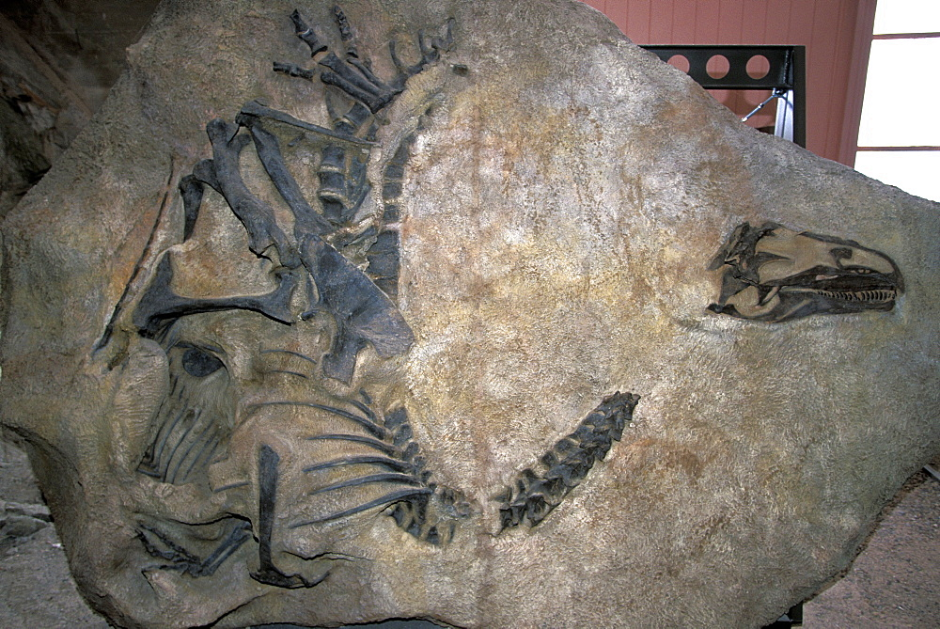
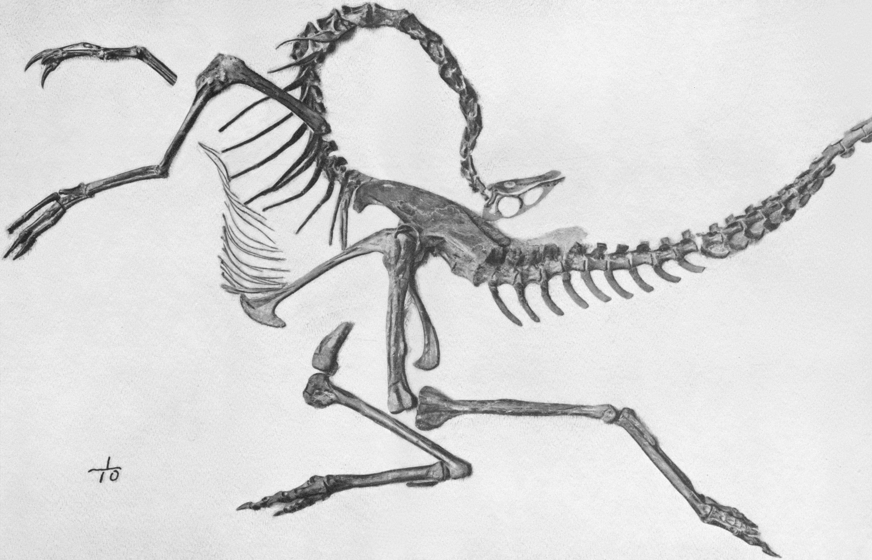
“Although the roads to the opisthotonic death pose are many, immersion in water is the simplest explanation.” (Brian Switek, The Water Secret of the Dinosaur Death Pose, Daily News 23 November 2011)

Slide 25
“Will you keep to the old way, which wicked men have trod,¹⁶ who were cut down before their time, whose foundations were swept away by a flood?”
-Job 22:15-16
“You are to bring into the ark two of all living creatures… every kind of bird, of every kind of animal and of every kind of creature that moves along the ground”
-Genesis 6:19,20

Slide 26
How does this affect us?

